Slide 1
State Experience: Approach & Plan of action for Establishment of Centre of Excellence
Dr. Usha Joshi
Director General
Sickle Cell Institute Chhattisgarh

Slide 2
What is Sickle Cell Disease?
An inherited red blood cell (RBC) disorder caused by substitution of valine for glutamic acid in beta-globin chain of Hb due to point mutation.
Causing abnormal haemoglobin production leads to sickle shaped RBC and haemolytic anaemia, episodes of pain, increased risk of infection
Complication includes sickle cell crisis and organ damage.
Types: 1. Sickle cell anaemia (HbSS)
2. Sickle- Haemoglobin C Disease (HbSC)
3. Sickle beta- thalassemia (HbSβ)
4. Other rare forms: HbSD, HbSE

Slide 3
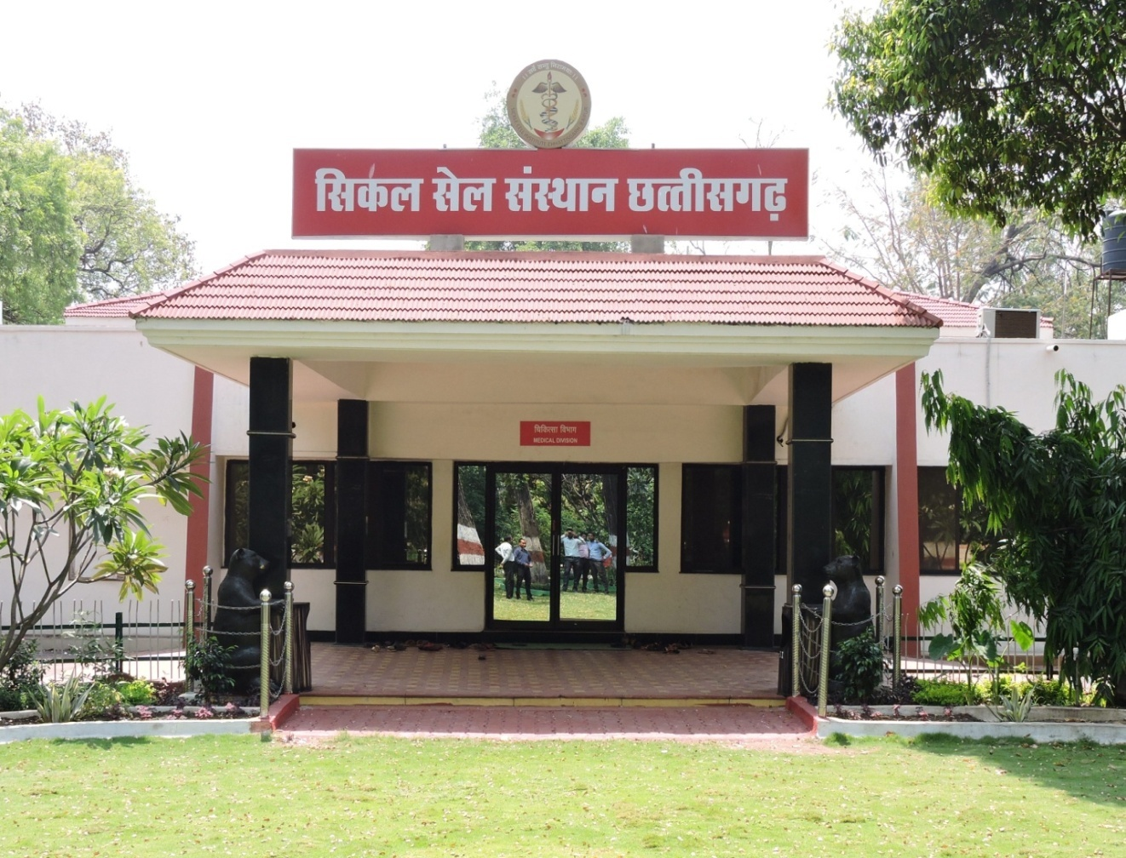
Sickle Cell Institute, Chhattisgarh (SCIC)-Raipur
An Autonomous institute established in the year 2013 to improve health services and research for sickle cell patients.
Functions under the Health and Family Welfare Department, Government of Chhattisgarh.

Slide 4
Aim and Objectives
To provide free diagnosis, treatment and counselling to all sickle cell patients.
To raise public awareness about this genetic disorder.
Training for all healthcare provider on diagnostic, treatment and counselling services.
Advanced research on various aspects of the disease.

Slide 5
Services provided by Sickle Cell Instiute Chhattisgarh (SCIC)
There are three main divisions of SCIC:
Medical Division
Research Division
Training division

Slide 6
Medical Division
Free diagnostic, treatment and counselling services to patients
Daily patient footfall: approximately 80-100 patients per day
52,387 persons has been screened on OPD basis till today, out of which 8491 were SS and 25898 were AS (Sickle cell Carriers)
Data from Screening camps organised by institute (since August 2021 to till date), reveals a total of 36079 persons has been screened, out of which AS were 2693 & SS were 82 cases
School children were screened under Sickle Cell project from 2008 – 2017- about 17 lakhs

Slide 7
Research Division
Conducts extensive research and organizes training initiatives.
The research division actively participates in the development of training materials and serving as resource persons for all programs.
Currently, 18 Non funded research studies have been published.
Funded research projects completed are 04 and 02 are ongoing.

Slide 8
Training Division
Institute conducts training programs on sickle cell disease for stake holders like specialist doctors/medical officers, Lab technicians, Counsellors, Data entry operators. Total training data :
Sickle cell Institute Chhattisgarh, Raipur
Training Data Year 2014 to 2024
S.No | Designation | Total participants
1 | Medical Officer/specialists | 804
2 | Medical Lab technologist | 936
3 | Counsellor | 188
4 | Data entry Operator | 248
5 | Nursing College Raipur | 20
6 | Medical Students | 242
Grand total |  | 2438

Slide 9
Sickle Cell Institute Chhattisgarh: Key Actions
Provided Training & established “Sickle Cell Prabandhan Kendra”:
Implemented in all the district hospitals of Chhattisgarh as per State Government’s instructions.
Specialized training provided to Medical Officers, Counsellors, Lab technicians, Data entry operators from each district.
Distributed IEC materials, necessary reagents, etc.

Slide 10
2. CHC Level Training:
Additional training of Medical Officers/specialists, Counselors, Lab technicians, and Data entry Operators at all the Community Health Centers of the State.
3. Provided TOT training under Sickle Cell Anemia Elimination Mission in coordination with NHM Chhattisgarh for -
1. Sickle Cell screening and confirmation training.
2. Data entry in online portal training.

Slide 11
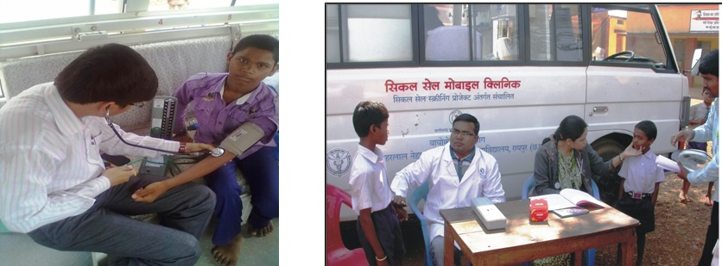

Slide 12
Future plan of action for centre of Excellance
To provide quality health services to the patient suffering from Haemoglobinpathy in Chhattisgarh ,the Sickle Cell Institute Chattisgarh in Raipur will be developed as a center of Excellance.
The primary Objective is to-
1. Provide quality healthcare services to patients with hemoglobinopathy CSCD, thallesemia, hemophilia.
2. Enhance their quality of life
3. Increase life expectancy
4. Mitigate the psychological and social stigma with these conditions.

Slide 13
Comprehensive services which will be offered by the Centre of excellance -
1. Advanced diagnostic facility and appropriate treatment.
2. Emergency Care.
3. Prenatal and New born diagnosis.
4. OPD and ICU services.
5. Bone marrow transplant facility.
6. Blood tranfusion facility (blood bank) in accordance with BMT unit.
7. Genetic counselling and psychological support.
8. Advanced Research facility .
9. National level training facility.

Slide 14
Proposed Centre of Excellence Infrastructure
OPD service Advanced research Offices for Recreational For training
Bone Marrow Facility Administrative Activity area purpose
Transplant Unit Prenatal and work
Blood bank Newborn
ICU diagnosis
Casuality DNA Sequencing
Facility
Hospital wing
Research wing
Administrative block
Recreational wing
Training wing

