Slide 1
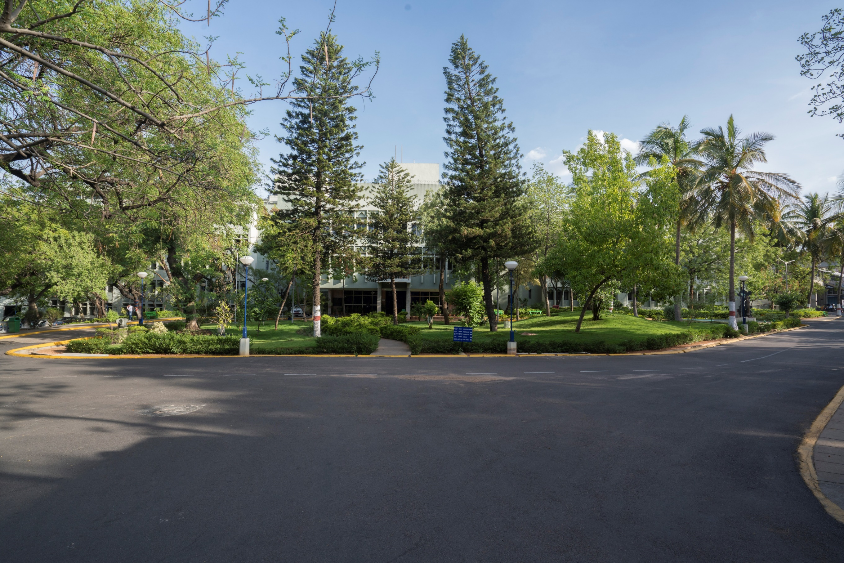

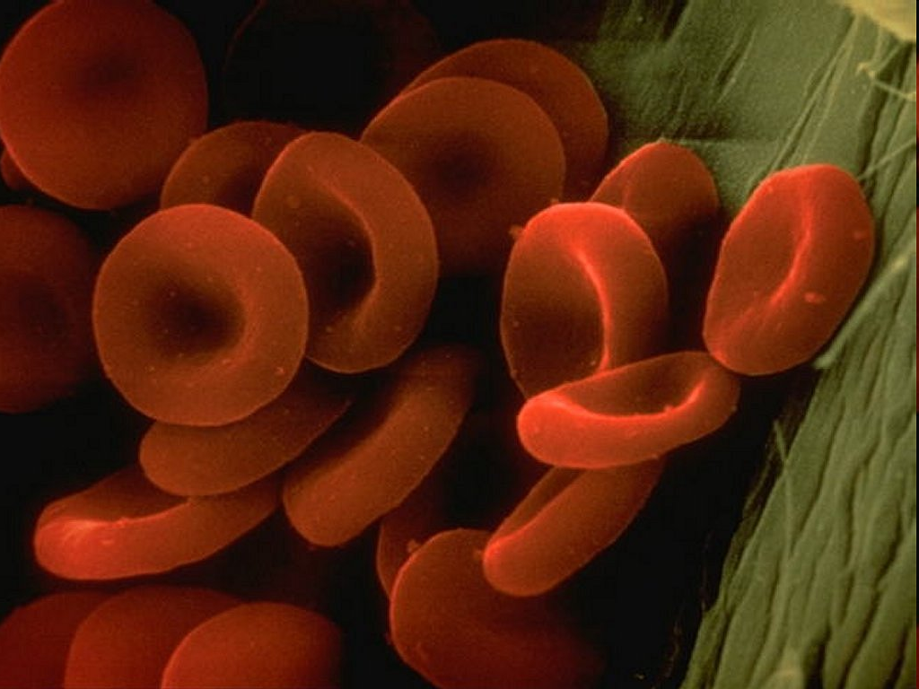
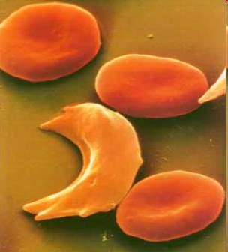

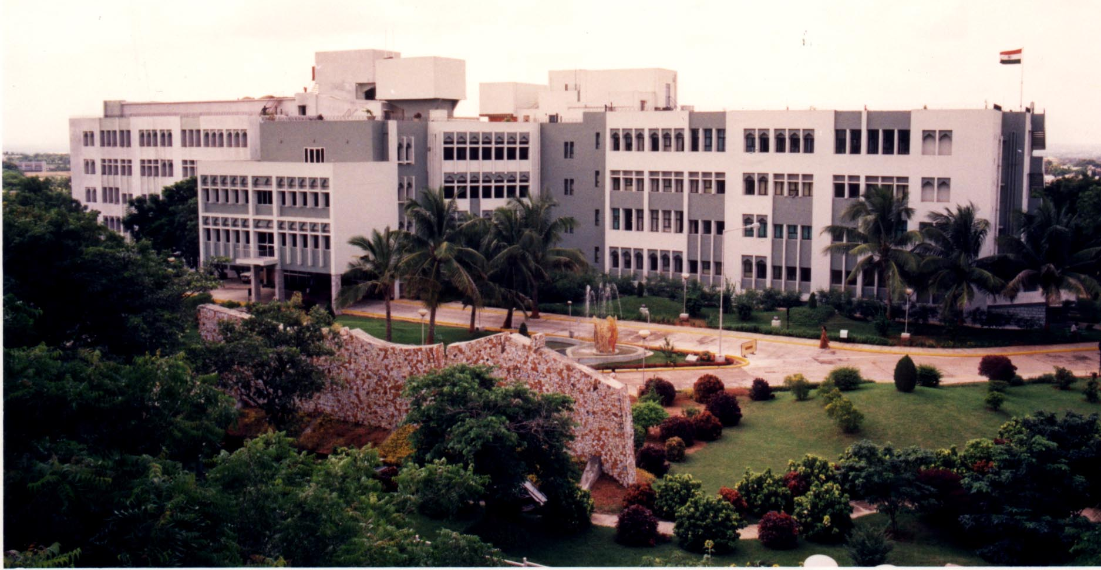
Development of A Molecular Test for Sickle Cell Anaemia
CSIR SCAN - Robust, Rapid and Affordable Test
CSIR
Sickle Cell Anaemia Mission
G R Chandak, MD, PhD, DNB
Sir J C Bose Fellow, CSIR-CCMB
National Training of Trainers (ToT), NSCAEM
NHM, Bhopal, 23rd October 2024

Slide 2

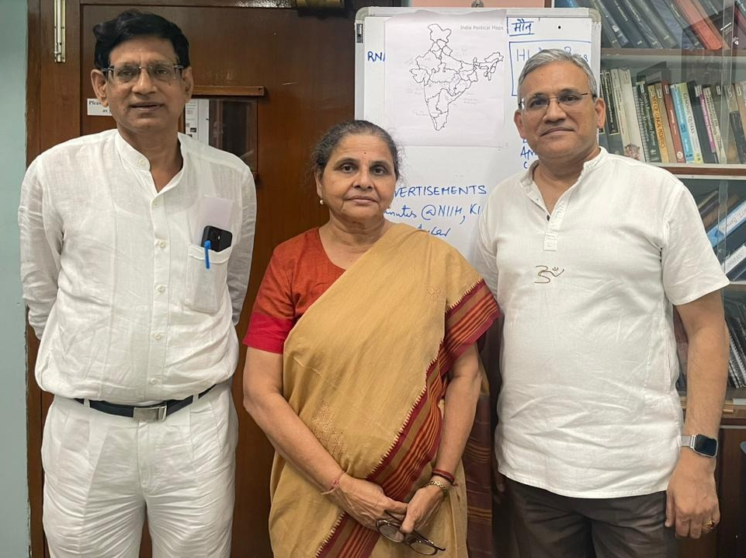
CSIR Sickle Cell Anaemia Mission (2017-23-24)
Overarching objectives
Reduce the burden of sickle cell anemia on the society by preventing the birth of affected children through multi-pronged strategies of genetic testing and counseling
AND
Improving the quality of life of patients by early diagnosis and proper treatment

Slide 3
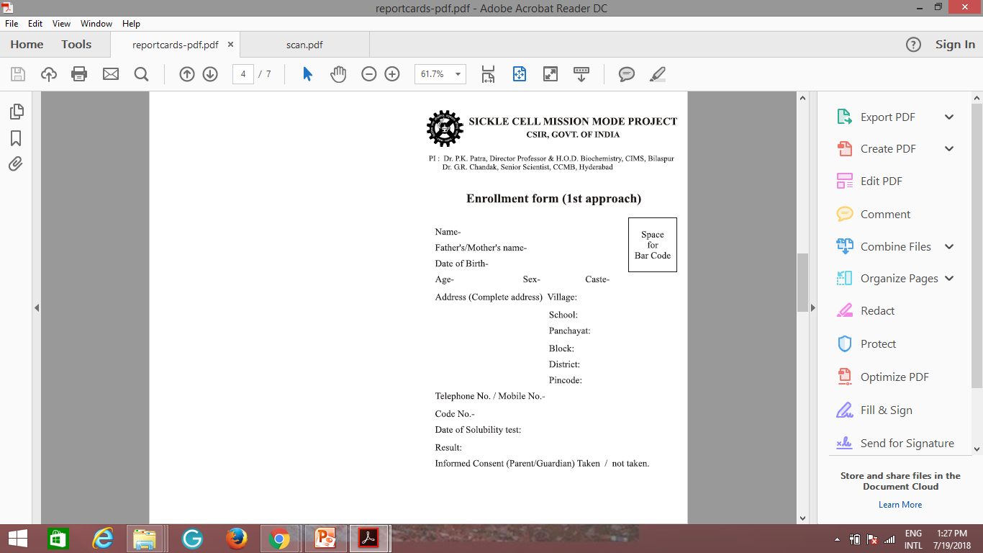
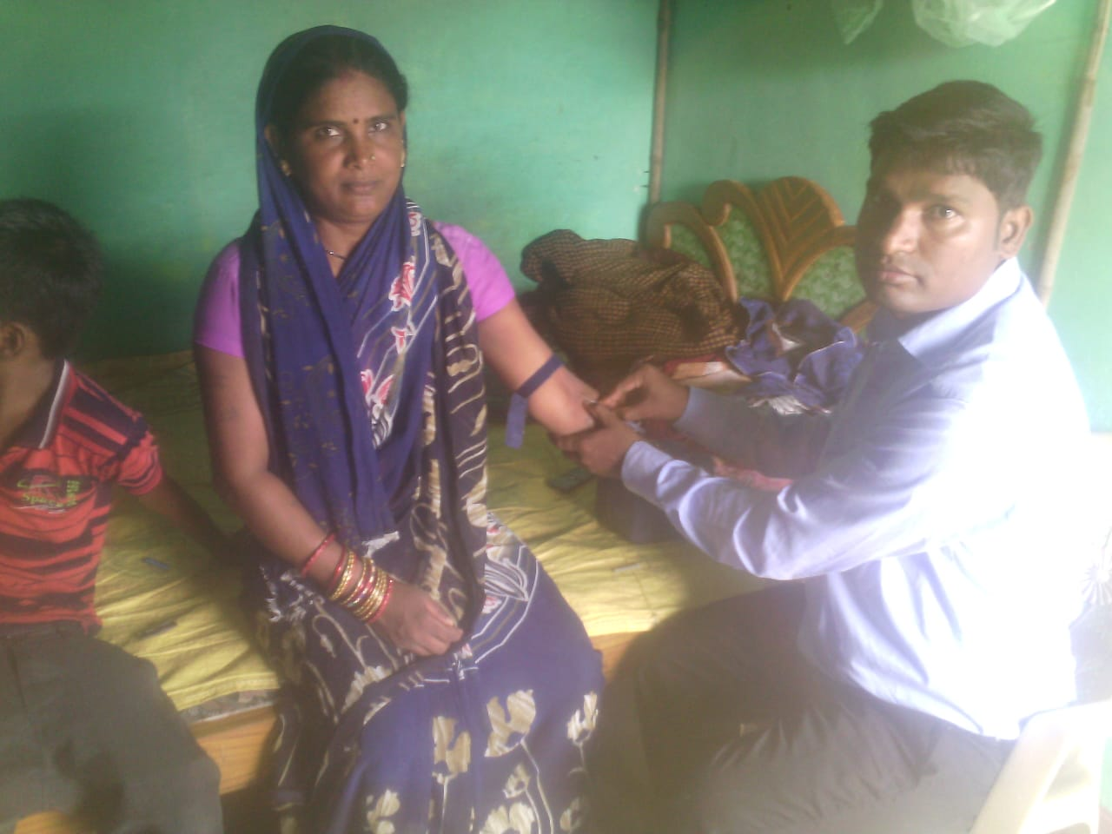
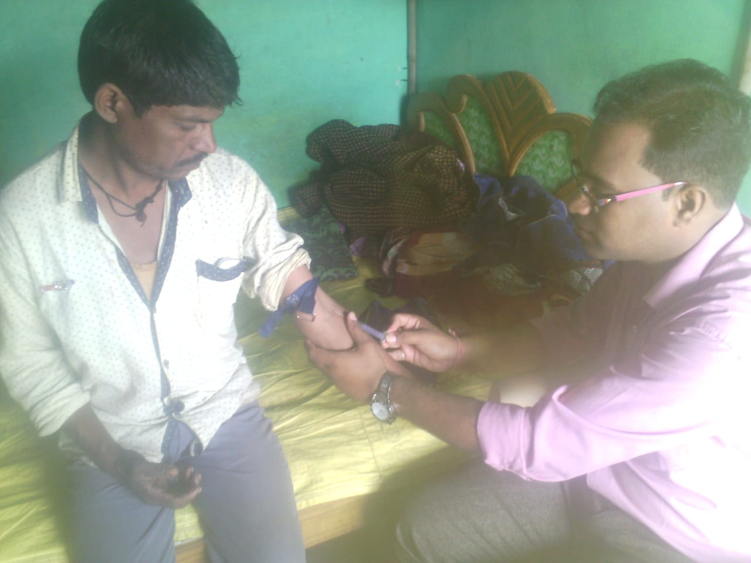
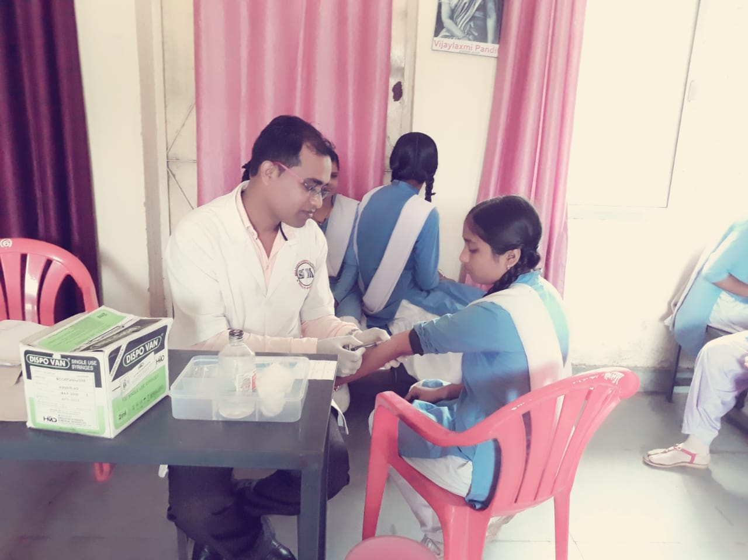
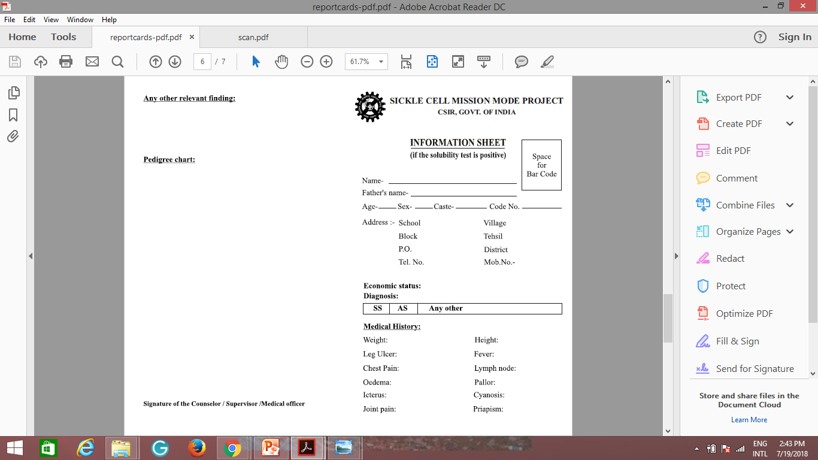
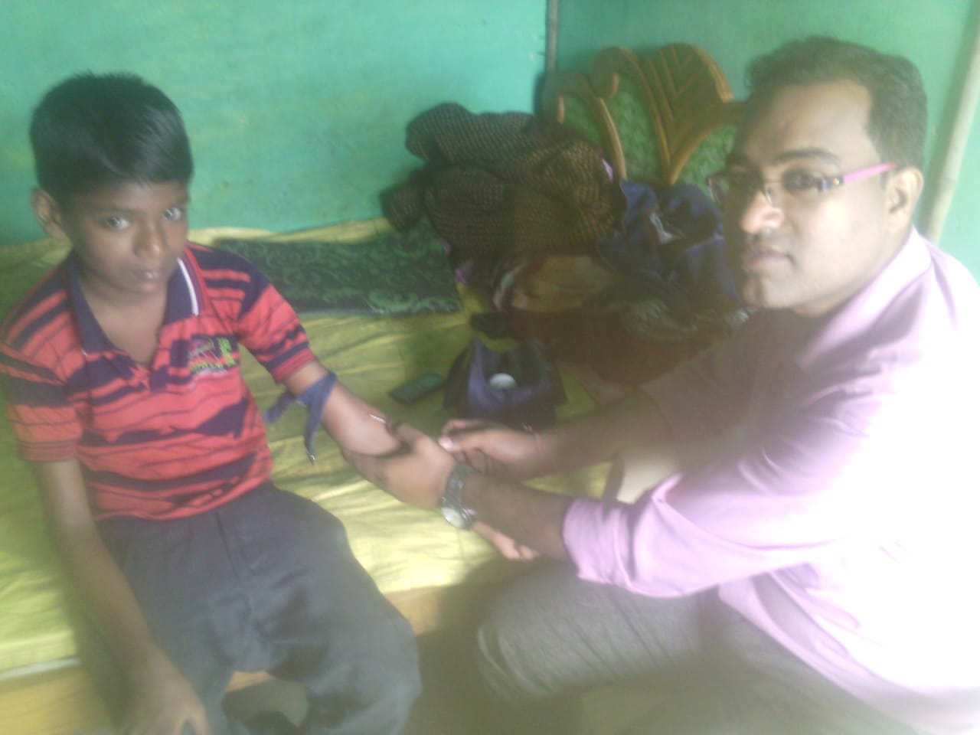
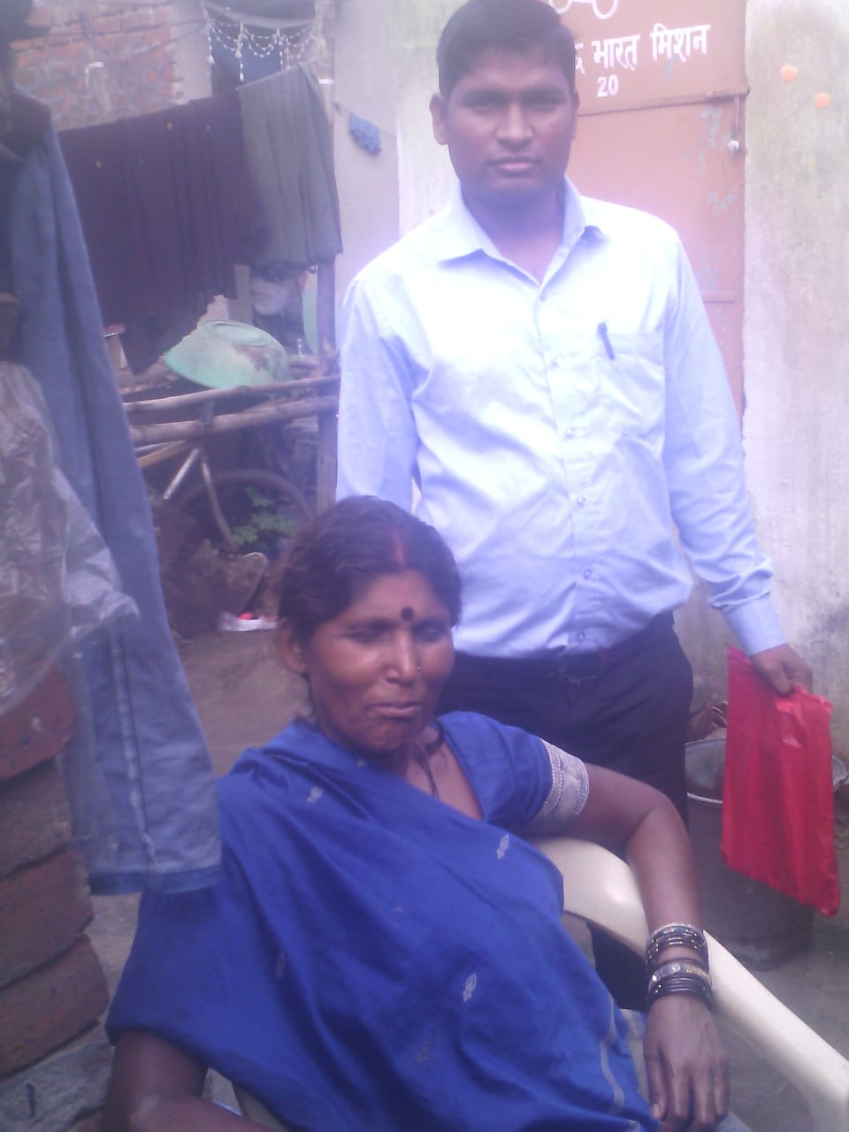
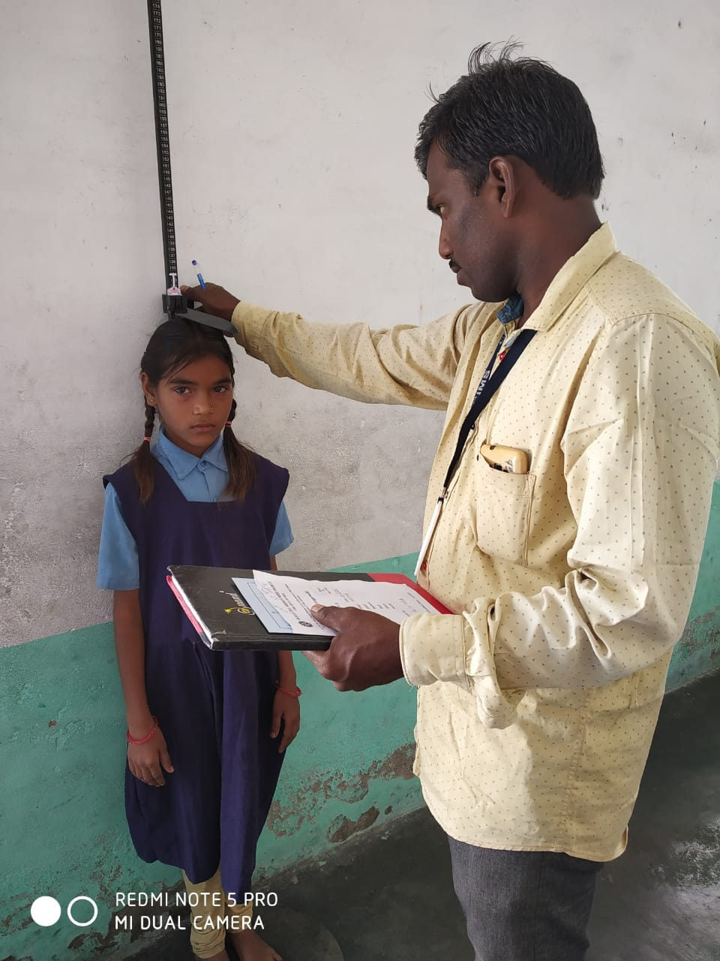
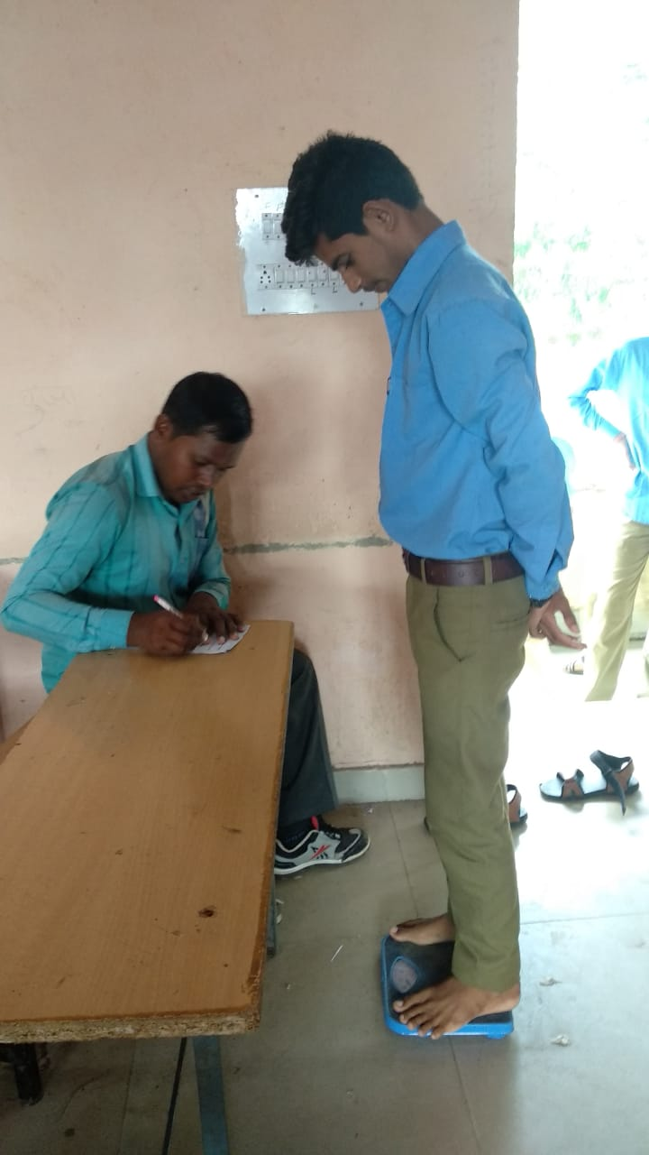
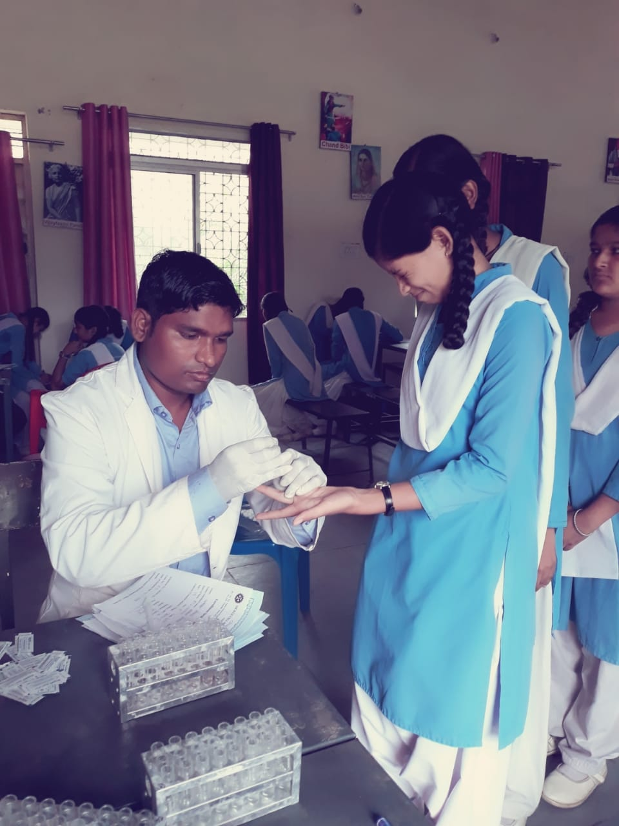
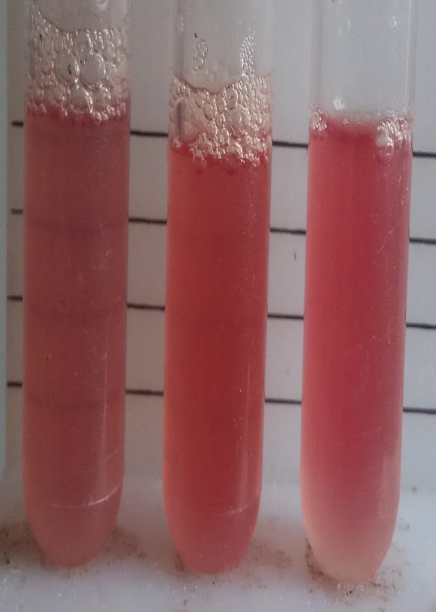
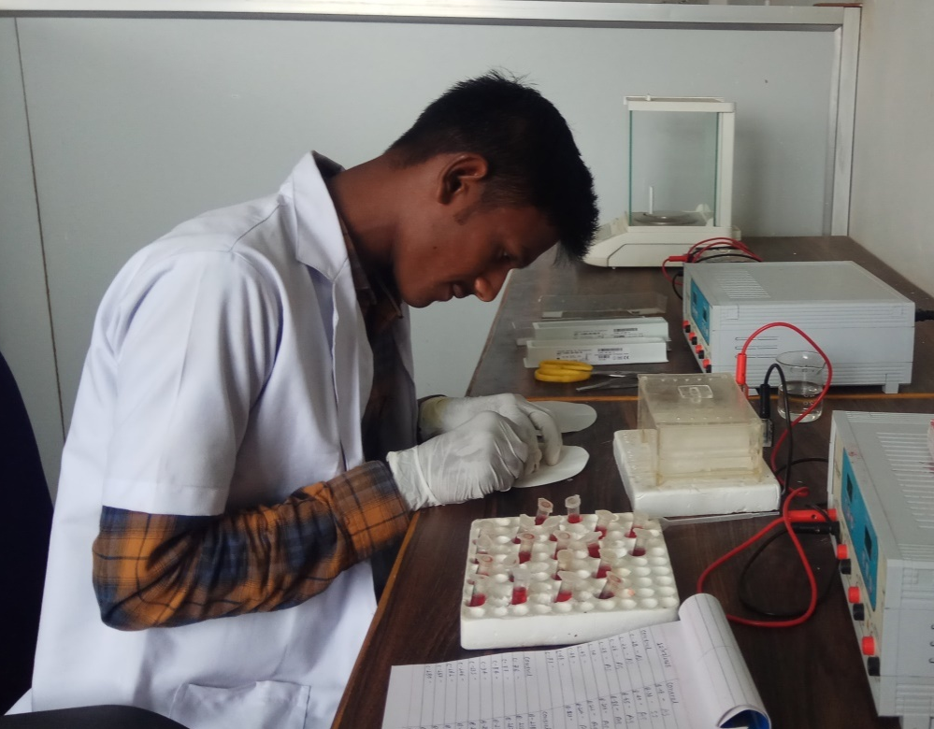
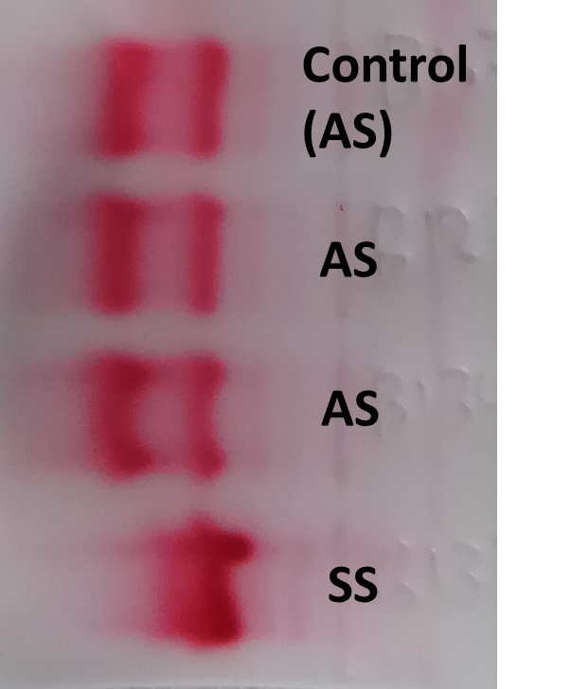
Screening at the schools……. to the family
SCHOOLS/ ANGANWADI
CIMS/ HEALTH CHECK UP CAMPS
ANTENATAL SCREENING
GOVT. HOSPITALS (PAEDIATRICS)
Confirmation by genetic testing @ CSIR-CCMB
by conventional PCR-based molecular method

Slide 4
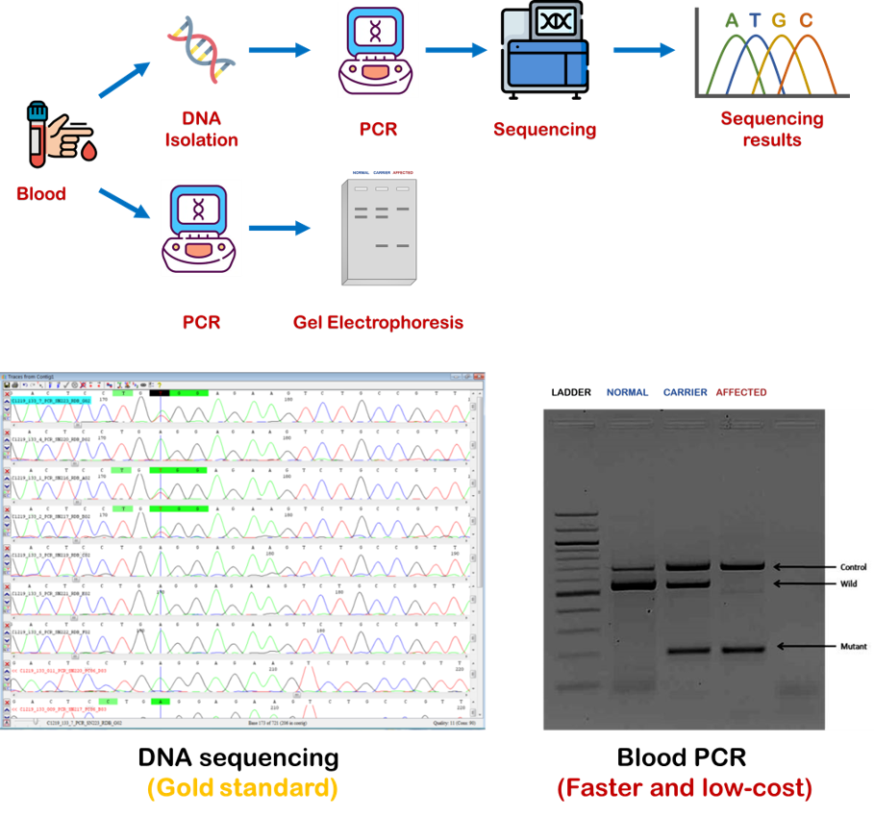
Traditional Molecular Testing for Sickle Cell Anaemia

Slide 5
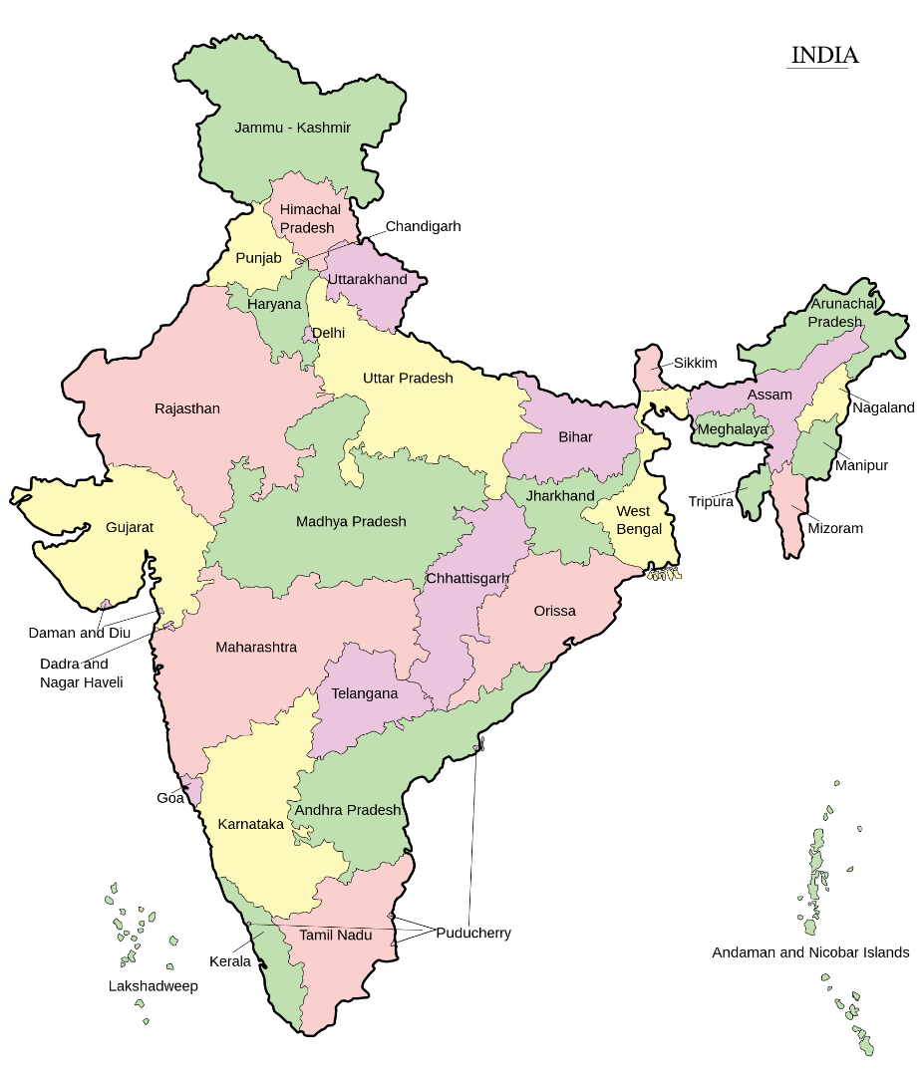
Screening using multi-pronged strategies
Mandla
(Mandla, Nainpur, Bichhiya, Bijadandi, Ghughri, Mawai, Mohgaon, Narayanganj, Niwas)
Dindori & Amarkantak
(Karanjiya, Dindori, Samnapur, Shahpura, Mehadwani, Amarpur, Bajag)
Seoni
(Seoni, Barghat, Chhapara, Dhanora, Ghansore, Keolari, Kurai, Lakhnadon)
Rajasthan
Bilaspur
(Bilha, Kota, Takhatpur, Masturi)
Udaipur Banswara
Madhya Pradesh
Maharashtra
Chhattisgarh
Raipur
(Dharsiwa, Tilda, Arang, Abhanpur)
Nagpur
(Nagpur, Gondia, Yavatmal, Amravati, Tumsar)
Total number of screened samples = 28,26,685
Schools covered – 1952
Angawadi centres etc. – 651
Overall frequency - ~9 - 10%
Carriers - ~8% - 9%
Patients - ~0.9% - 1.0%

Slide 6
Traditional Molecular Testing for Sickle Cell Anaemia
DBS-PCR

Slide 7
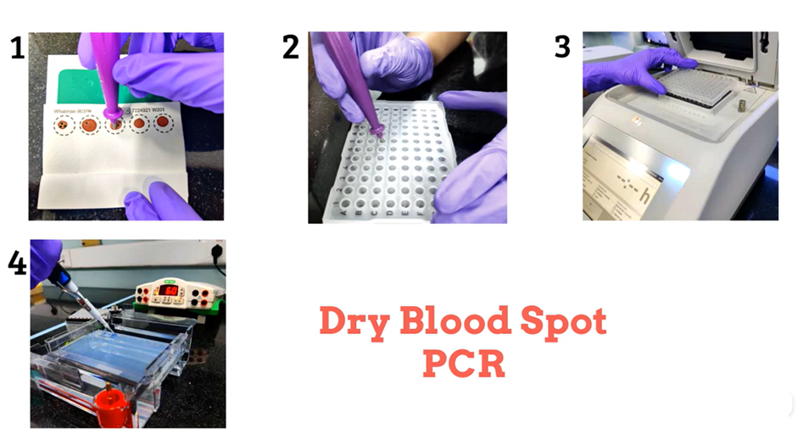
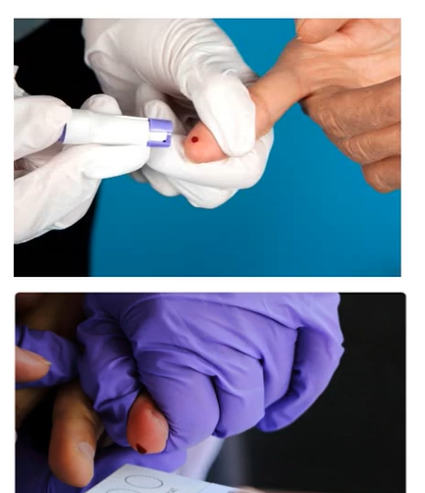
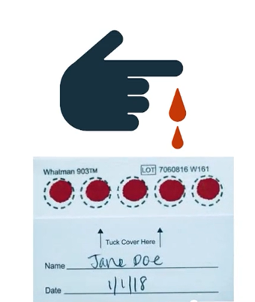
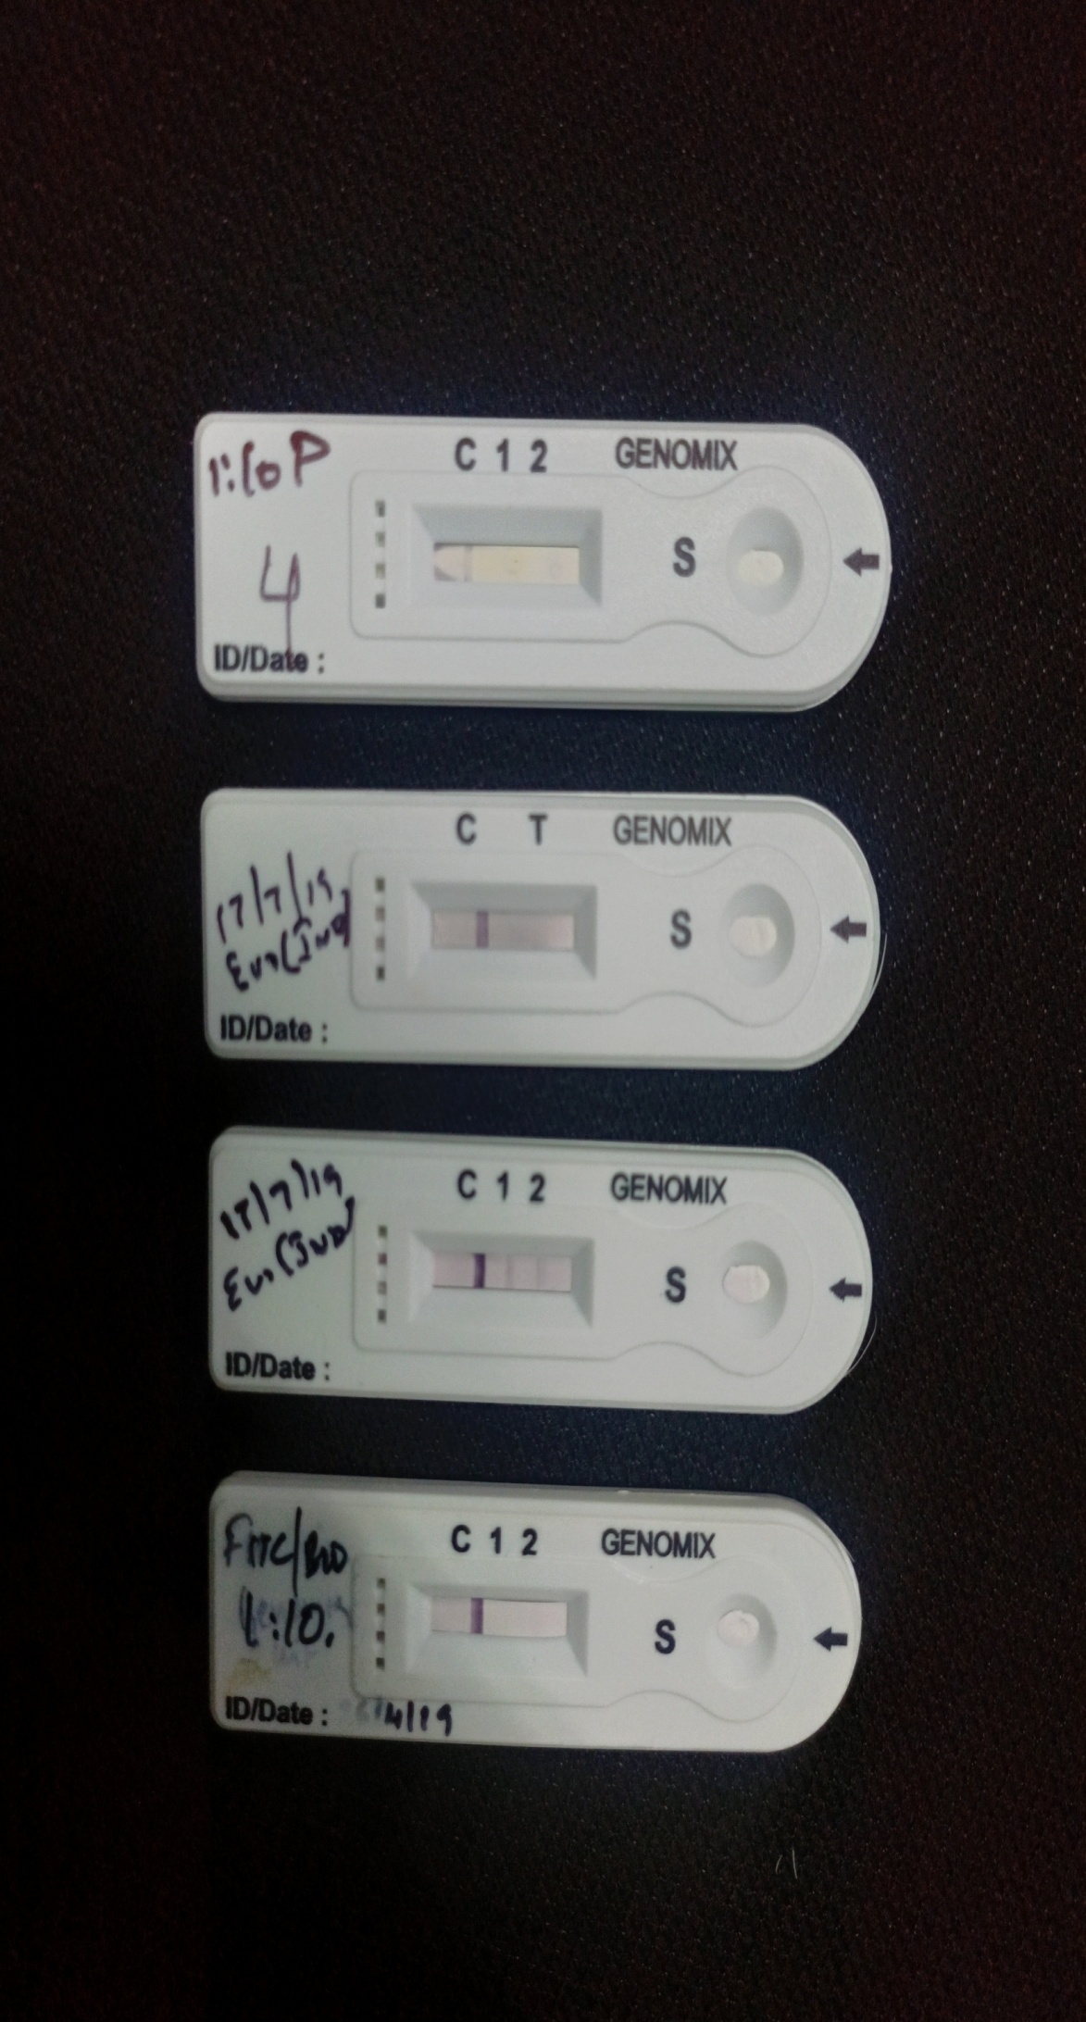
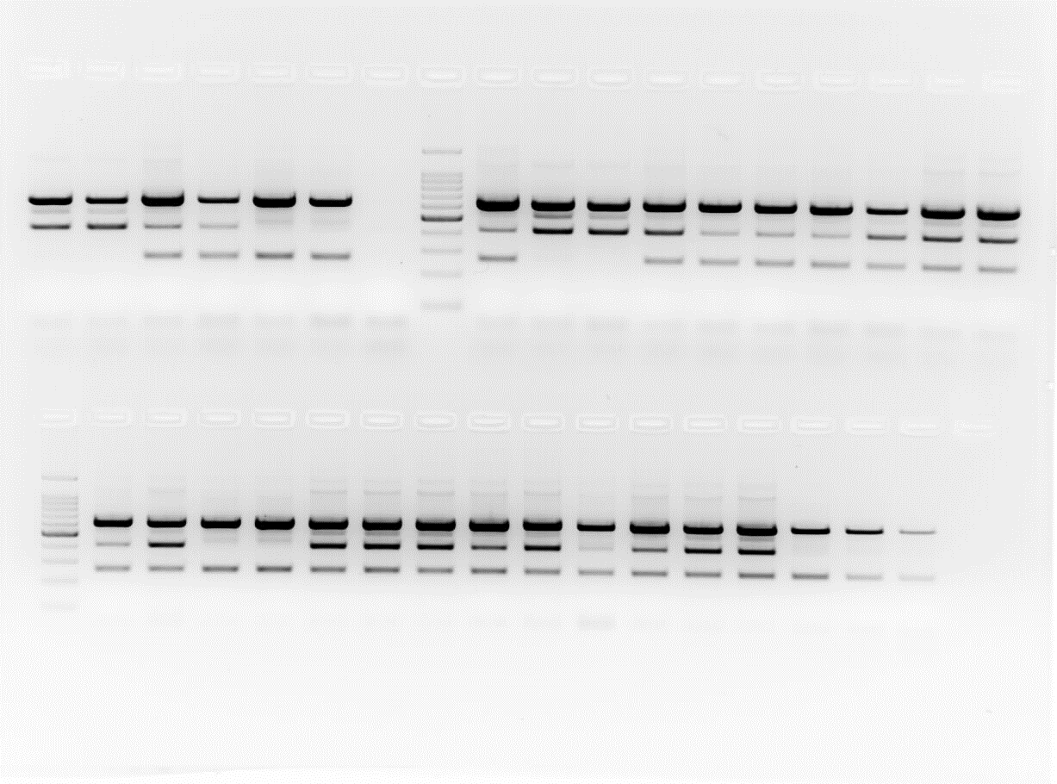
Workflow of WB/DBS-PCR
Hb SS
Using unprocessed whole blood/dried blood spot
    Number of samples screened-10753
    Successful - 10650 99.1% success)
    Failed - 103 (0.9% failure rate)
    Concordance – 99.6%
High specificity (100%) and sensitivity (99.6%) with HPLC and Sanger Sequencing

Slide 8
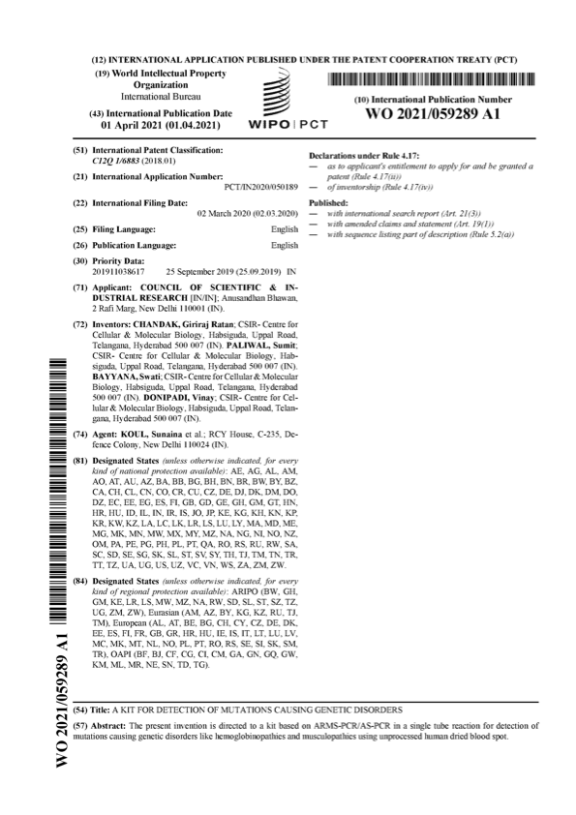
DNA-based ASSURED test for SCA screening
(Affordable, Sensitive, Specific, User-friendly, Rapid
and Robust, Equipment-free, Deliverable)
Using unprocessed whole blood/dried blood spot
High specificity and sensitivity with HPLC and Sanger Sequencing

Slide 9
Approval from ICMR & MOH&FW

Slide 10
Concordance Analysis of DBS PCR
Solubility test vs Molecular method
HPLC vs Molecular method
 | CIMS
Total no. of samples received | 1559
Overall concordance | 1474
Overall discordance | 62
AA | 1152
AT | 284
TT | 38
 | CIMS
Total no. of samples received | 266
Overall concordance | 250
Overall discordance | 11
AA | 24
AT | 195
Sβ | 10
TT | 21
Overall concordance | 95.96
Overall discordance | 4.04
Overall concordance | 95.78
Overall discordance | 4.22

Slide 11
Human resources slide 7
Comparison with other Approaches
WB-PCR is a Rapid, Robust and Affordable Test
80.25%
97.9%
99.6%
Conventional
Strip based/ Gazelle
WB/DBS PCR
Genetic confirmation still needed
Step-wise process
Reporting takes days
Rs 300-500/- per sample
Genetic confirmation still needed
Low throughput (10-12 minutes per test)
35-40 tests per day per person
Rs 150-300/- per sample
Screening cum genetic confirmation
High-throughput (96 samples/3h)
~300 samples per day per person
Rs 90-100/- per sample

Slide 12
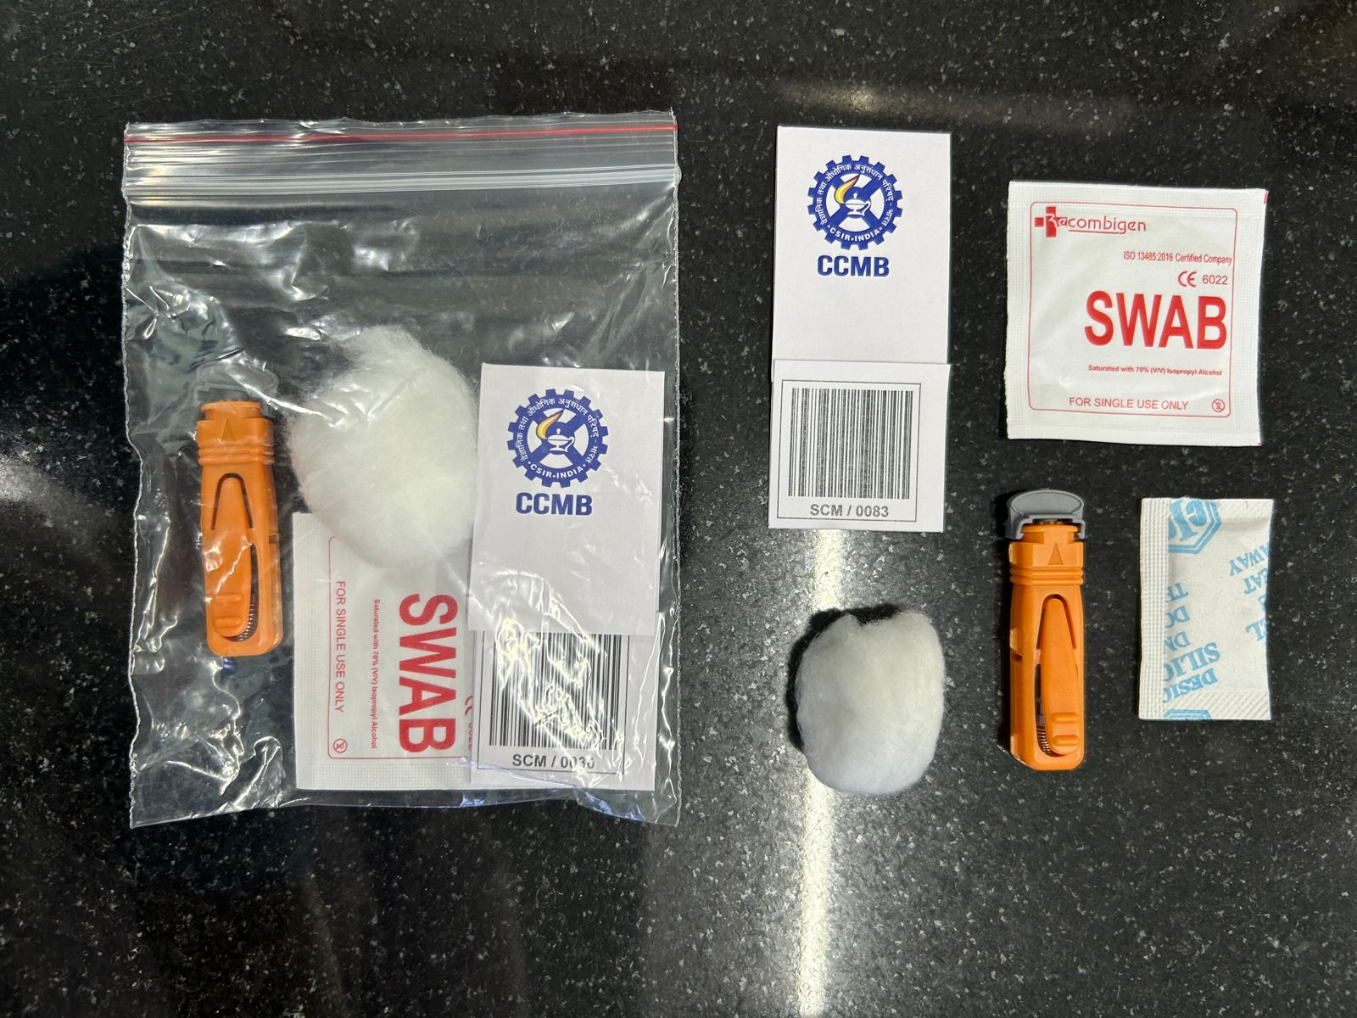
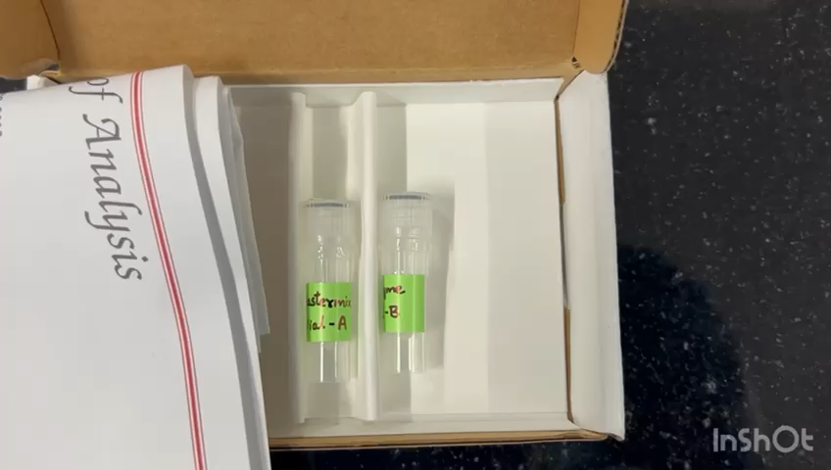
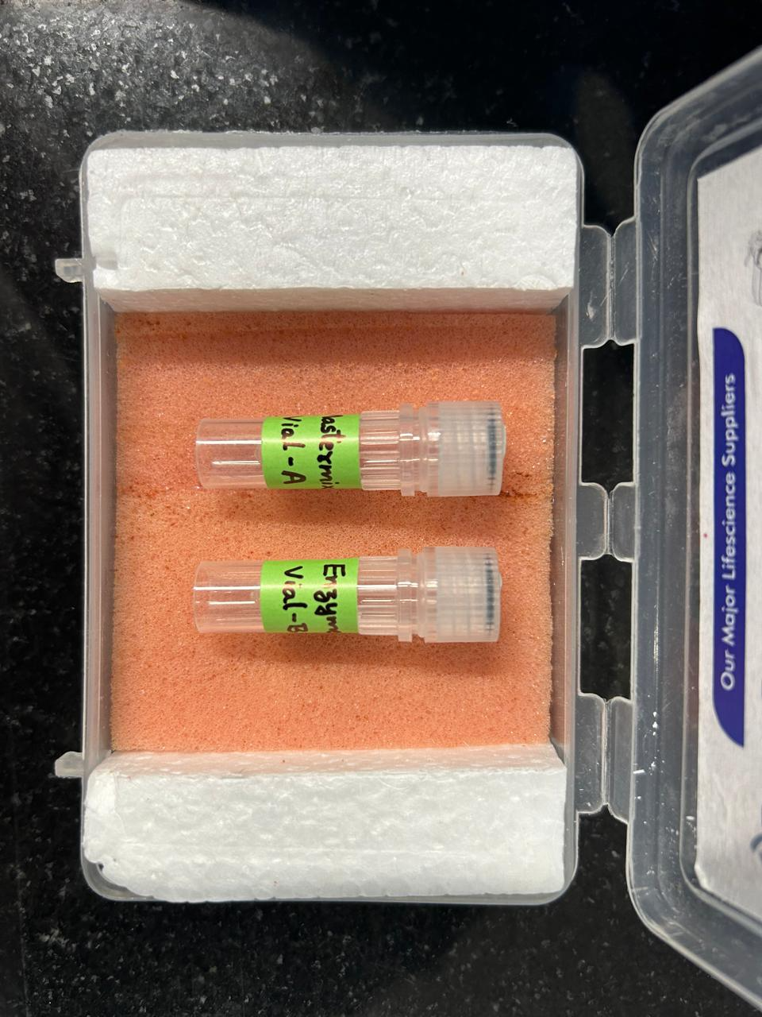
WB/DBS-PCR Kit and its components

Slide 14
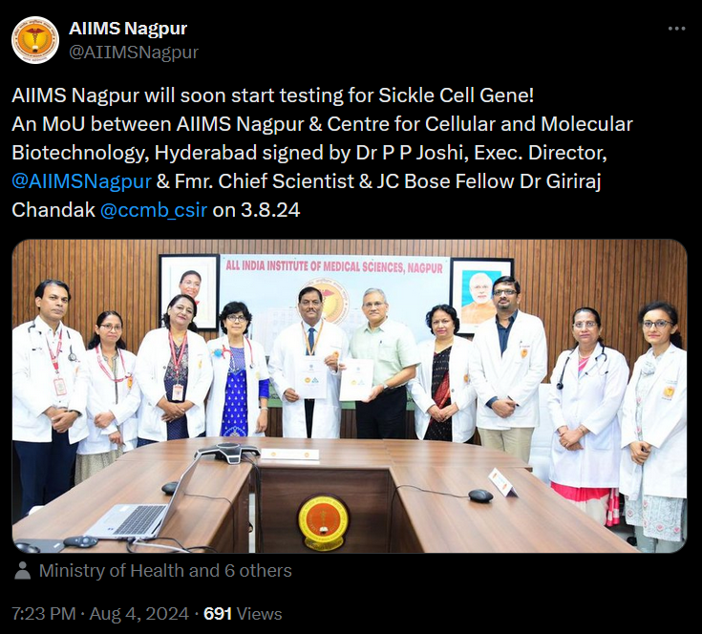
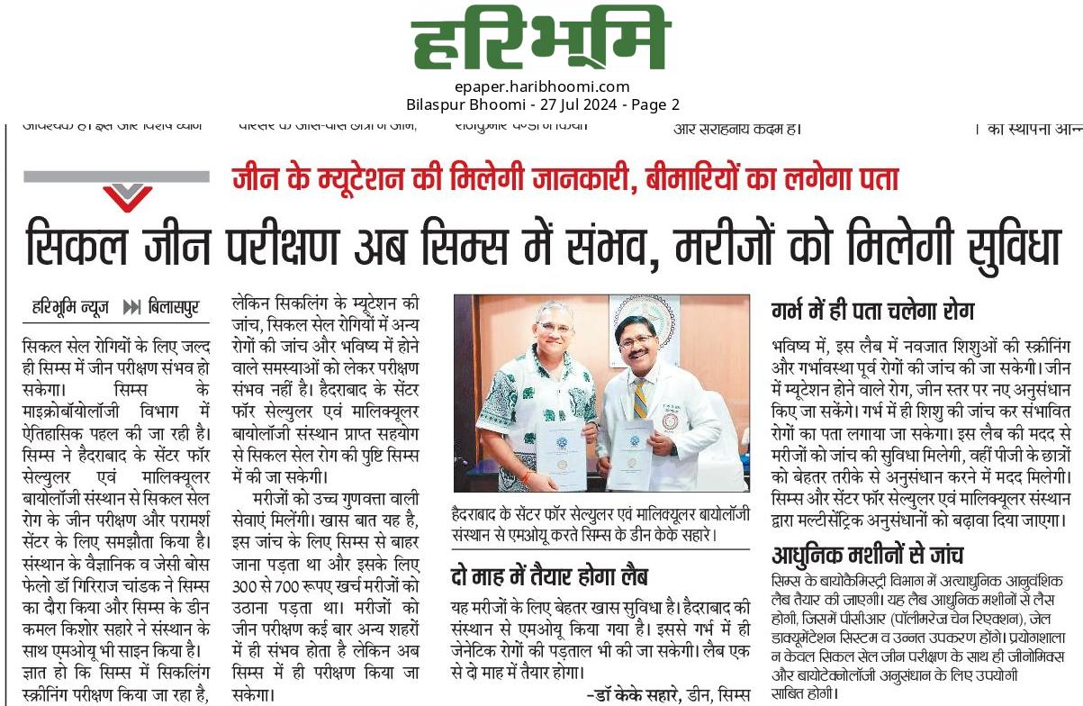
Signing of MoUs with Medical College and Hospitals
Biology,
All India Institutes of Medical Sciences, Nagpur
Chhattisgarh Institute of Medical Sciences, Bilaspur
Four more Medical College and Hospitals are in advanced stages of discussion

Slide 15
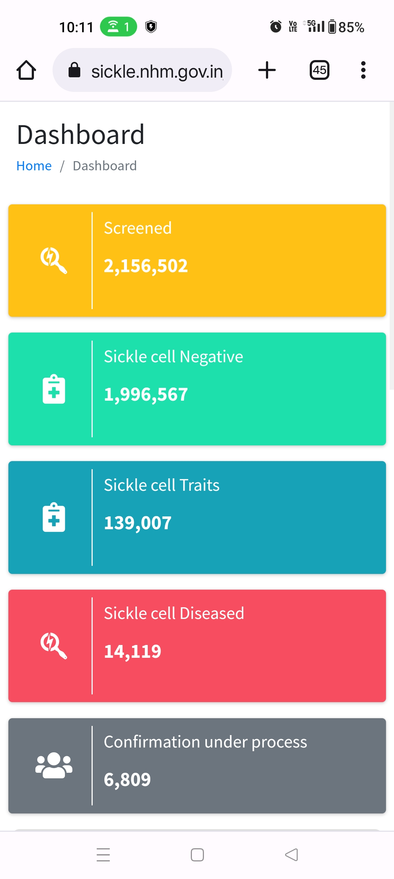
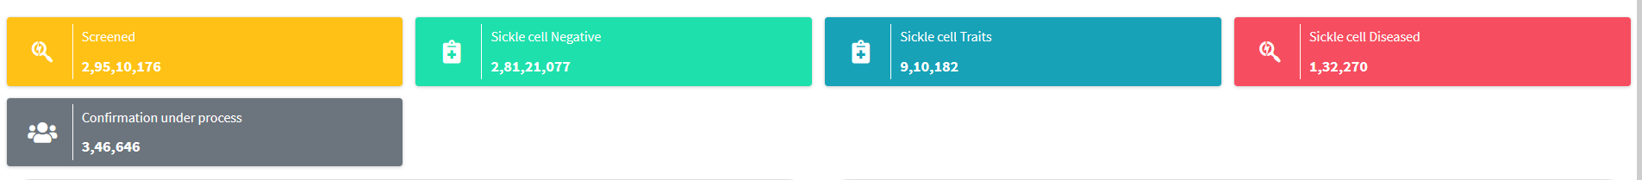
SCA Screening status - Dashboard @ NSCAEM
One year status
10.05.2023
06.05.2024
Screened 2,73,53,674 39.08%
Negative 2,61,24,510 95.51%
Trait 7,71,175 2.82%
Patients 1,18,151 0.43%
(92.88%)
(96.43%)
(6.47%)
(3.12%)
(0.65%)
(0.45%)
Prevalence of SCA patients and carriers is significantly lower than reported in large studies
05.10.2024
Total screened – 4.0 crores
Carriers – 11.7 lakh (~3.0%)
Patients – 1.7 lakh (0.41%)

Slide 16
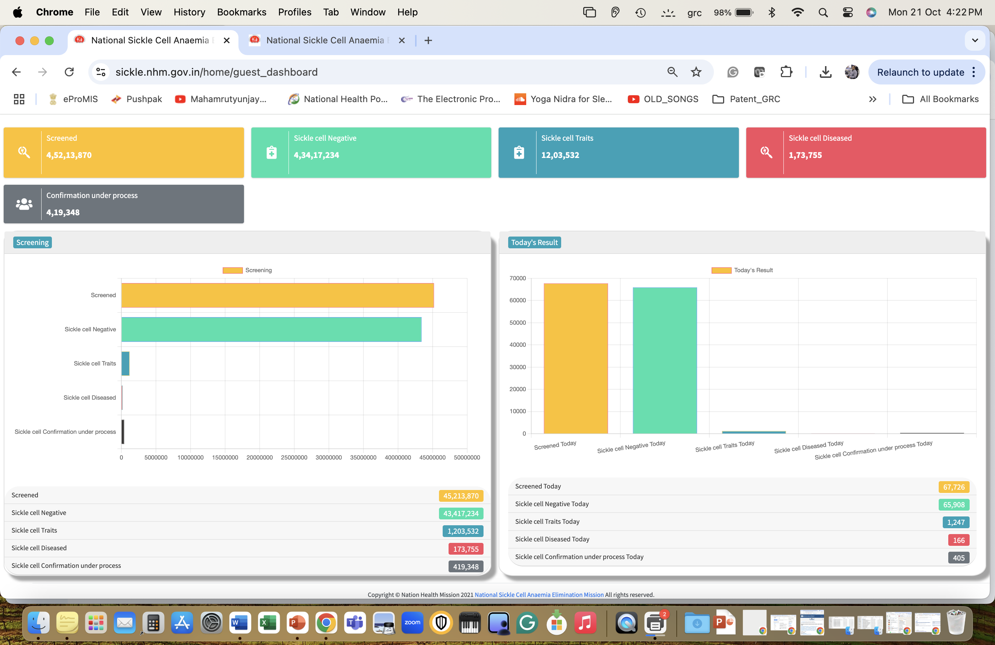
Dashboard @ NSCAEM – 21.10.2024

Slide 17
Why Whole Blood/Dried Blood Spot PCR Test
Current methods have issues with robustness and cost, leading to missed diagnosis
One-step, molecular screening-cum-confirmation of sickle cell status
A Rapid, Robust, Affordable and High throughput test – 300 samples per day
Only one drop of blood from Finger prick is enough; no IV sampling needed
Works equally well at any setup, including population, newborn & antenatal level
Existing infrastructure (COVID) is enough to conduct the test at ground level
No need for two-step, error prone screening leading to wrong diagnosis
Being a molecular test, prenatal diagnosis and genetic counselling is possible
An accurate and early diagnosis, is key to preventive and treatment strategies

Slide 18
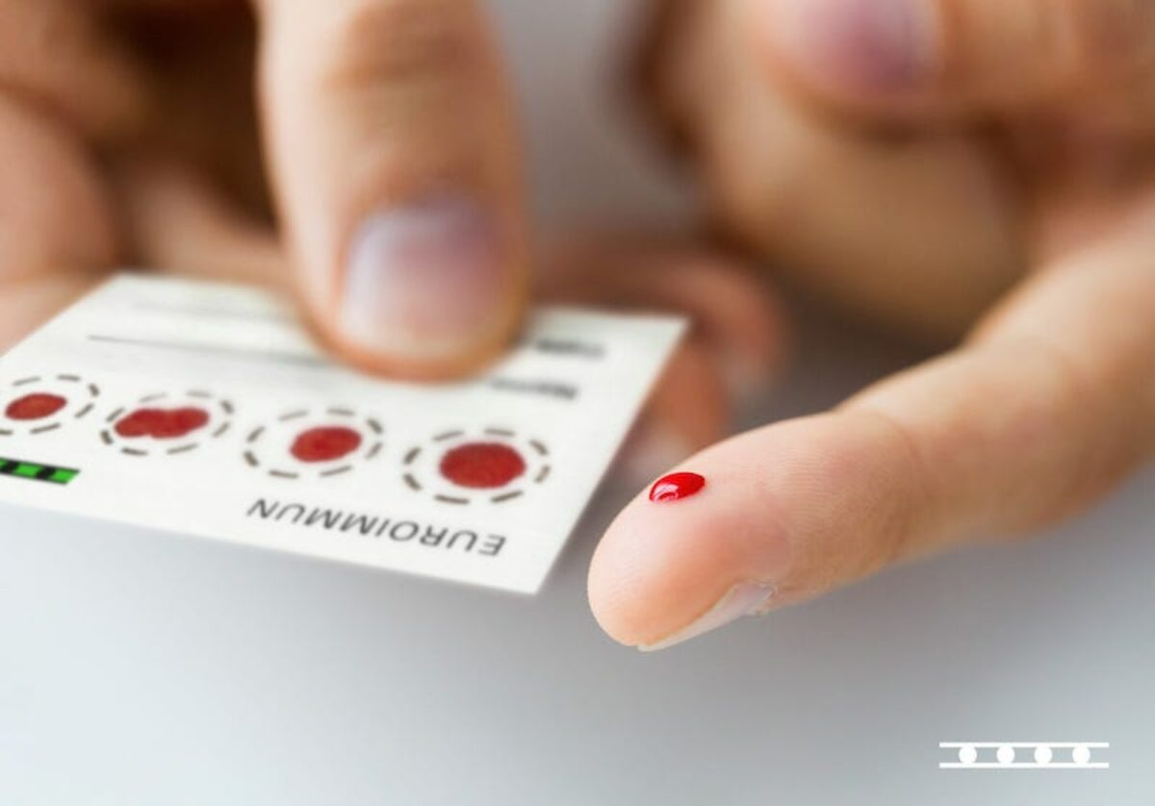
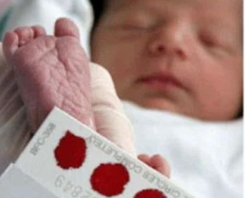



Comprehensive Model
Regional Genetic Testing Centers
Population-based
Blood
PCR
Newborn
Population-based
School children
Hospital-based
Genetic testing to confirm the status of SCA patients and carriers
Identification of target couple (carrier husband and wife and in the reproductive age)
Extended family screening by genetic testing (including sibs of patients)
Identification and genetic confirmation of carriers in the families
Prenatal diagnosis
Unmarried
Married and having no children
or normal children
Married and having affected children
Social counseling
Social counseling
Pre-pregnancy counseling
Prenatal diagnosis and genetic counseling
Clinical counseling
Social counseling
Pre-pregnancy counseling
Prenatal diagnosis and genetic counseling

Slide 19











ROADMAP
Sample collection at mobile camps
Samples subjected to screening cum confirmatory molecular test developed by CCMB
Transport of the samples to nearby PHC/ Medical colleges- SCA testing centres
Follow up, awareness programs and support groups are made to help in efficient management of the disease
Reports generated after genotyping for SCA status of the individual
Treatment is provided to the patients depending on the severity and genetic counselling is provided to the carriers with premarital age as priority to help in elimination of the sickle cell anemia

Slide 20
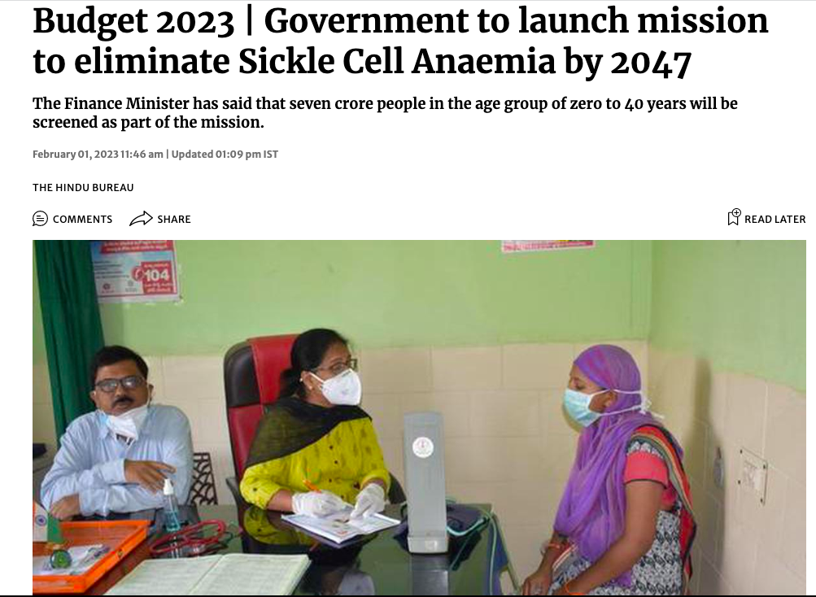

A combination of
Kal ki Wisdom, Aaj ka Development and Kal ki preparation
we can fulfill the Nation’s Dream of “Eradication of Sickle Cell Anaemia” by 2047

Slide 21
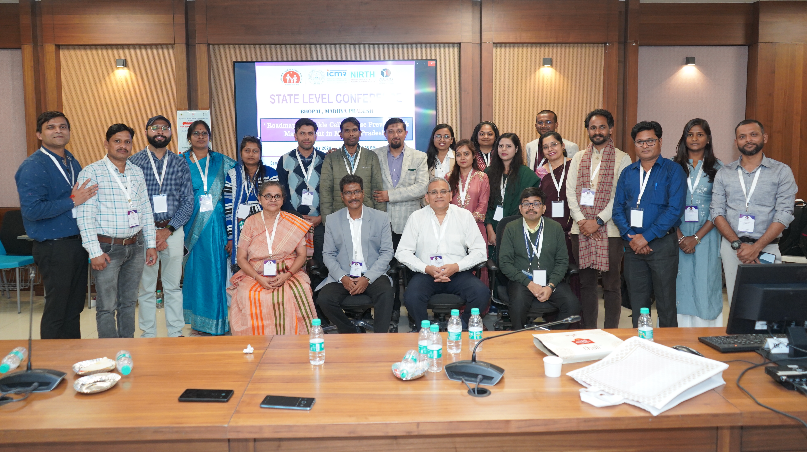
Sickle Cell Awareness Meeting @ NASCO

