Slide 1
Role of Center of Excellence in Management and Research of Sickle Cell disease including Prenatal Diagnosis and Newborn Screening
Dr Dinesh Pendharkar, MD PhD FASCO

Slide 2
Dr Dinesh Pendharkar, MD,PhD,FASCO
Director Sarvodaya Cancer Institute
Head Haemato-oncology, BMT, Cell & Gene Therapy
Advisor Sickle Program Govt of Odisha
Mentor Cancer Care Program MP, Rajasthan, Chhattisgarh, Odisha, Gujarat, Himachal Pradesh

Slide 3
Dr Dinesh Pendharkar
Global Committee Member American Society of Gene and Cell Therapy
Asian Cellular Therapy Organisation, Executive Committee Member
Past President Indian Society of Oncology
Past President Indian Society of Medical and Paediatric Oncology
Past Chair International Affairs Committee of American Society of Clinical Oncology

Slide 4
Summary
Create District Sickle Care Programme
Create Center of Excellence in each state to play role of lead MENTOR
Preferably near the site of highest prevalence
Control Training activities
Control Diagnostics
Control Newborn screening
Offer highest level of specialized medical care related to sickle cell disease

Slide 5
SCD Management in Odisha: An Overview
NHM, ODISHA

Slide 6
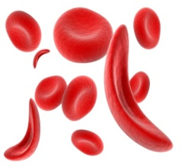
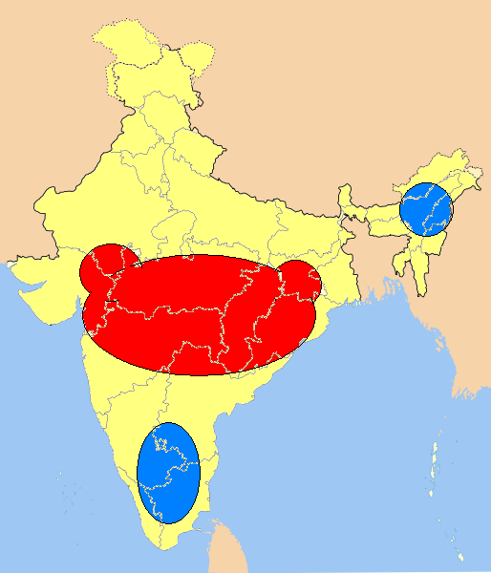
State Scenario in Haemoglobinopathy
The State- Odisha comes in the high sickle cell prevalence zone in the country along with States like Jharkhand, Madhya Pradesh, Chhattisgarh, Maharashtra & Gujarat
The State has prevalence of both Sickle Cell (10-15%) and Thalassemia (6-10%) as per the study report of CMC Vellore.
India
Orissa
21-40%
5-20%
<5%

Slide 7
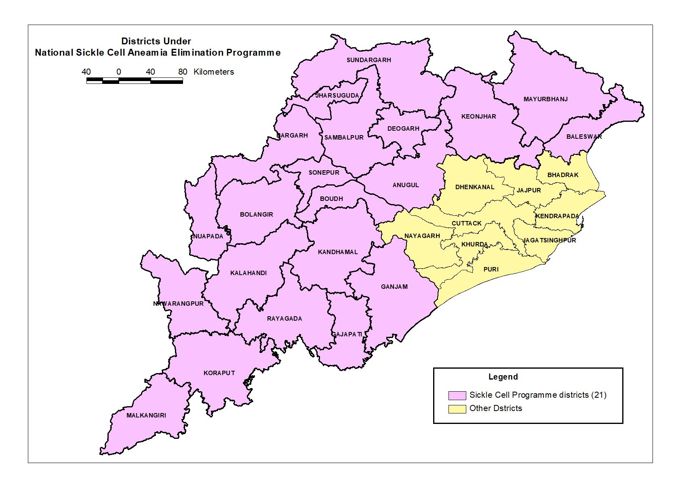
Selection of Districts
Out of 30 districts, 13 tribal districts and 12 Western Odisha districts have high prevalence in Sickle Cell comes together to 21 districts – Targeted for Universal Screening
Rest 9 districts are targeted for Opportunistic Screening at Facility level (Provision has been made as part of Essential Diagnostic List for facilities issued by GoI)

Slide 8
Modes of Universal Screening
Initially , screening started using POC across the targeted districts .
On analysis of report submitted by CMC Vallore , it was found that there is prevalence of both Sickle Cell & Thallesemia across the State & Thallasemia prevalence is more in some districts.
So, revised the Screening strategy & screen population with DBS-HPLC method in 7 districts (Balasore, Bolangir, Gajapati, Ganjam, Kalahandi, Rayagada & Sundargarh).
Engaged various platform / Service Providers to improve screening - Mobile Health Units, (State Specific) Mobile Health Teams under RBSK, VHSND, HW-F at SHCs, Selected ASHAs those are well versed with Portal entry , Service Providers at Urban AAM etc.

Slide 9
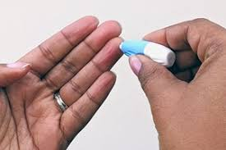
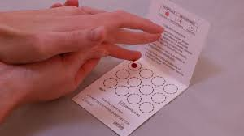
Universal Screening: Using DBS-HPLC Method
One single test for all clinically relevant Haemoglobinopathy
Simple Procedure : Works on a finger/heel prick sample soaked on a filter paper i.e. Dried Blood Spot (DBS) , very easy to collected no special training needed,
Logistically convenient, DBS is extremely robust and stable at room temperature for weeks , no cold chain or special transport or storage requirement.
Fast program roll out, with minimal burden on the already overworked HCW.
No subjectivity and human errors as the results are analyzed in the Lab
Screening done in outsourced mode- Sample drawn using DBS by the system and sample collection from CHC, undertaking the Tests & result updation in the portal is the responsibility of he agency.

Slide 10
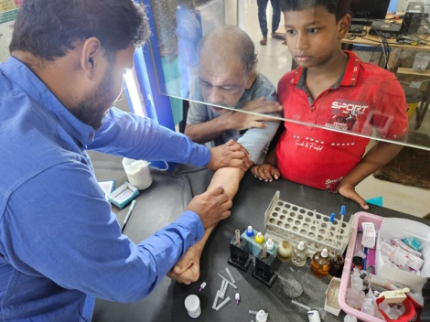
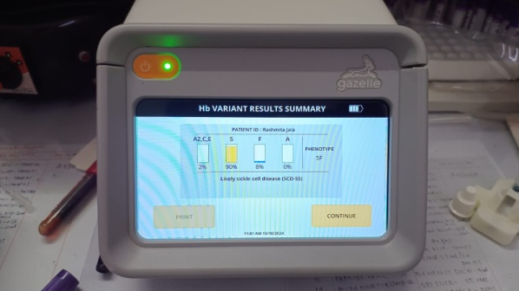
Opportunistic Screening: Using Gazelle Hb Variant
Suitable for Facility based screening (PHCs,CHCs,SDHs)
Samples to results in 10 mins
All patients and carriers can be tested- newborns, children, adults, premarital adults and pregnant females.
Fingerprick and venous blood
Quantitative
Detection of Sickle cell, Beta Thalassemia & Hb E on one platform
Automated Interpretation
Battery operated and printable patient report

Slide 11
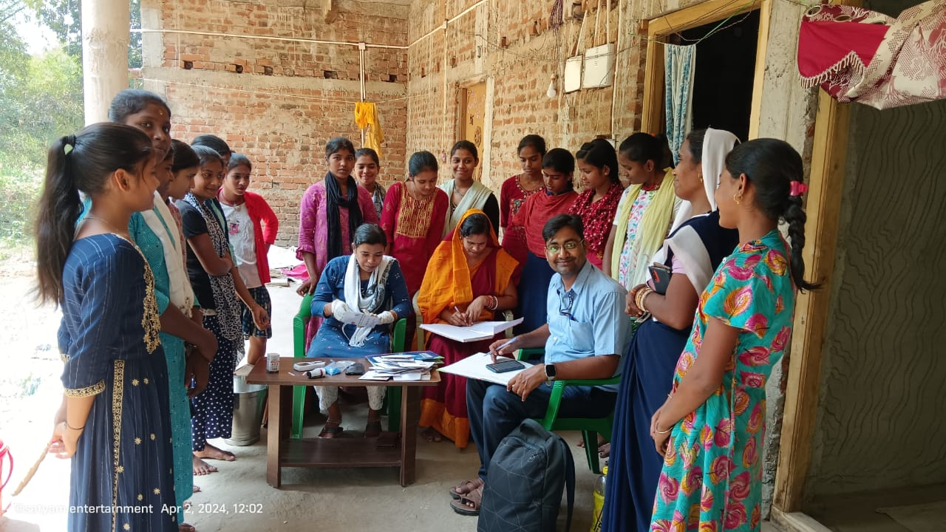
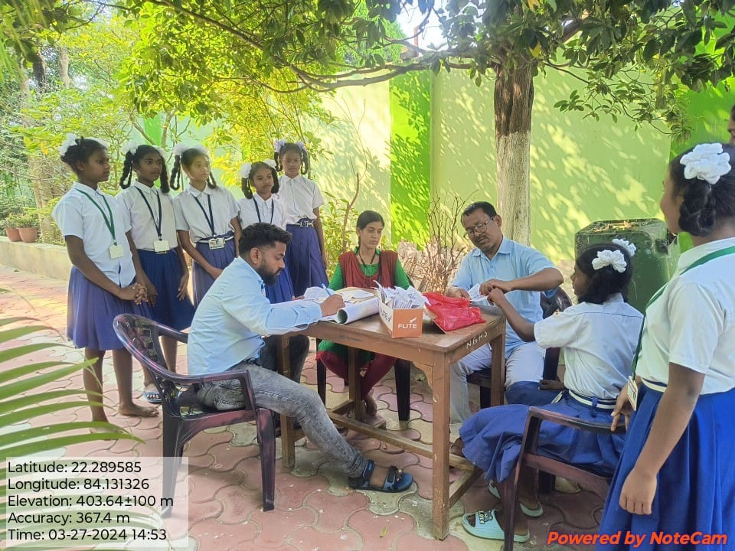
Screening at Different Platforms : A Snapshots
RBSK Team Involved for School Level Screening
Mobile Health Units Engaged at Community Level Screening

Slide 12
State Specific IEC-BCC
Two different Packages developed i.e. one for improving screening and other for sustaining treatment /management of positive cases.
Screening Centric IEC Package : Specially developed for different target groups i.e. Students/ Pregnant Women/ General Population etc
Treatment and Management centric IEC Package : Information brochure has been developed for all disease & Trait cases
Other Strategies :
Facility based Counsellors are being trained (Counsellor’s module shared by MOTA )
Plan is to establish genetic counselling unit at all 32 DHH sand 13 MCHs.
UNICEF supported In this drive

Slide 13
State specific IEC-BCC : Prototypes
For School
For VHSND Session Site

Slide 14
State specific IEC-BCC: Prototypes
For Community
Information Brochure

Slide 15
Strengthening Treatment & Follow Up at SC AAMs
Training is being taken up in cascade model till CHOs - ToT organised with the support of UNICEF
State has introduced Referral Card – Used for referring cases for confirmatory tests, Periodic tests those are put on treatment & Treatment at referral centres if required .
Introduced Drug Dispensation & Follow Up Register at each SC AAM level – For one to one tracking
Hand holding support at Quarterly CHO meeting by Master Trainers at district level .
Hydroxyurea in State Essential Drug List (EDl)
Making use of Tele-consultation Facilities for follow up treatment - SC AAM connected to treatment centres at CHC & DHH Level
Patient support group meeting at SC AAM level – Just initiated

Slide 16
REFERRAL CARD PROTOTYPE

Slide 17
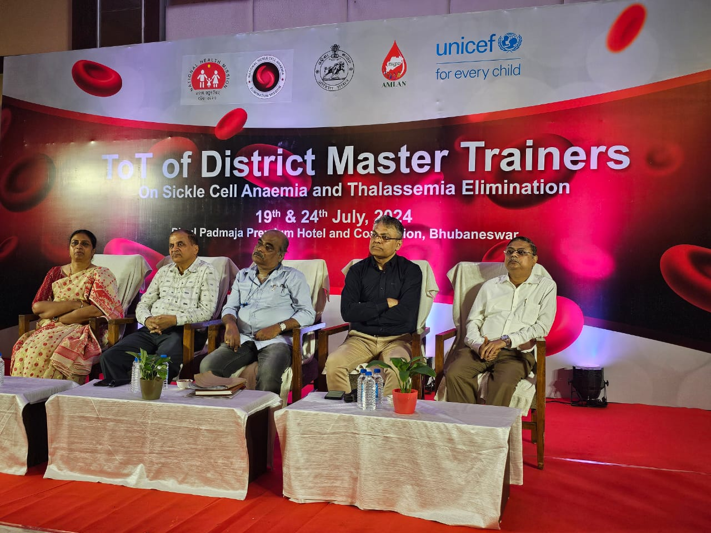
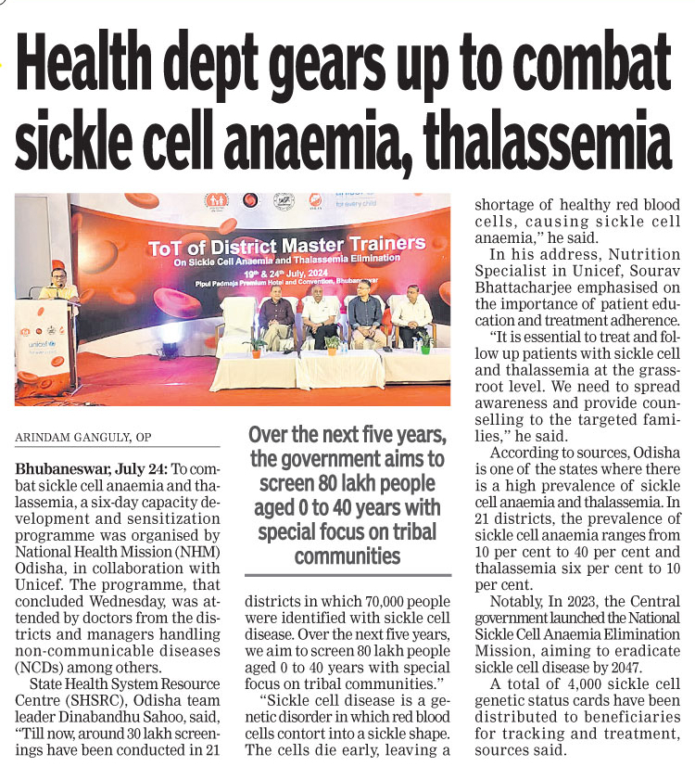
ToT for Strengthening Treatment / Management at Field Level : Snapshots

Slide 18
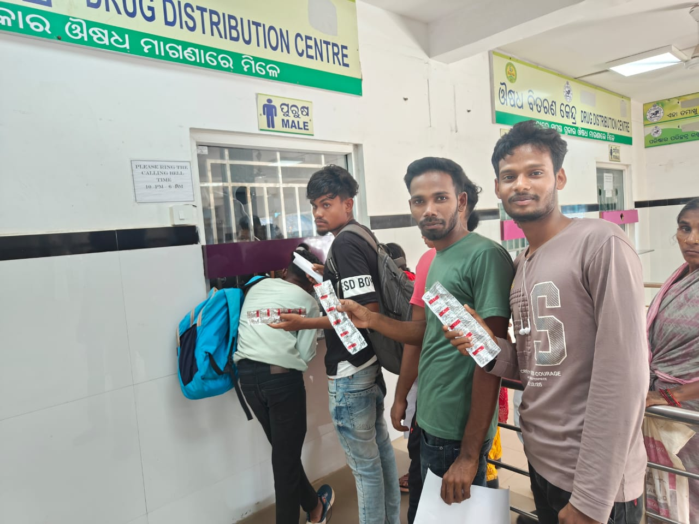
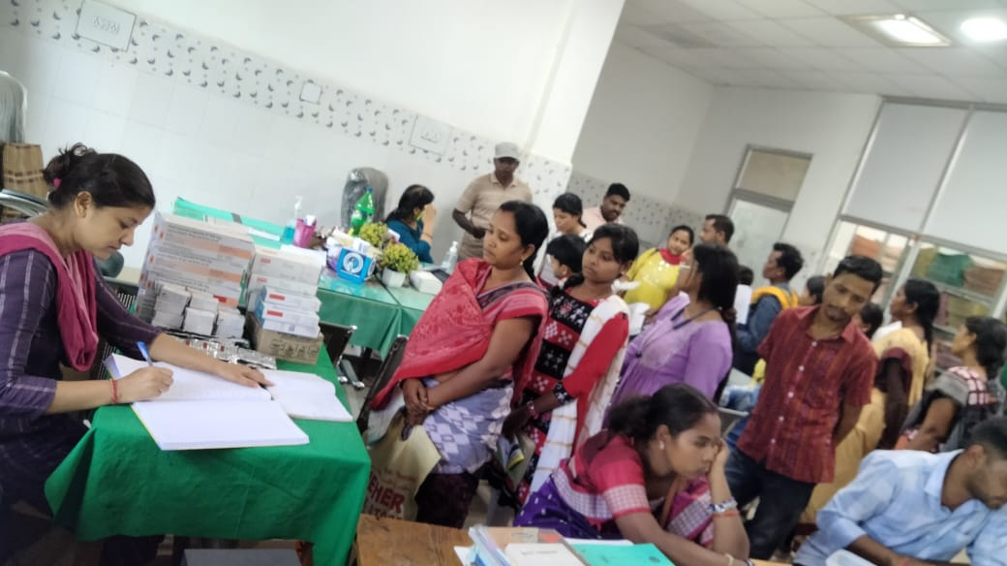
SC AAM: Dispensation of Hydroxyurea

Slide 19
Achievements
With the systematic approach, the State has able to cover a decent achievements :
1 | Screening: | 43,57,071 Vs Target of 55,16,270 (79%)
2 | SCD cases: | 85,459
3 | Sickle Cell Trait Cases | 3,37,871
4 | Thalassemia Cases (positive) | 22,622 out of 8,88,337 screened cases
5 | Card distributed Cases | 4,21,465
6 | Treatment (Hydroxyurea) initiated: | 33,187

Slide 20
Lessons Learnt
Modalities /methods of screening :State to decide depending on prevalence of disease
Issues with present modalities of screening : Needs Repeat Screening, (initially with POC than DBS-HPLC as prevalence of Thalasemia also present in Odisha again for confirmation of positive cases) , double man days involved, re-mobilisation of cases for screening also a difficult task, difficult in result updation in the portal etc.
Treatment needs periodic tests (atleast once in 3 months for every positive cases put on treatment ) & thus nearest PHC/UPHCs should be equipped for all tests to reduce OOPs.
DVDMS (e- Niramay) to extend to SC AAM level to monitor the Hydroxyurea
Use of Tele-consultation facilities for Follow up of treatment – CHO to connect with treating Physicians

Slide 21
Lessons learnt from CMC Vellore study
CMC Vellore has done the screening of ANC PW in 15 districts. The study report shown 24,112 nos. of hemoglobinopathies out of 1,72,217 screened cases(prevalence of 14%).
A sentinel surveillance study was conducted in 3 medical college and hospitals which revealed 1,444 nos. of hemoglobinopathies out of 12039 screened cases(prevalence of 12%).

Slide 22
Odisha Model: Beyond Screening
SCD Screening by POCT: 14 districts at Community level.
Confirmatory test by Microchip Gazelle : across the State at Facility level, all types Hb pathies (HbS, Thal, HbE etc.)
Confirmatory test by DBS-HPLC : 7 districts at Community level.
PND facilities: at all MCHs.
SCB MCH, Cuttack: Nodal Centre at present to provide technical expertise to the State, PND, Genetic Study, BMT and Training Facilities.
Model Day Care Centre at SCB MCH, Cuttack with all facilities in a single window with support of NHM

Slide 23
National Sickle Cell Elimination Mission
Integrated Approach towards Screening and Management
Reduce prevalence
Improve quality of life
Reduce complications
Increase life expectancy

Slide 24
Strategy
Primary prevention, Mass screening, Counseling
Secondary prevention- Early detection and comprehensive care to patients

Slide 25
Strategies
Antenatal Screening
Prenatal Screening
New Born Screening

Slide 26
Antenatal screening
Aim- To provide a couple- information and option for reproductive decision making including prenatal testing
Approach- Antenatal screening of all pregnant mothers in sickle anemia-affected geographies shall include compulsory screening for SCD along with other tests to high-risk risk pregnancies.
The Pradhan Mantri Surakshit Matritva Abhiyan (PMSMA) program,Janani Suraksha Yojana (JSY), Janani Shishu Suraksha Karyakaram (JSSK )would be leveraged for this

Slide 27
Antenatal screening
Majority of the screening is over in prevalent zones
Medical officer to specifically inquire about test and #sickle card # and counsel
If tests not done to perform immediately for both parents
Counsel

Slide 28
Prenatal Diagnosis
Aim- To reduce the birth of child with sickle cell disease
Approach- Specialized diagnostic tests
CVS- Chorionic Villi Sampling
Amniotic fluid testing
Check card /status of the partner

Slide 29
Prenatal screening
Sample of Amniotic fluid
Sample from the placenta
DNA Analysis
Amplification Refractory Mutation System (ARMS)
Covalent Reverse Dot Blot hybridization (CRDB)
DNA sequencing

Slide 30
Chorionic villous sampling
10.5-11 to 13.5-14 weeks of pregnancy
Trans-abdominal
Trans-cervical

Slide 31
Amniocentesis
14-16 weeks of pregnancy
20-35 ml of fluid
Variable techniques of DNA analysis

Slide 32
Risks
0.5-2% risk of fetal loss
Bleeding
Mix up with maternal blood

Slide 33
Newborn Screening- General
SDG Goal-3.2-
End preventable deaths of New Borns and Children under age of 5 by 2030
SDG Target - 3.2.2
Reduce IMR to atleast 12 per 100 berths

Slide 34
Newborn Screening
Aim- To identify SCD patients and initiate prophylactic strategies to reduce under 5 mortality, increase overall survival, improve quality of life.
Approach-Immediate sampling and shipment to diagnostic lab.

Slide 35
In Africa
Below 5 mortality high because of sickle
Invasive Pneumococcal infection
Acute Malaria
Acute splenic sequestration

Slide 36
Newborn screening-If positive
Extended focus on regular follow ups
Rigorous follow up on immunization schedule
Prompt attendance of any infection or sickle related episode

Slide 37
Newborn Screening
24-48 hrs after birth
Blood spot
Heel lance dried blood

Slide 38
Requirement
For Prenatal screening-
Specialized facility
Personnel
Diagnostic capacity
For Newborn Screening
Availability of the kits
Transport logistics ,in time line

Slide 39
Role of consent
Counseling at every stage is important
Consenting is mandatory before procedure
Involve local obstetrician in every decision

Slide 40
Issues
Policy on Newborn Screening
Care of the Newborn
Strategy-
Universal New born Screening
Targeted Newborn Screening

Slide 41
Policy on Newborn Screening
Strategy-
Universal Newborn Screening
Targeted New Born Screening

Slide 42
Care of the Newborn
Strategy
District Sickle Care Programme
Empowerment of CHO-Community Health Officers at HWC_Arogya Mandir

Slide 43
Center of Excellence
Should have capacity of performing all tests- Diagnostics and Follow up
Equipment required for diagnostics
Prenatal Screening capabilities
Red Cell Exchange
Slowly develop Specialised clinical procedures- like BMT, Kidney Transplant, Hip Replacement

Slide 44
Suggestions
Take initially districts with known sickle patients , example more than 2000,3000
Restrict to districts closer to available Center of Excellence or Sickle Institute
ICMR to confirm confirmatory test

Slide 45
Antenatal
Prenatal
Newborn

Slide 46
Antenatal
TRAINING ASHA ANM CHO
If Mother has positive statuts
Check Fathers status
If not done –Carry the test
If both positive
Go to the next step of Counseling for PRENATAL TESTS

Slide 47
Prenatal
TRAINING ASHA ANM CHO
Counselling
Referral to COE

Slide 48
Newborn
Training Asha, ANM, CHO, District Sickle Care Officer
Test all newborn- Born to carrier mothers ,If fathers status unknown or carrier
If father proven-No carrier, initial programme avoid

Slide 49
Summary
Create District Sickle Care Programme
Create Center of Excellence in each state to play role of lead MENTOR
Preferably near the site of highest prevalence
Control Training activities
Control Diagnostics
Control Newborn screening
Offer highest level of specialized medical care related to sickle cell disease

Slide 50
Thank You

