Slide 1
Challenges in Diagnosis & Management of Sickle Cell Disease: An Experience from Tamil Nadu
Presented by
Tmt. Shilpa Prabhakar Satish, I.A.S.,
Mission Director, National Health Mission - Tamil Nadu

Slide 2
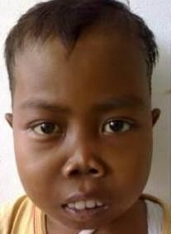
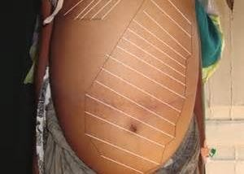
“A group of genetic disorders affecting blood, characterized by abnormalities in the structure or production of the hemoglobin molecule.”
Hemoglobinopathies
MAJOR TYPES OF HEMOGLOBINOPATHIES IN INDIA
Beta Thalassemia
Sickle Cell Anaemia
Haemoglobin D (Hb D) Haemoglobin E (Hb E) Sickle Thalassemia
2

Slide 3
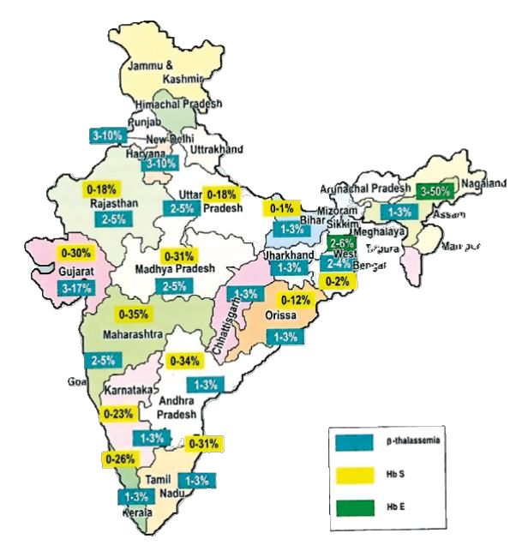
Estimated Prevalence
SICKLE CELL ANAEMIA
THALASSEMIA
0-31%
1–3 %
According to screening data, Thalassemia trait is more prevalent in Tamil Nadu than the sickle cell trait.
This burden highlights the necessity for policy-driven solutions focused on early diagnosis, resource planning, and sustained health outcomes.
Source: NHM guidelines for prevention and control of
Hemoglobinopathies in India 2016
3

Slide 4
National Vision: Sickle Cell Disease Elimination by 2047
OBJECTIVES
Prevalence of Hemoglobinopathies
Reduce
Ǫuality of Care for
patients
Ensure
Provide
Affordable and
accessible care
‹#›

Slide 5
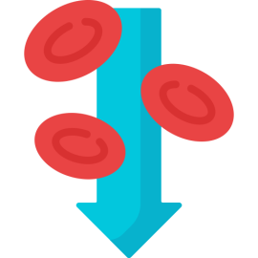
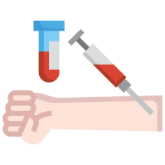
Strategies Adopted by Tamil Nadu
Preventive Strategies
Early Screening &
Diagnosis
4-Pronged Approach
Comprehensive Treatment & Management Framework
Long-Term Follow-up
‹#›

Slide 6
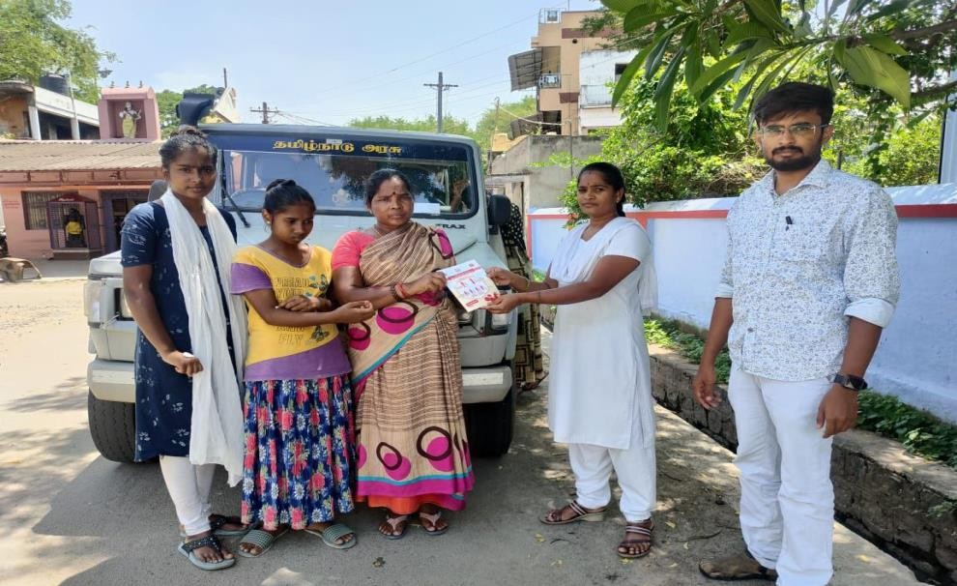
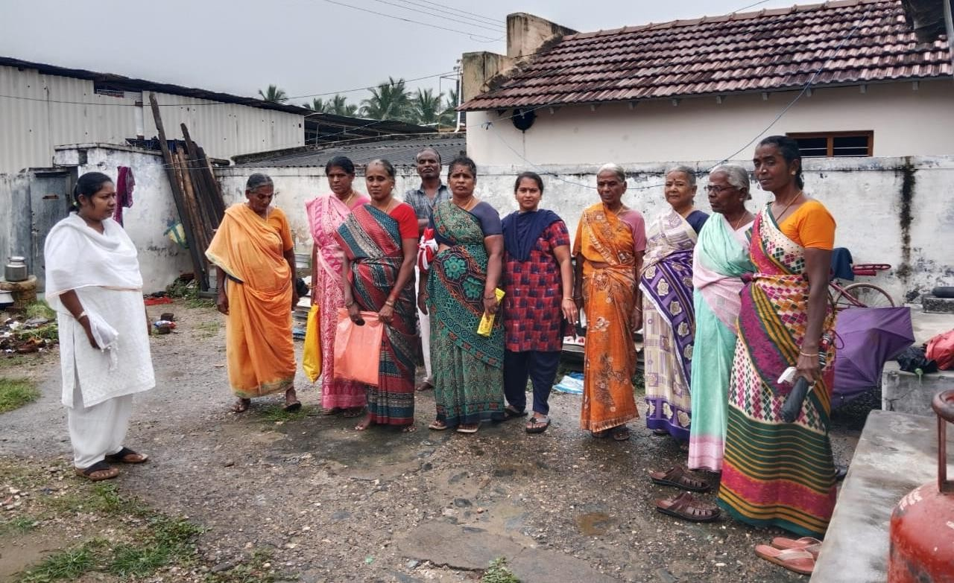
Preventive Strategies
AWARENESS CREATION (SINCE 2017)
Mobilization of community-based platforms
Awareness Campaign
Local body authorities
Self Help Groups (SHGs) NGOs
Tribal Welfare Department.
Self Help Groups
6

Slide 7
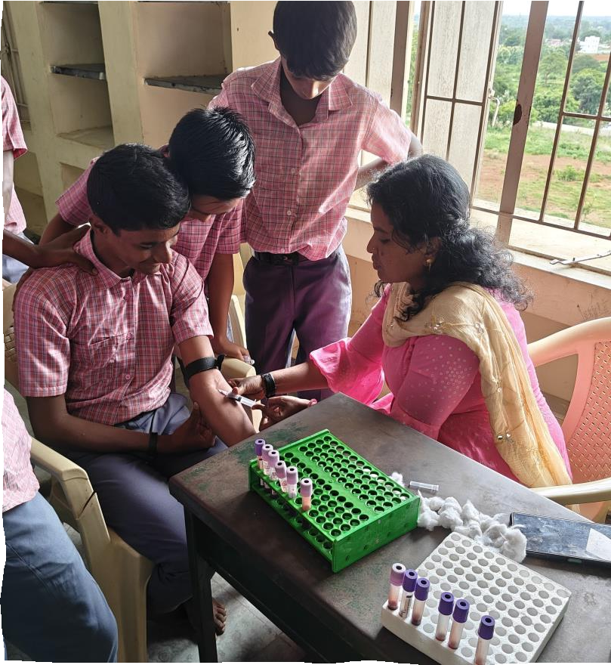
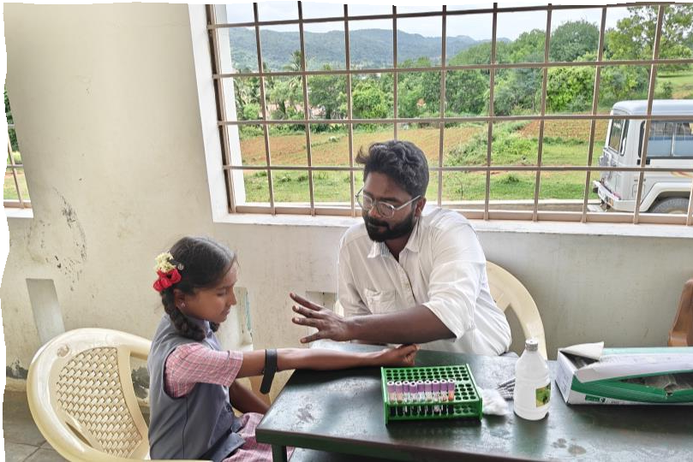
School Screening for Hemoglobinopathies
Blood Sampling by Tribal MMU / RBSK team at school after informed consent
Since 2017, 1.23 Lakh
school children screened
10,635 (8.5%)
positive identified
CBC, NESTROFT,
soulblity test
at PHC
Genetic Counselling
Children between 6th to 12th std in Govt & Govt aided schools and unmarried school dropouts >14 years
3,167 SCA & Trait identified
7,377
Thalassemia trait including Borderline
Cascade screening of family members of children who tested +ve
+ve Samples transported to Medical Colleges for HPLC
91 Mixed cases identified
30 Blocks – 14 Districts
‹#›

Slide 8
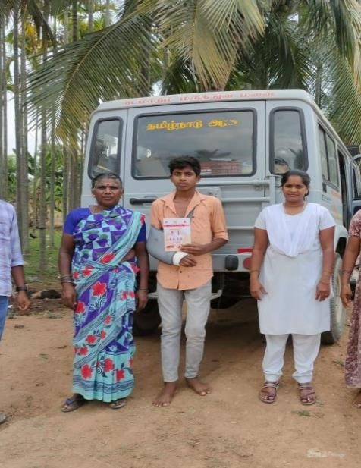
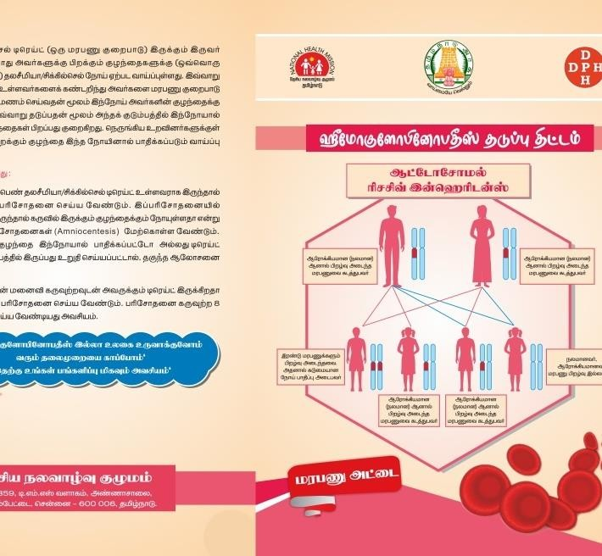
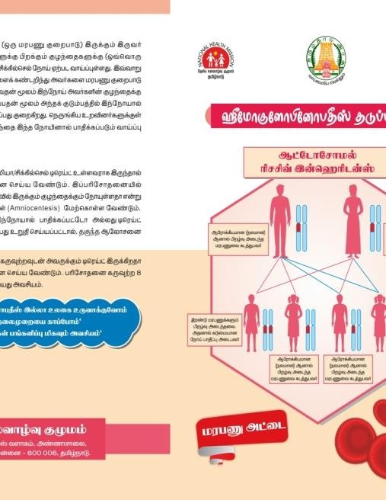
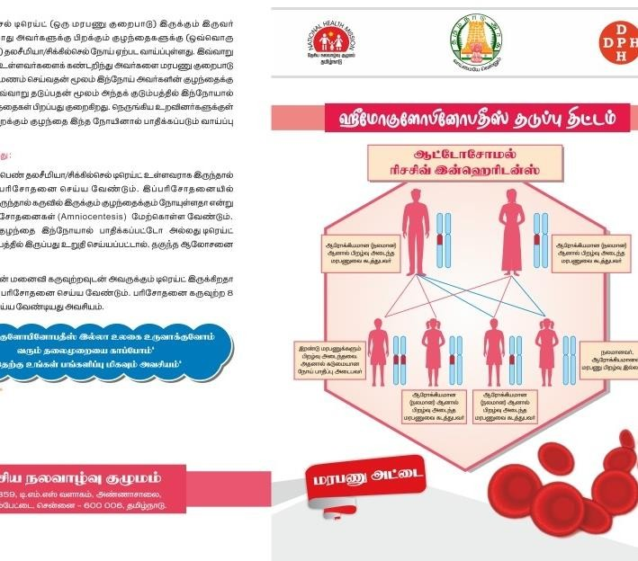
Genetic Counselling
Pre-marital Counselling
Through DEIC, Tribal MMU team and Block PHC team
Genetic color-coded cards (3 Types - Disease , Trait , Normal)
NGOs such as NAWA, ASHWINI etc engaged.
1.23 Lakh School children given Genetic Counselling
CHALLENGES
Lack of awareness
Geographical Barriers
Cost of the confirmatory tests such as HPLC
Non-availability of parents for screening
Social Stigma & Cultural beliefs
Lack of Genetic Counsellors
‹#›

Slide 9
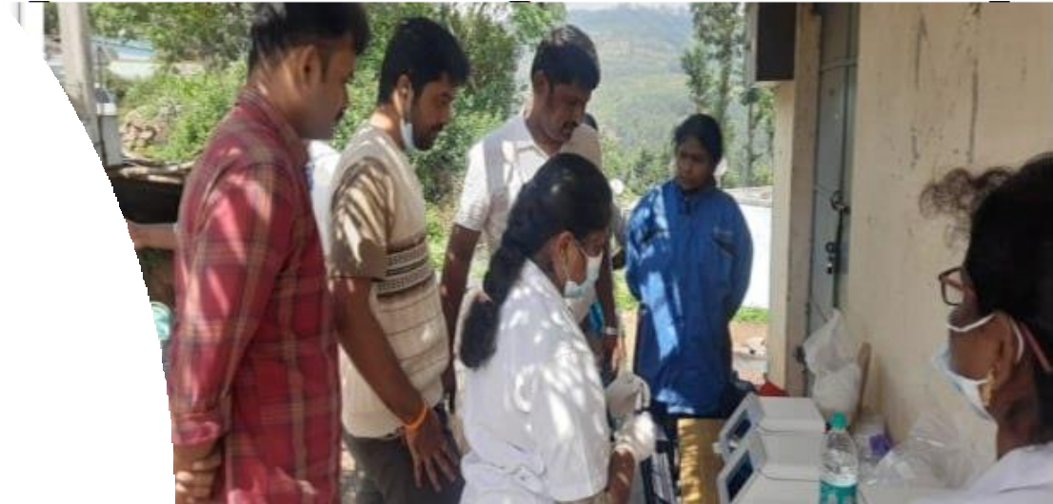
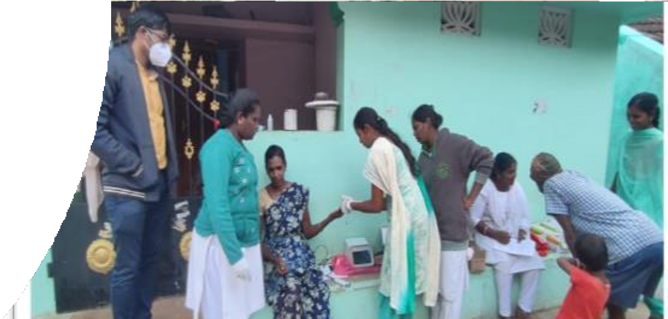
Community Screening
Age 6 months - 6 years
POCT
Solubility testing
NESTROFT
CBC
Age 7 – 40 years
‹#›

Slide 10
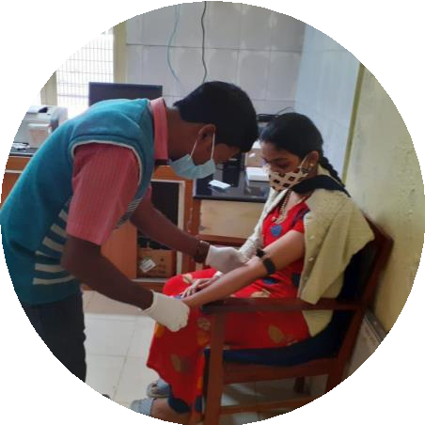
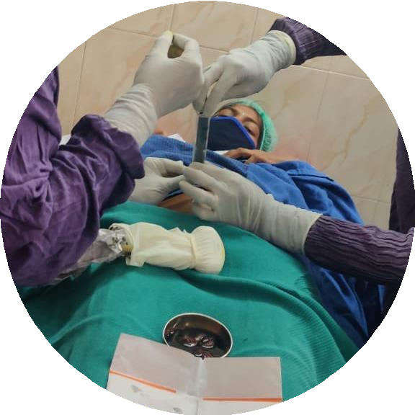
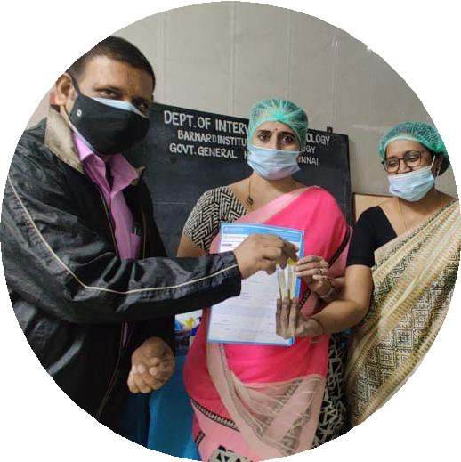
Antenatal Screening
AN Mothers of all 30 tribal blocks
CBC & HPLC
Tests
AN Screening for Hemoglobinopathies in 30 tribal blocks
AN Mothers screened | 84,263
Borderline Trait | 4,450 (5.3%)
B. Thal Trait | 2,340 (2.8%)
Sickle Trait | 1,259 (1.5%)
SCA Trait | 379 (0.5%)
Total +ve | 8,428(10%)
No. of Husband screening | 4,849
No.of couple positive | 398
No. of amniocentesis done | 171
^{No of fetus with Trait} | 60 (35%)
^{No of Fetus as Normal} | 64 (37%)
^{No.of foetus affected} | 47 (27%)
No.of MTP done (Outcome) | 40 (85%)
If, Mothers are
+ve, their husband counseled
Samples for husband sent for CBC & HPLC
If +ve, Pre-Test Genetic Counseling at DEIC
Amniocentesis at RGGGH
For Affected foetus – Post-test Counselling & MTP Offered
If foetus is Normal / Trait – Counselling
10

Slide 11
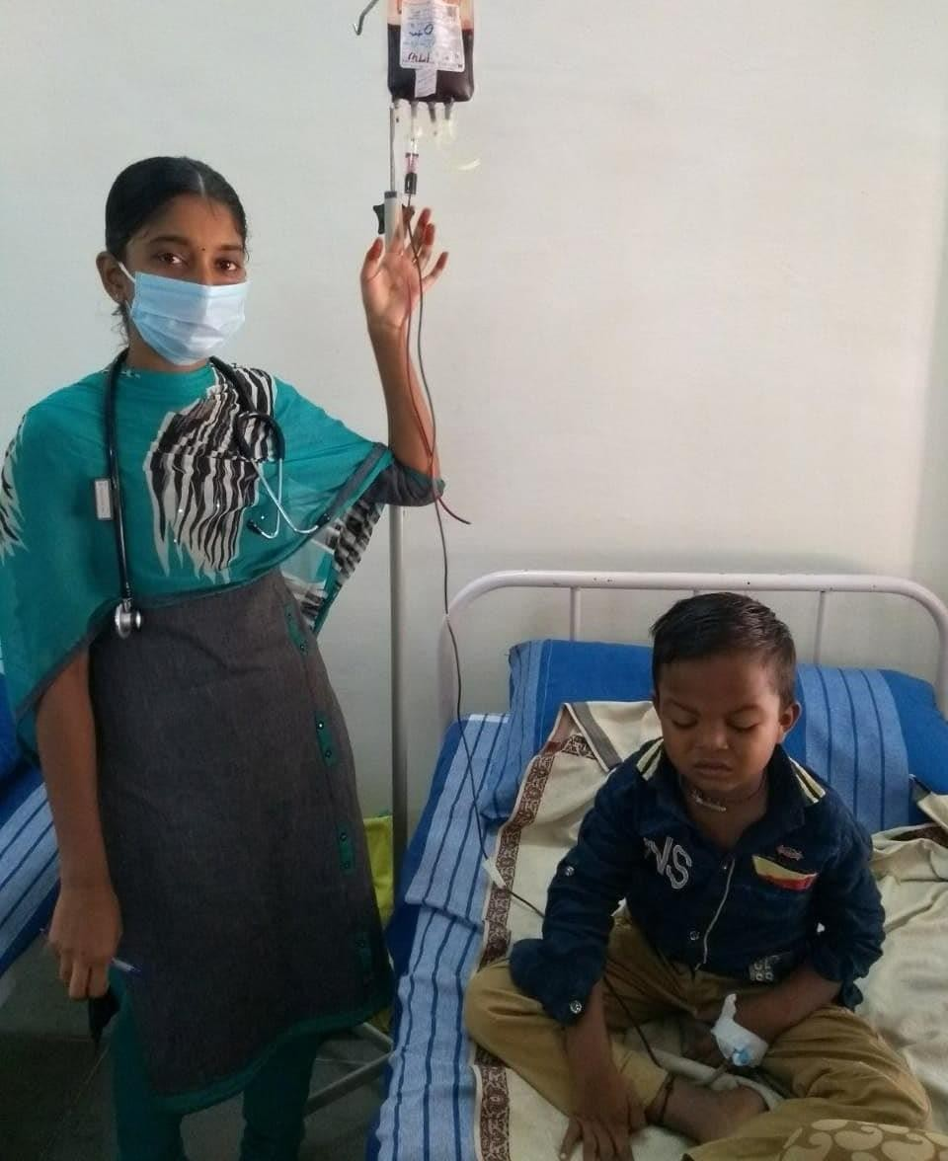
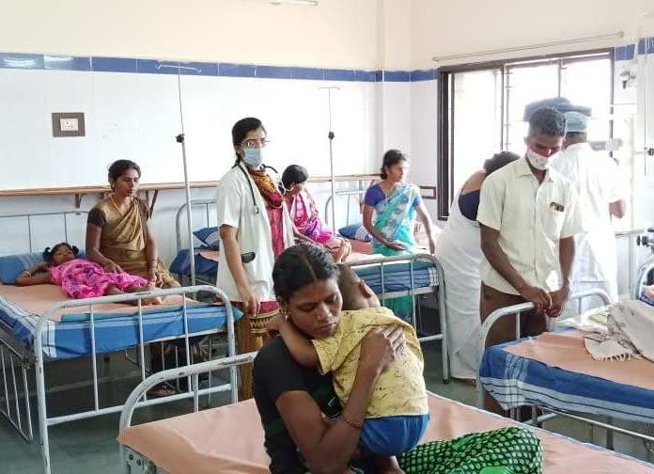
Management of Hemoglobinopathies
Penicillin Prophylaxis
For infection prevention
Vaccinations
Against HiB, pneumococcus, meningococcus, and typhoid
Supplements
Folic acid, calcium, Vitamin D, and Zinc
Pharmaceutical Interventions
Hydroxyurea for symptom control
Pain Management
Hydration, NSAIDs, opioids, non- pharmacologic therapy
Blood Transfusions
Monthly for thalassemia and as required for SCA, with iron chelation therapies

Slide 12
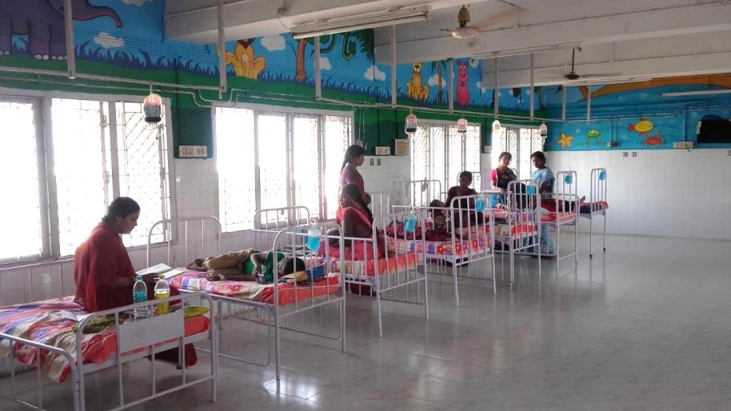
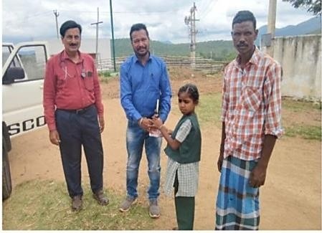
Management of Hemoglobinopathies
24 x 7 Services
All the 36 MCH & all DHǪH provide 24 X 7 services
Day-care Centres
10 regional Integrated Day Care Centres
across Tamil Nadu
Challenges
Lack of knowledge amongst
healthcare personnel
Delayed diagnosis
Supply of Hydroxyurea
Access barriers to advanced Therapies

Slide 13
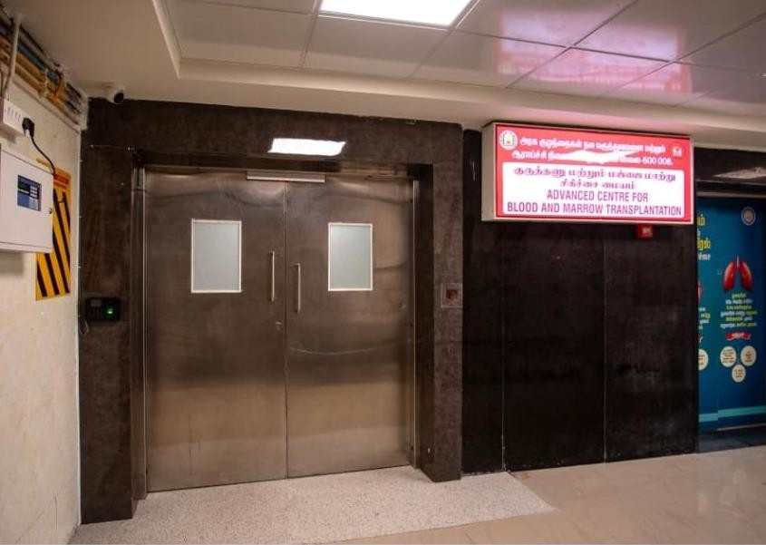
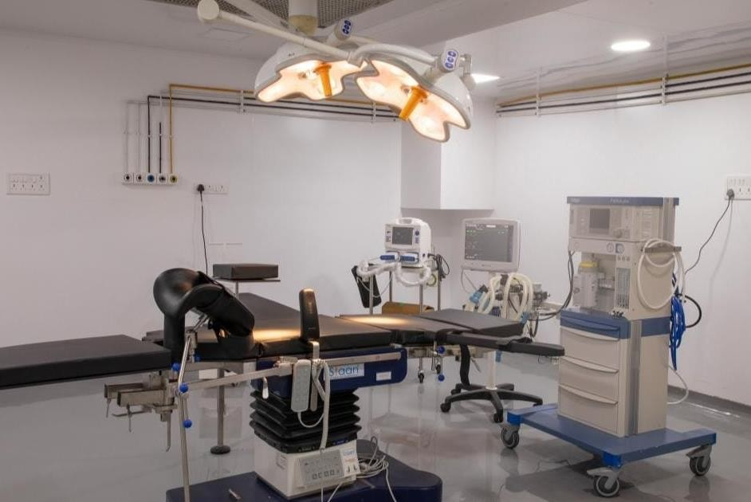
Newer Initiatives
Bone Marrow Transplantation Unit
Established in RGGGH since 2018 .
113 BMT procedures have been done.
Out of which 2 Thalassemia & 2 SCA cases have been managed
Under NHM: Pediatric BMT unit established in Institute of Child Health, Egmore – Chennai since 2024
1st procedure was performed on 11.9.2024 for Thalassemia
Financial support under Chief Minister's Comprehensive Health Insurance Scheme (CMCHIS)
Challenge: Identifying matched sibling donors

Slide 14
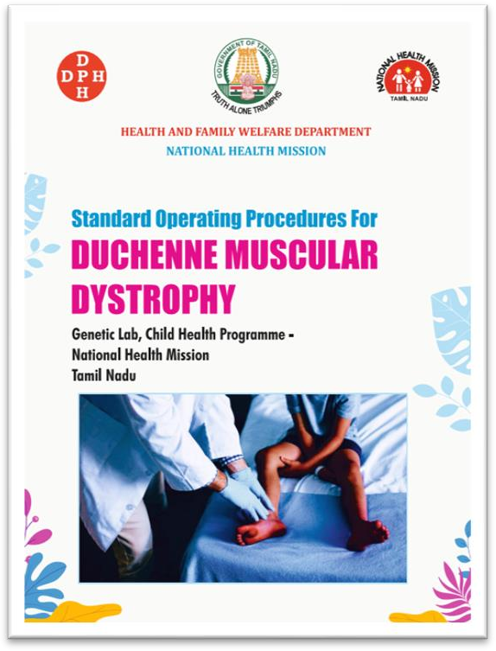
Newer Initiatives
Genetic Centres to Cater to Genetic Disorders
DISEASES MANAGED IN GENETIC CENTRES
Haemoglobinopathies- Sickle Cell Anaemia
and Thalassemia
Duchenne-Muscular Dystrophy/ Spinal
Muscular Atrophy
Genetic Clinic
Genetic Laboratory
Chromosomal Disorders
Genetic Counselling Services
Lysosomal Storage Disease
Medical Termination of Pregnancy
Mucopolysaccharidosis
Rehabilitation Support
Congenital Adrenal Hyperplasia
SoP under development for all 21 Diseases / Disorders
Congenital Hypothyroidism
The Services are available currently in Chennai since Jan 2024 and extended to Madurai & Coimbatore
Glucose 6 Phosphate Dehydrogenase (G6pd)
Deficiency
Rights of Persons with Disabilities Act
Cystic Fibrosis
14

Slide 15
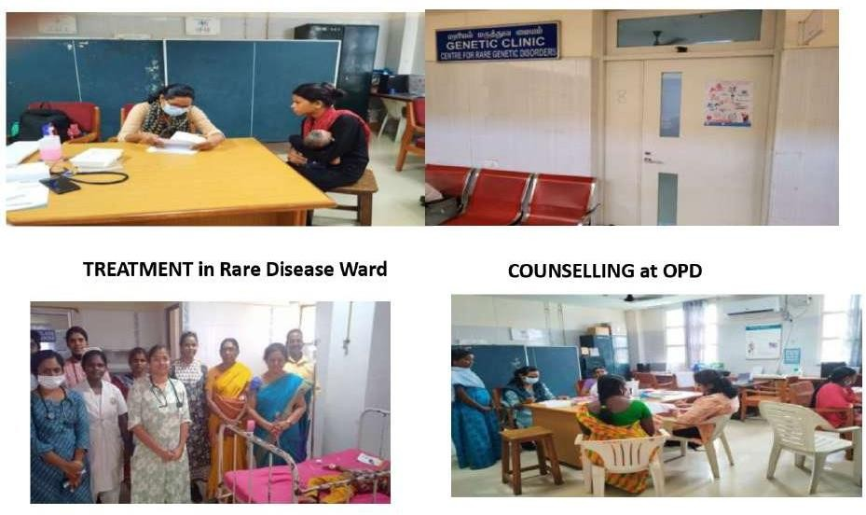
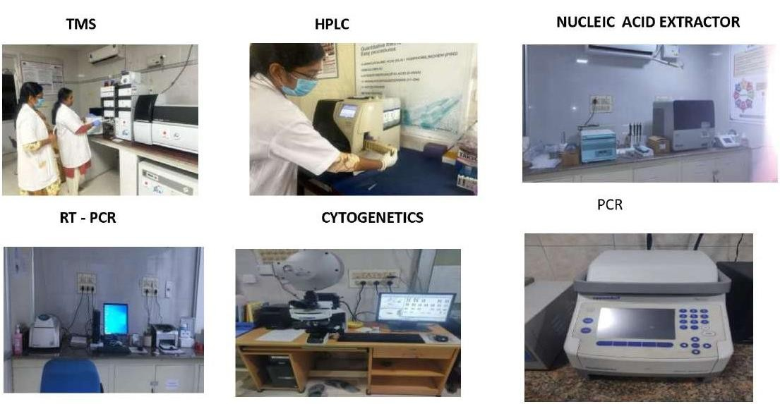
GENETIC CLINIC & RARE DISEASE WARD
GENETIC LABORATORY

Slide 16
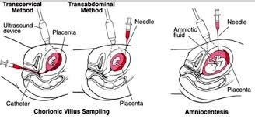
Newer Initiatives
Pre Natal-Diagnosis (PND)
Rajiv Gandhi Government General Hospital, Chennai
Coimbatore Medical College Hospital
Salem Medical College Hospital Vellore Medical College Hospital
6 Centres Newly established (2024)
Dharmapuri Medical College Hospital
10 – 12 weeks
Chorionic Villus Sampling
Madurai Medical College Hospital
16 – 20 weeks
Amniocentesis
Trichy Medical College Hospital

Slide 17
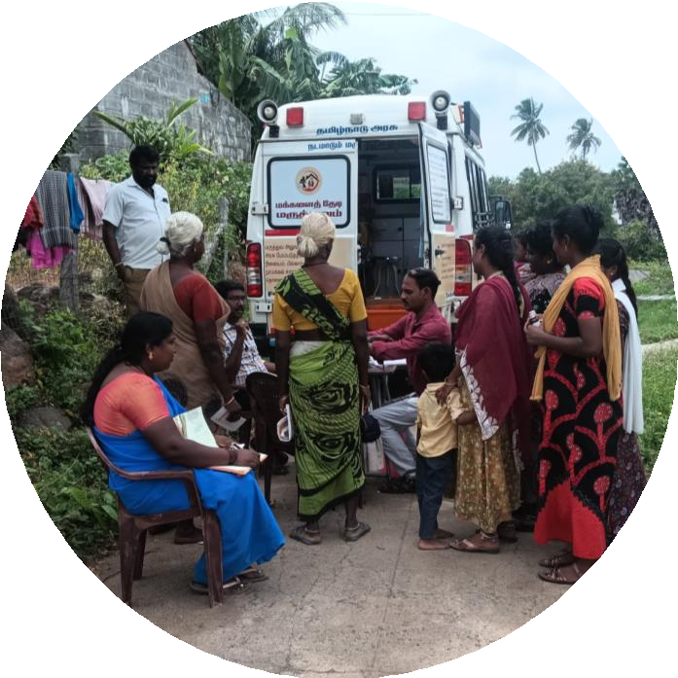
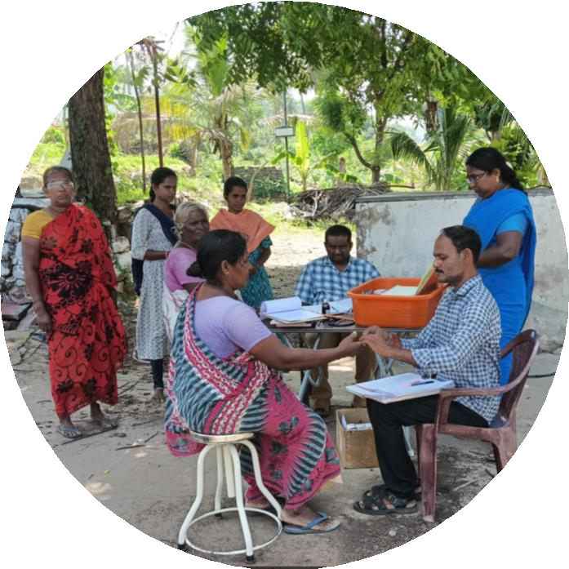
PMJANMAN
Newer Initiatives
2900 PVTG areas: 695 areas identified as having no health facilities
Mobile Medical Units: Mapped to serve remote areas
NGO Involvement: Active in raising awareness and
providing education
Inter-sectoral Coordination: Involves tribal, women & child development departments
Expanding screening to Non-Tribal areas:
Piloting hemoglobinopathy screening to non-tribal areas
3000 Antenatal (AN) mothers in Karur District for a period of 3 months
The screening will be initiated from November 2024 to study the
prevalence of the disease.
17

Slide 18
Tamil Nadu's Vision for Hemoglobinopathies:
Tamil Nadu envisions a future free of hemoglobinopathies through a comprehensive, inclusive
approach. The state is committed to
Expanding
Providing
Integrating
Scaling
Promoting
Screening and testing to reach even remote tribal areas.
State-of-the-art treatment services across all regions to break the barriers of accessibility.
With education, social welfare, and community engagement for holistic support.
Advanced treatments like bone marrow transplantation and fostering innovative therapies.
Prevention through premarital genetic counseling and early diagnosis, aligning with the national goal to eliminate sickle cell disease by 2047.

Slide 19
Thank you

