Slide 1

GREETINGS
from
Valsad Raktdan Kendra
Birthplace of
Sickle Cell Anemia Control Program

Slide 2
Community Awareness, Counseling
and Social Support Schemes
(including premarital counseling)
- Dr. Yazdi Italia, Ph.D.
Former Hon. Director, Sickle Cell Anemia Control Program
A GO-NGO Partnership Program of
Department of Health & Family Welfare,
Government of Gujarat
Former Hon. Secretary, Valsad Raktdan Kendra,
VALSAD, Gujarat
&
West Zone Chairperson
Indian Society of Blood Transfusion & Immunohaematology
Email: yitalia@yahoo.com
Phone: +91 9825158044

Slide 3

Bringing Science
to the Doorstep of Tribal Communities………
National Sickle Cell Anemia
Elimination Mission 2023
Elimination of sickle cell disease -
No birth of SCD child by 2047.
Government of India

Slide 4

Road Map of
Anemia Mukt Bharat
goes via……
Thalassemia Major
&
Sickle Cell Disease
Mukt Bharat
Both Diseases are PREVENTABLE.
8th of March 2018
We have to take care of patients suffering from DISEASE
&
We have to prevent their BIRTH.

Slide 5

India’s past, history, present and India’s future will never be complete without the tribal community. Tribal populations in India share a disproportionate burden of sickle cell disease. We will usher in a social revolution against this disease and bring in the most advanced science and technology to tackle it. We are committed to improve the quality of life of people with sickle cell disease and ensure future generation is safe from it.
- Hon’ble Prime Minister Shri Narendra Modi

Slide 6

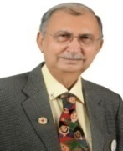
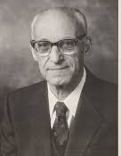
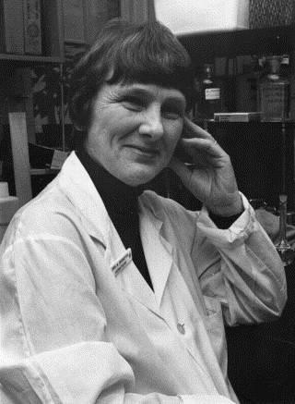
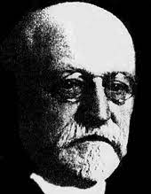
Sickle Cell Anemia – Gujarat Model
As a nodal agency, Valsad Raktdan Kendra played a crucial role in designing and implementing the program in Gujarat State.
2023
National Sickle Cell Anemia Elimination Mission by 2047 was launched
2016
SCD Included in NHM
Transforming Projects Into Programmatic Mode.
A journey of 46 years from 1978 to 2024
2006
Sickle Cell Anemia Control Program initiated in the State of Gujarat
1978
Italia, identified / diagnosed
SCD patient at Valsad, Gujarat.
1952 :
Lehmann & Cutbush
1910 :
James Heric

Slide 7
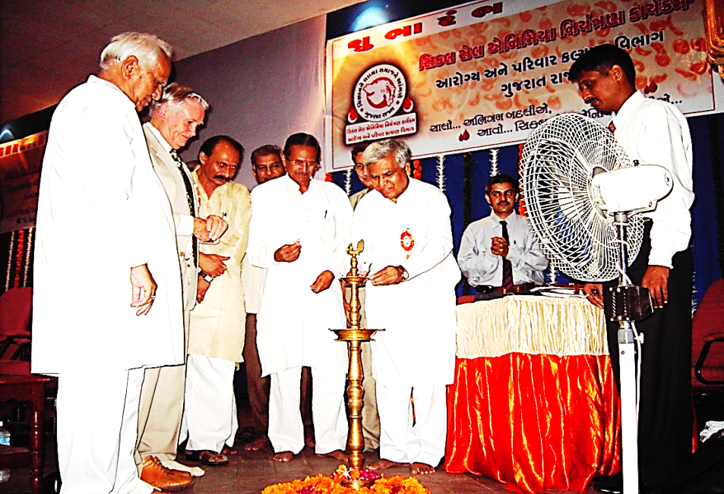
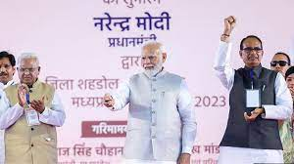
Written in Golden Words in the Medical History of India
30th July 2006 & 1st July 2023
E
During his tenure as Chief Minister of Gujarat, Narendra Modi made the state the first in India to implement a Sickle Cell Anemia Control Program. The program was inaugurated by Mangubhai Patel, then Minister of Tribal Affairs, in the presence of other Gujarat state ministers and Dr. Graham Serjeant.
Hon. Prime Minister Shri Narendra Modi launched the National Sickle Cell Anemia Elimination Mission in Shehdol, Madhya Pradesh, in the presence of His Excellency Hon. Shri Mangubhai Patel, Governor of MP, and Hon. Shri Shivraj Singh Chauhan, Chief Minister of MP.

Slide 8
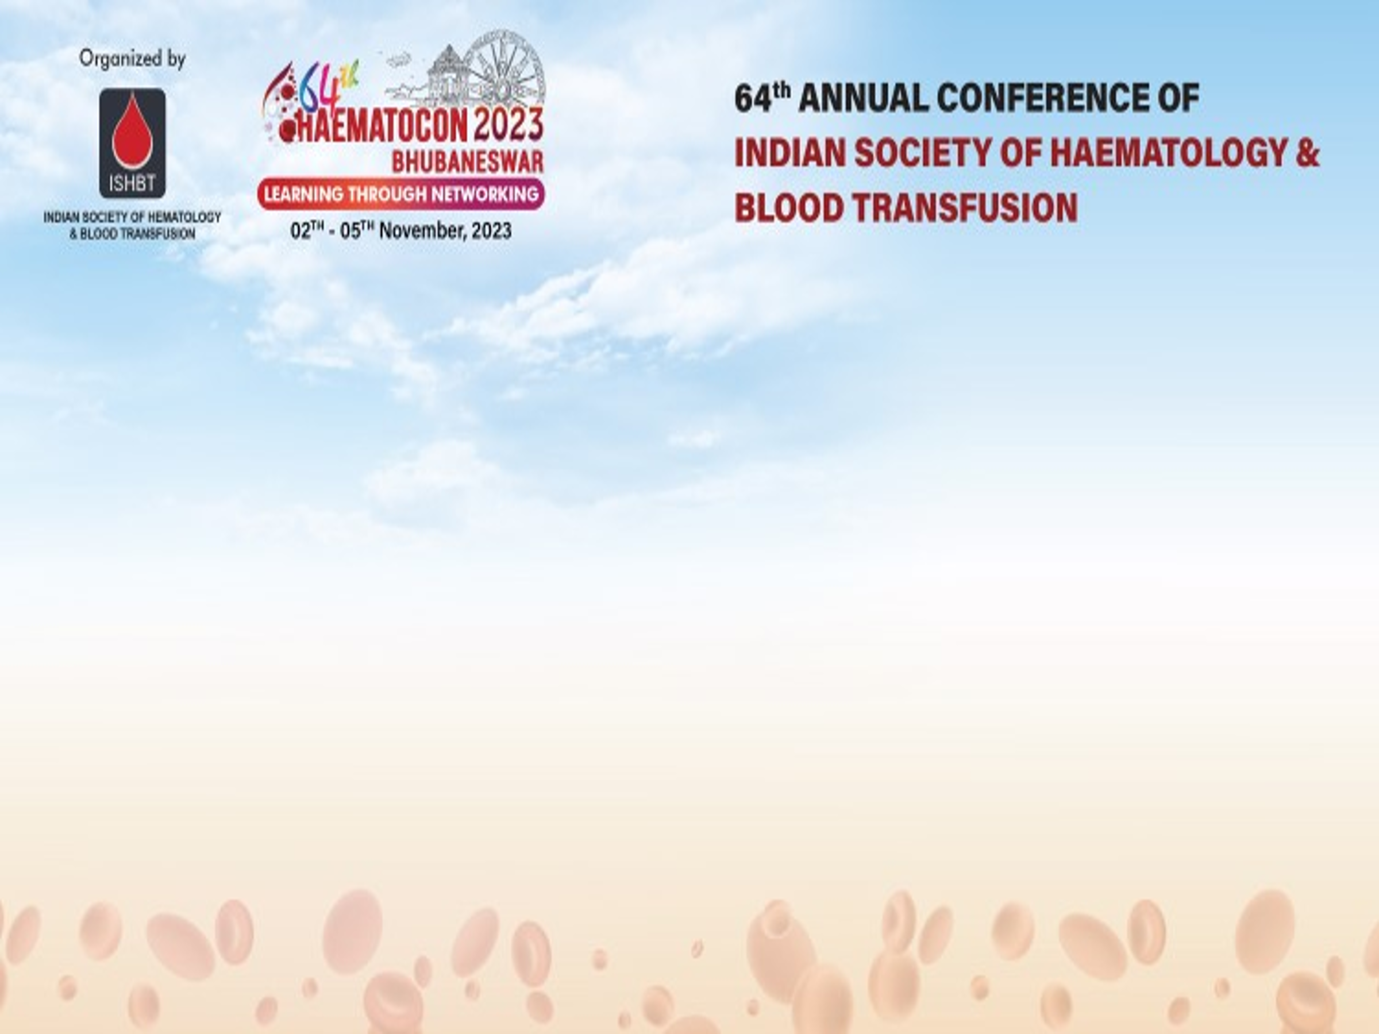
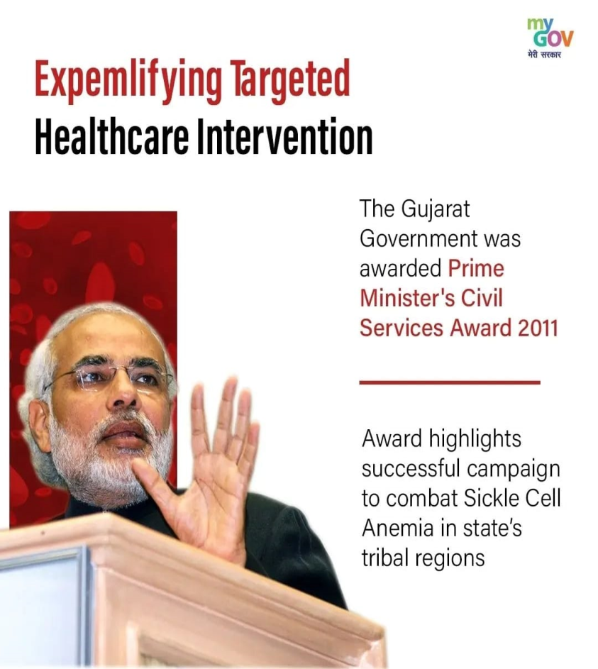
In 2011, the Commissionerate of Health & Family Planning, Gujarat, was awarded the Prime Minister’s Civil Services Award for its efforts to improve the health of the tribal people and reduce morbidity and mortality among Sickle Cell Disease patients. This initiative aimed to address the long-neglected health issues of tribal communities in India.
Valsad Raktdan Kendra is proud to be the architect of Gujarat's Modern Sickle Cell Anemia Control Program and, indirectly, of the nation, when NHM included the Sickle Cell Program in 2016.

Slide 9
Proper counseling of individuals with sickle cell disease can enhance their well-being by adhering to these guidelines.
Staying well-hydrated,
Engaging in regular physical activity,
Maintaining a balanced diet,
Getting adequate sleep,
Refraining from alcohol and smoking,
Avoiding strenuous physical activity,
Staying dry during the monsoon season,
Avoiding exposure to high temperatures, and
Taking regular doses of folic acid and hydroxyurea as advised by their doctor.
Remember: Proper counseling can help prevent 70% of crises.

Slide 10
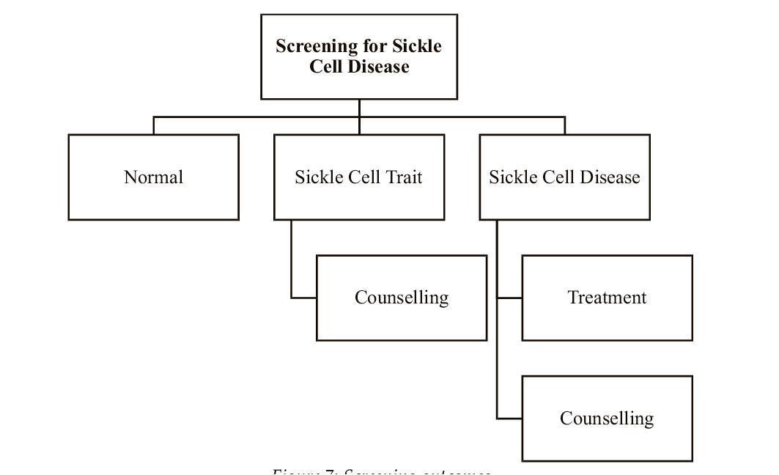
Support to SCD and SCT cases
The treatment and counseling approach.

Slide 11
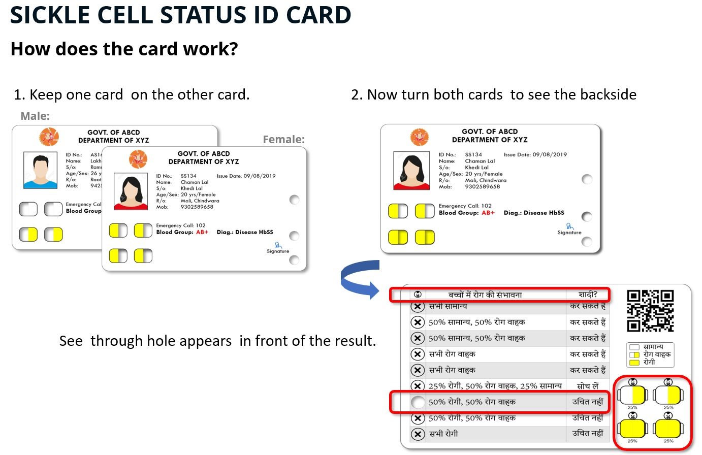
The New Central Government ID Cards

Slide 12
Information for the General public:
One can acquire SCD only from parents through genes before birth.
The sickle cell gene may also be found in non-tribal groups.
Eating rice does not cause SCD.
Sickle cell disease is not transmitted through air, water, skin, food, or any other means.
• SCD is a lifelong condition, but with proper
medical interventions, it can be well managed.
• Sickle cell trait is not a disease, and individuals
with SCT will not develop SCD as they age.

Slide 13
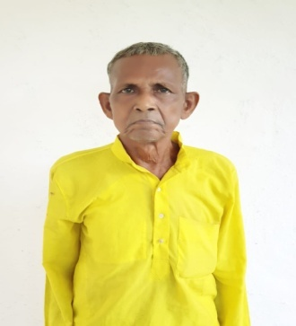
How long is a patient with Sickle Cell Anemia expected to survive?
1st Sickle Cell Disease patient
diagnosed at Valsad, Gujarat.
Diagnosed as SCD in 1978
Born: 1944 Died: 2020
Lived: 76 years
(Miss-Diagnosed & Miss-Treated for first 34 years of his life.)
Lived a better life for 42 years after diagnosis due to proper
counseling, follow-up, and regular treatment.

Slide 14
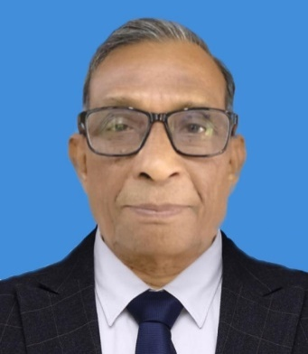
How long is a patient with Sickle Cell Anemia expected to survive?
2nd Sickle Cell Disease patient
diagnosed at Valsad, Gujarat.
Diagnosed as SCD in 1978
Born: 1940 Died: 2021
Lived: 81 years
(Miss-Diagnosed & Miss-Treated for the first 28 years of his life.)
He lived a better life for 43 years after diagnosis due to proper counseling, follow-up, and regular treatment.
Longevity is Associated with
Care Maintenance and Family Involvement.

Slide 15
Teachers’ awareness of children with SCD.
Teachers should pay special attention to children with sickle cell disease (SCD) as they require regular medication and extra fluids to prevent dehydration and increased urination.
If SCD student experiences severe pain, high fever, breathing problems, or sudden weakness, the parents or doctor should be notified immediately.
Symptoms of SCD usually appear early in life and can include swelling in the hands and feet, chest and back pain, paleness, frequent fevers, weakness, repeated infections, poor growth, and jaundice.
With regular medical care, children with SCD can live normal lives.

Slide 16
Best Characteristics of Counselling
Active Listening
- Counsellors should be fully engaged, giving the patient their undivided attention.
- They must listen to what is being said and unsaid, recognizing emotional cues.
- Active listening fosters trust and allows patients to express concerns openly.

Slide 17
Sickle Cell Anemia Counselling
Non-Directive Approach:
- Counsellors should provide information without influencing decisions.
- Patients and families should be empowered to make informed decisions based on their values, rather than feeling pressured or judged.
Empathy and Compassion:
Understanding and connecting with the patient's emotional state is crucial in genetic counseling.
Demonstrating sympathy raises a supportive environment where the patient feels valued and respected.

Slide 18
Confidentiality:
- Ensuring privacy and protecting sensitive genetic information is crucial.
- Patients must feel safe sharing personal and medical information.
Clear Communication:
- Counsellors should explain complex medical and genetic information in a clear and accessible manner using the local language.
- Avoiding complex terms and using simple language helps patients make informed choices and understand the risks involved.

Slide 19
The counselling process is
patient-centric, ethical, and effective,
enabling individuals to make informed decisions about their health and well-being.
Hydroxyurea
Should be started with monitoring of WBC, platelets, and kidney and liver function tests. In most Indian cases, it is well-tolerated.
But Remember that Hydroxyurea, once started, should be supplied uninterruptedly.
(e.g. stroke patients)

Slide 20



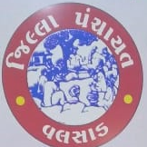

Department of Health and family Welfare
District Panchayat, Valsad &
Valsad Raktdan Kendra initiated
100% Voluntary
Universal Antenatal Screening Program for
Prevention of Sickle Cell Disease and Thalassemia Major
under
CSR (2021-22) funding from Bayer Vapi Pvt. Ltd. &
GETCO (2024-25), a Gujarat state-owned company.

Slide 21
Carrier Screening and Genetic Counseling
Preconception Screening:
Couples who are at risk (both partners carrying the sickle cell trait) can undergo genetic testing before pregnancy to determine the likelihood of passing SCD to their child.
Genetic Counseling:
Couples receive counseling on their genetic status, inheritance risks, and reproductive options. This helps them make informed decisions about family planning.

Slide 22
Antenatal Screening (During Pregnancy)
Non-Invasive Prenatal Testing (NIPT):
A relatively new and Non-Invasive technique, that involves analysing fetal DNA from the mother’s blood to screen for sickle cell disease and other genetic disorders as early as 10 weeks into pregnancy.
It is safe for both the mother and the baby and reduces the need for more invasive procedures.
Along with SCD, it can help identify chromosomal abnormalities associated with Down syndrome, Edwards syndrome, Patau syndrome, and certain sex chromosome trisomies. Many private labs carry out tests.

Slide 23
Chorionic Villus Sampling (CVS):
- CVS is performed between 10-12 weeks of pregnancy and involves taking a small sample of placental tissue to check for genetic abnormalities, including SCD.
- It allows early detection but carries a small risk of miscarriage due to its invasive nature.
Amniocentesis:
- Performed between 15-20 weeks of pregnancy, amniocentesis involves extracting a sample of amniotic fluid to test for genetic disorders.
It is more accurate than NIPT, but it is invasive and carries a slight risk of complications.

Slide 24
Pre-implantation Genetic Diagnosis (PGD)
In Vitro Fertilization (IVF) with PGD:
- Recently, we often hear about the live birth of HLA-matched savior siblings intended to cure a previously diagnosed sibling with beta-thalassemia major through a bone marrow transplant.
The couple must have patience for an average of 4 to 6 months and be prepared to spend money, just as much as the cost of a mini SUV…..
With little luxury, one can think about a “Designer’s Baby”

Slide 25
Pre-implantation Genetic Diagnosis (PGD)
In Vitro Fertilization (IVF) with PGD:
At least there should be one center (preferably at AIIMS) in every state to offer free or at low-cost services for IVF with PGD to high-risk couples (although they are fertile), who have one or more than one sibling with thalassemia major or Sickle Cell Disease or double heterozygous.
Couples who are not ready for MTP in the case of a homozygous or double heterozygous fetus after PND may benefit from this technique.
Preventing birth would be cheaper than treating the child for life, sparing the family and child from immense suffering.

Slide 26
Gene Editing Technologies
- Gene-editing technologies like CRISPR-Cas9 can potentially cure or prevent Sickle Cell Disease at the genetic level.
- Although this technology is still in the experimental stages for preventing sickle cell disease (SCD) in embryos, it aims to correct the mutation in the gene that causes sickle cell anemia.
- As this method progresses, it could become a future solution for preventing the inheritance of SCD.
- Indian companies, such as MERIL from Gujarat, intend to implement this technology at Rs. 15 to 20 lakhs.

Slide 27
Alternative Reproductive Options
- Sperm or Egg Donation:
- If one or both parents carry the sickle cell gene, they can consider using a sperm or egg donor from a person without the trait to conceive a child who will not inherit SCD.
- Adoption:
- Couples with a high risk of passing on SCD may choose adoption as an alternative to prevent the transmission of the disease.

Slide 28
Ethical Considerations:
- Informed Decision-Making:
- Couples must be fully informed about their options, the risks involved in invasive testing, and the emotional, ethical, and cultural factors influencing their decisions.
- Respect for Autonomy:
- Couples should have the freedom to make their own decisions based on their values and beliefs, free from external pressure.
The couple can opt out of the PND program at any time, even after the PND is completed and the fetus is either homozygous or double heterozygous.

Slide 29
Conclusion:
Modern technologies such as carrier screening, prenatal testing, in vitro fertilization (IVF) with preimplantation genetic diagnosis (PGD), along with emerging techniques like CRISPR provide promising methods for preventing the childbirth of children with sickle cell disease. When coupled with effective genetic counseling, these advancements empower families to make informed and ethical reproductive decisions.

Slide 30
National Sickle Cell Anemia Elimination Mission
Social Support Schemes
- The mission aims to provide affordable and accessible healthcare, improve the quality of care, and reduce the prevalence of Sickle Cell Disease (SCD)
Sickle Cell Disease Support Corner
This portal from the Ministry of Tribal Affairs provides information and resources about SCD, and allows people with SCD or SCD traits to register voluntarily.

Slide 31
Social Support Schemes
Patient Support Groups (PSG)
These groups are facilitated by frontline workers to improve treatment compliance and engage patients, family members, and caregivers.
Some hospitals, like AIIMS Nagpur, also offer support services for SCD patients, including priority access to care, financial assistance, and accommodations.
Awareness generation and premarital counseling
These efforts aim to educate people about SCD and screening services. The government has spared a separate budget for awareness program.

Slide 32
Social Support Scheme
Financial Help
In Gujarat, patients with Sickle Cell Disease along with Thalassemia, Cancer, and AIDS receive Rs. 2,500/- per month. In Maharashtra, the amount is Rs. 1,500/-. This assistance varies from state to state.
Free blood units are available at all blood centers throughout India.
In Maharashtra, the education department published a GR stating that SCD patients will receive an additional half an hour during examinations.

Slide 33
Centres of Competence (CoCs)
GoI intends to establish 16 Centres of Competence for early diagnosis and treatment of Sickle Cell Disease (SCD) (unit cost: ₹6 crore).
Diagnose Sickle Cell in the foetus to detect carrier status.
Allow termination of pregnancy for foetuses diagnosed with Sickle Cell Disease up to 24 weeks.
Patient/Social Support System
Generate awareness about Sickle Cell Disease.
Reassure carriers that they can lead normal, healthy lives.
Support field-level health efforts for SCD.
Emphasize the importance of prenatal testing and provide counselling for affected pregnancies.
*₹96 crore for establishing 16 Centres of Competence (CoCs) and ₹100 crore for awareness generation and counselling efforts.

Slide 34
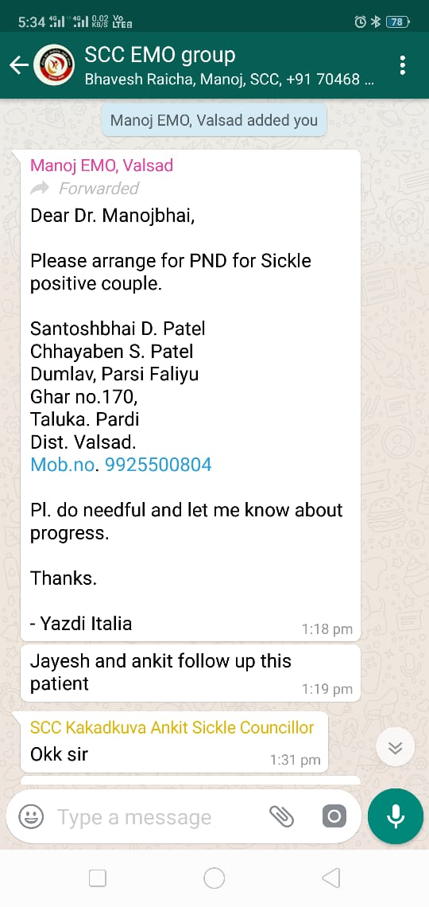
Role of Sickle Cell Counselors & EMO
Govt. of Gujarat has appointed 184 sickle cell counselors. They are supposed to be in touch with all identified/registered SCD patients. They are supposed to help not only in crisis but also in getting all government-offered privileges like disability certificates, monthly dolls, arranging hospitalization, follow-up, and reporting. High-risk couples were counseled for PND, and those who gave consent were subjected to PND before 20 weeks of pregnancy.
Simply inform the EMO (nodal officer in the district) and he will put up the contact details in the WhatsApp group. The nearby area counselors will contact the couple and will do the necessary counseling and with their consent, will arrange for free PND.
The couple has a right to opt out of this program at any time.

Slide 35
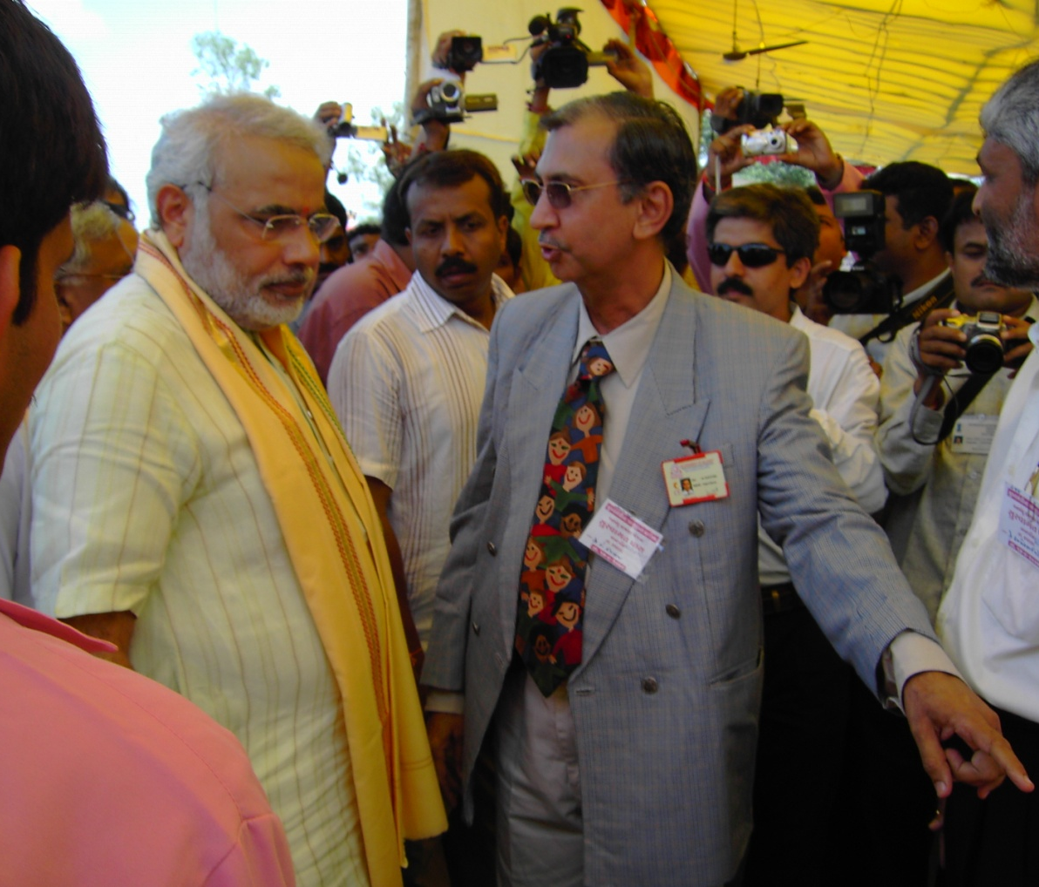
Man Behind the Success of Sickle Cell Program in India
- A Strong Political Will
Hon. Prime Minister Shri Narendra Modi, then Chief Minister of Gujarat, attentively engaged with attendees to understand Sickle Cell Disease during a Comprehensive Sickle Cell Camp.

Slide 36
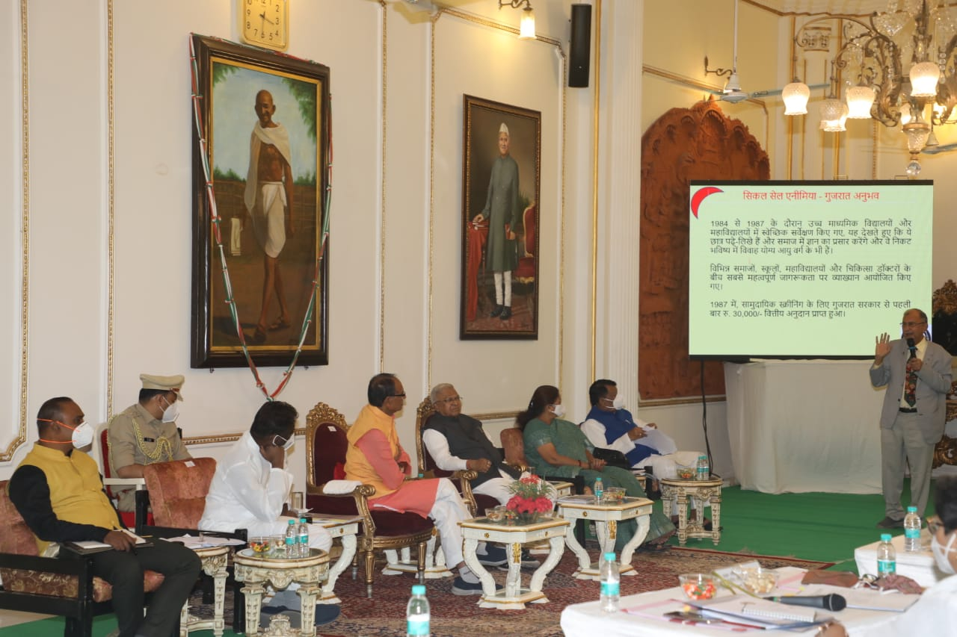
Political Awareness at Rajbhavan, Bhopal, Madhya Pradesh

Slide 37
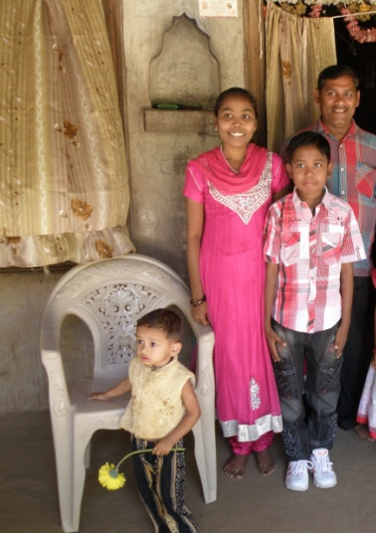
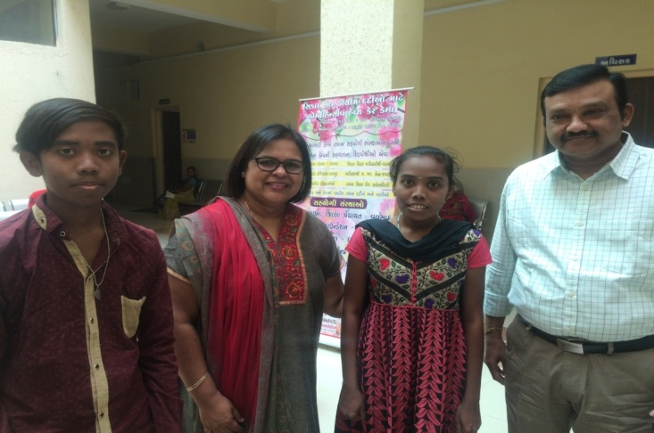
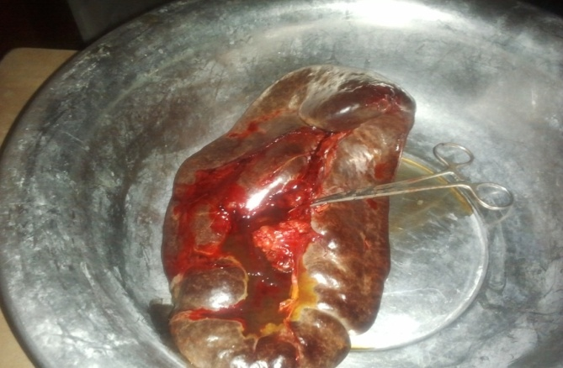
Case Study
14-year-old SCD transfusion-dependent schoolboy with a huge spleen. Difficult to get blood for transfusion because of antibodies. Advised splenectomy but reluctant for splenectomy.
Finally, told:
“Do you want to die with spleen or live without spleen”
Finally operated in February 2012. Died in September 2020.
Before splenectomy, autologous blood was collected for future use, but no further transfusion was required.
Spleen size 20 CM
Weight 1.65 Kg.
Better growth within the next 2 years.
Younger brother looks taller than elder sister

Slide 38
Just think of
a Short-Term Goal
&
a Long-Term Goal
!!!!!!!
Just let us give thought to
a Short term Goal
&
a Long Term Goal
!!!!!!!

Slide 39
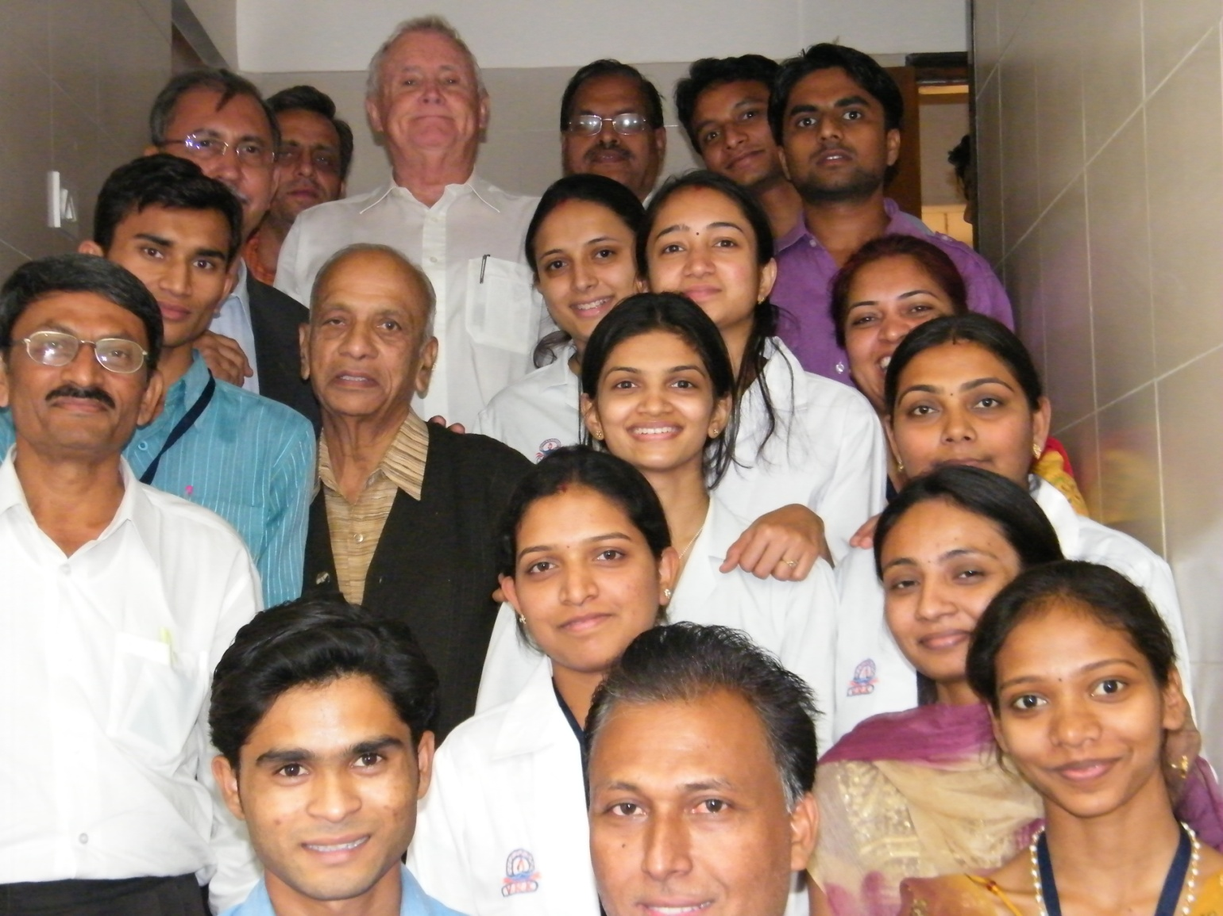
We had many visitors from India and abroad,
those who are left are all invited at Valsad, Gujarat - कुछ दिन तो गुजारो गुजरातमे

Slide 40



Slide 41
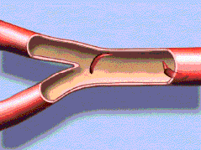
Our Sicklers are
Born with Pain
Live with Pain
&
Die with Pain.
They hardly Complain.
Thank you very much
for paying attention to them.
- Dr. Yazdi Italia

