Slide 1
National Training of Trainers on National Sickle Cell Anemia Elimination Mission; 23rd-24th October, Bhopal
NGO perspective on understanding patients living with Sickle Cell Disease
Gautam Dongre
Secretary,
National Alliance of Sickle Cell Organizations, NASCO.

Slide 2
NASCO is a voluntary, non-profit National consortium of 20 + like-minded organizations constituted by patient advocacy groups (PAGs).

Slide 3
NASCO’S Office Inauguration By Hon. Minister of Road Transport & Highways Shree Nitin Gadkari Ji

Slide 4
Role of the National Alliance of Sickle Cell Organization (NASCO)
PURPOSE
NASCO’s aims to unite various organizations working on sickle cell disease across the country.
OBJECTIVES
Advocate for better policies and programs for sickle cell disease management
Promote awareness about the condition
Support research initiatives Improve care and support for patients with sickle cell disease
20 millions Sickle Cell Trait

Slide 5
Role of the National Alliance of Sickle Cell Organization (NASCO)
Advocacy and awareness
campaigns.
Support groups and networking.
Collaborating with healthcare
providers and researchers.
Policy influence and change.

Slide 6
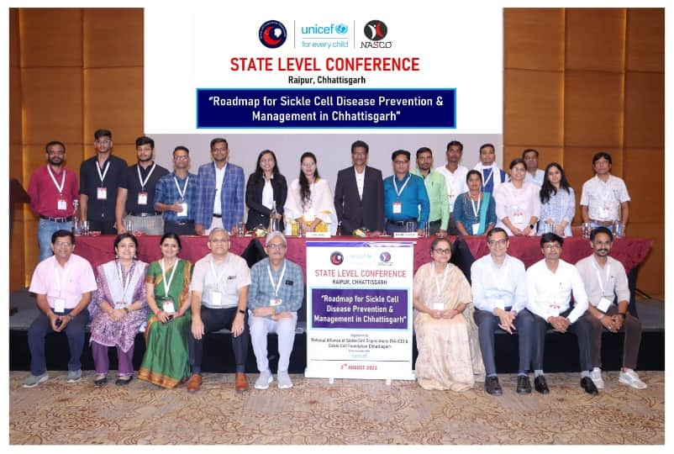
Activities of NASCO
Organizing International & National SCD Conferences

Slide 7
NASCO Chennel
UDAAN Series
Sickle Cell SAMWAD

Slide 8
NASCO 7X7 Monthly Meetings (lkFk&lkFk)

Slide 9
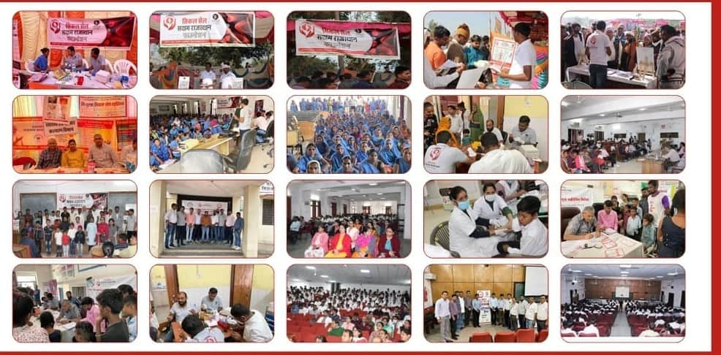
NASCO’s Support to Member Organizations Activities

Slide 10
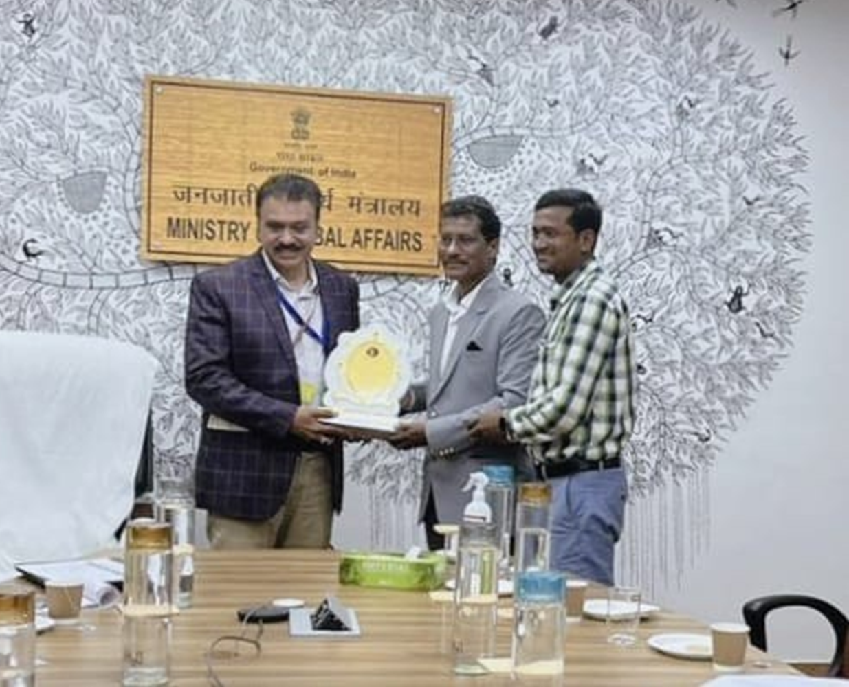
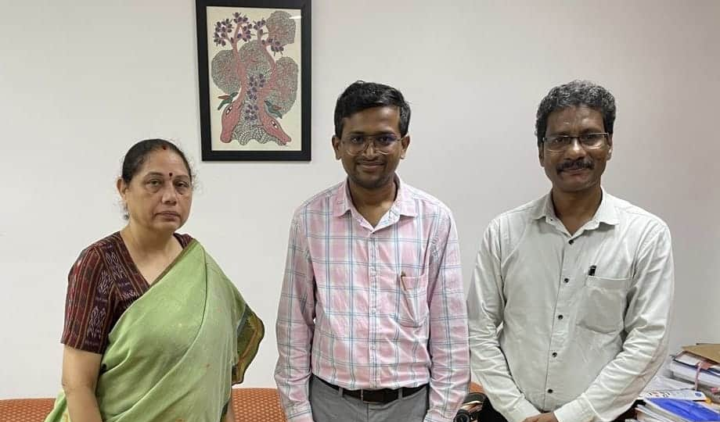
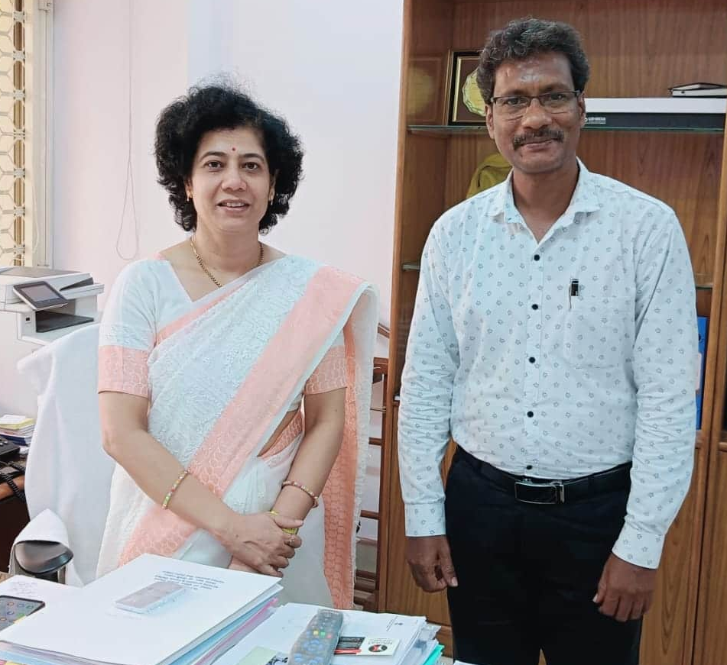
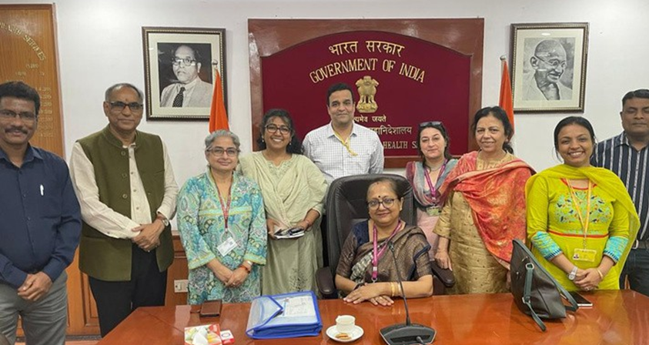
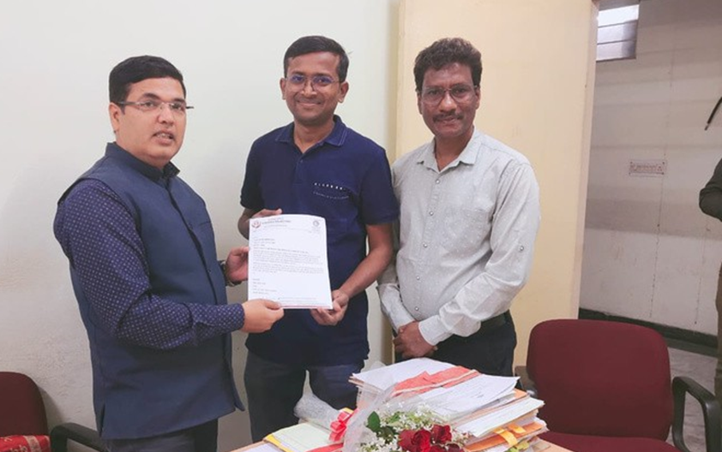
NASCO’S Advocacy to National & State Govt.

Slide 11
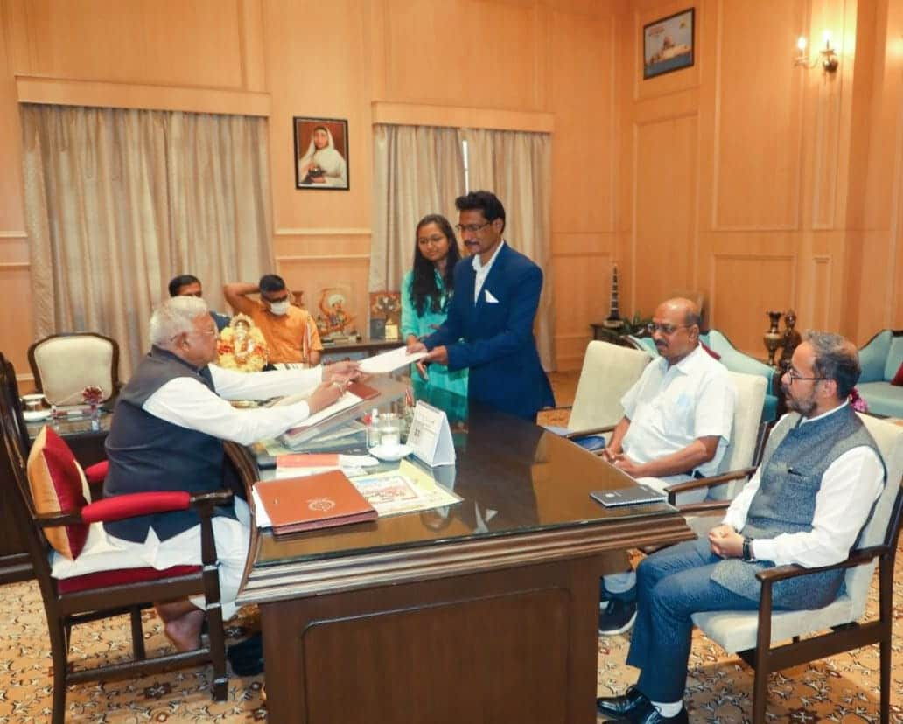
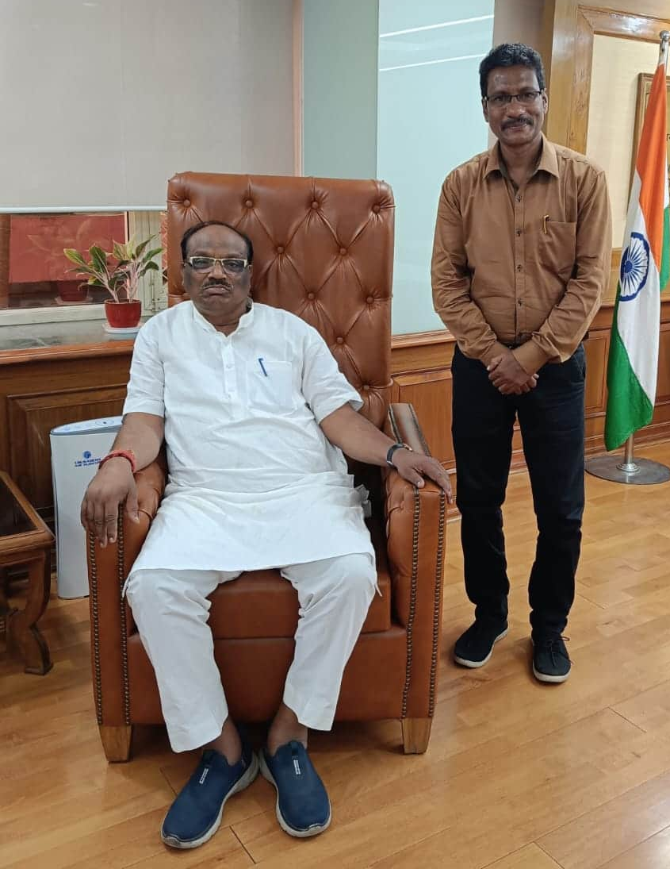
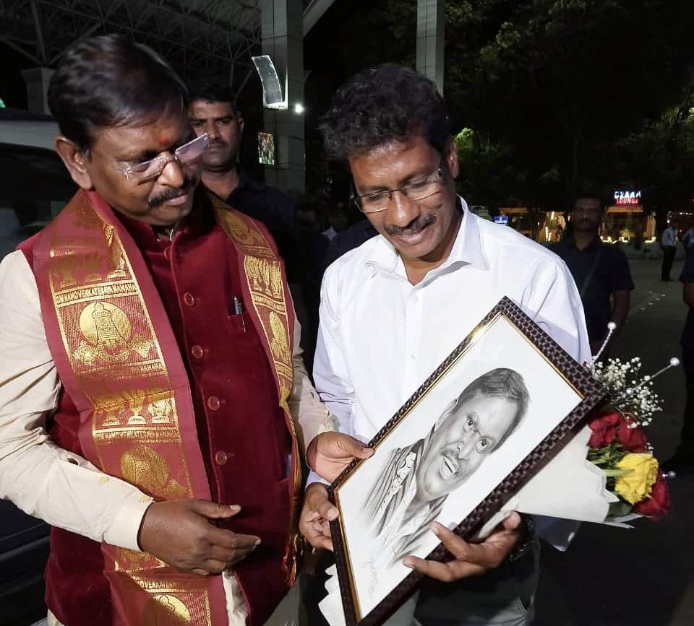
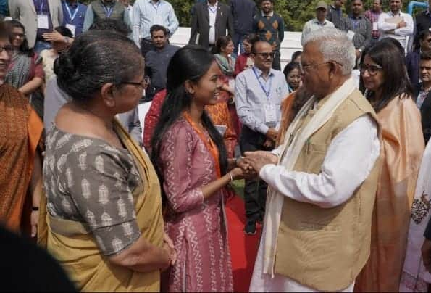
Advocacy to Public Representatives

Slide 12
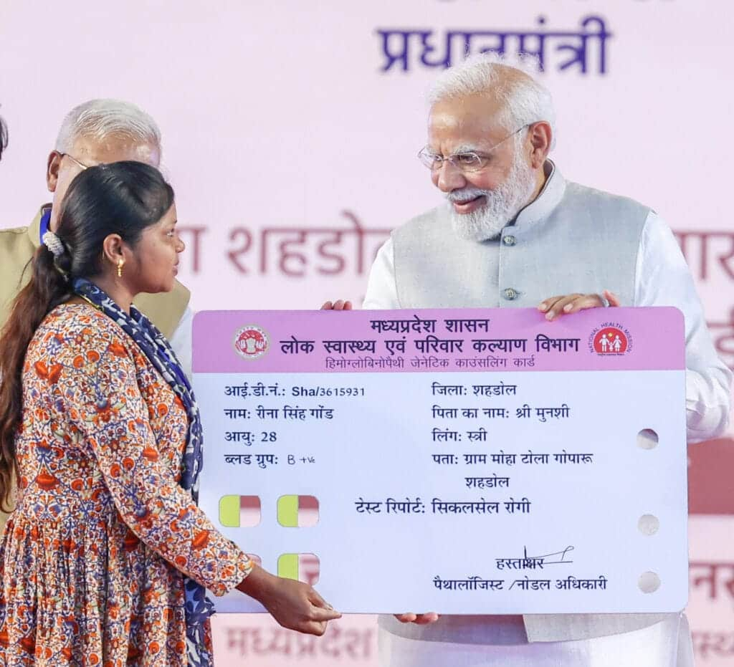
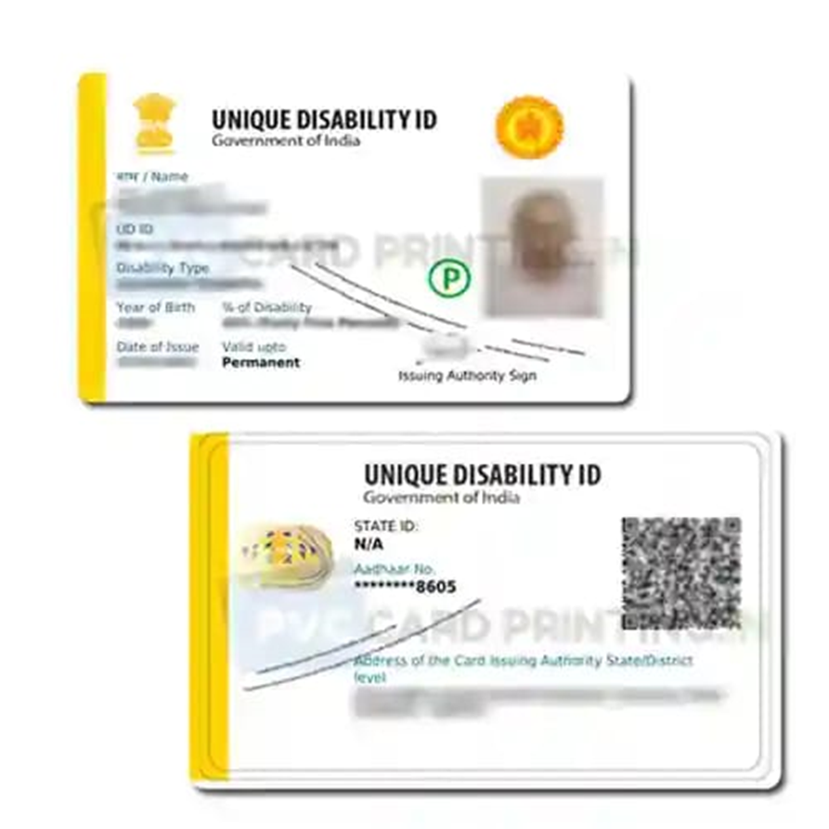
Achievements
Hon. PM announced “National Sickle Cell Elimination Mission till 2047”
UDID Card Parment
Hydroxyurea in EDL

Slide 13
"The Sickle Cell Elimination Mission 2047 aims to reduce the burden of SCD in India. The national SCD patients community (NASCO) plays a vital role in achieving this goal.”
Raising awareness
Advocating for policy changes
Supporting research and screening
Empowering patients and families

Slide 14
Support & Collaboration
Government State & Central
Pharmaceuticals Companies
Corporate CSR
NGO’s
Social Workers
Societies

Slide 15
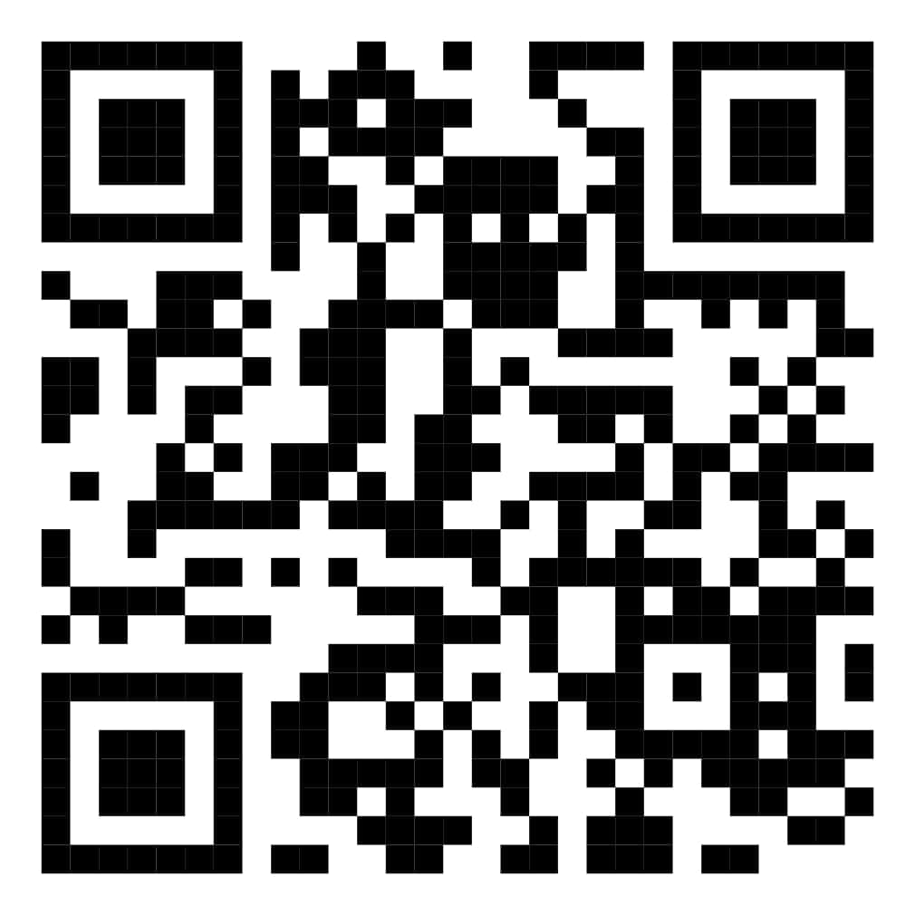
THANK YOU
Gautam Dongre
Secretary,
National Alliance of Sickle Cell Organizations, NASCO.
Board Member, Global Alliance of Sickle Cell Disease Organizations, GASCDO
Contact - +91 9421709245
Email - indiascdalliance@gmail.com
gautamndongre04@gmail.com
Website- www.nascoindia.org

