Slide 1
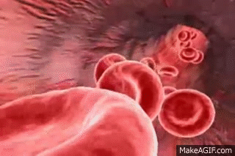
Sickle Cell Disease and RBC Exchange Transfusion
Dr. Aseem K Tiwari, Senior Director, Transfusion Medicine, Medanta-Gurugram

Slide 2
Outline
Scale of problem (SCD)
Sickle Cell Disease
  Description
  Inheritance
  Pathophysiology
  Clinical presentations/Complications
  Management
Transfusion in SCD
  Guidelines
Exchange Transfusion
  Indications
  Overview
  Illustration
Summary
Acknowledgements
Dr. Swati Pabbi
Dr. Geet Aggarwal
Institute for Health Metrics and Evaluation/Lancet Hematology
British Journal of Hematology
American Society for Apheresis

Slide 3
Scale of Problem
(Significant Disease Burden)

Slide 4
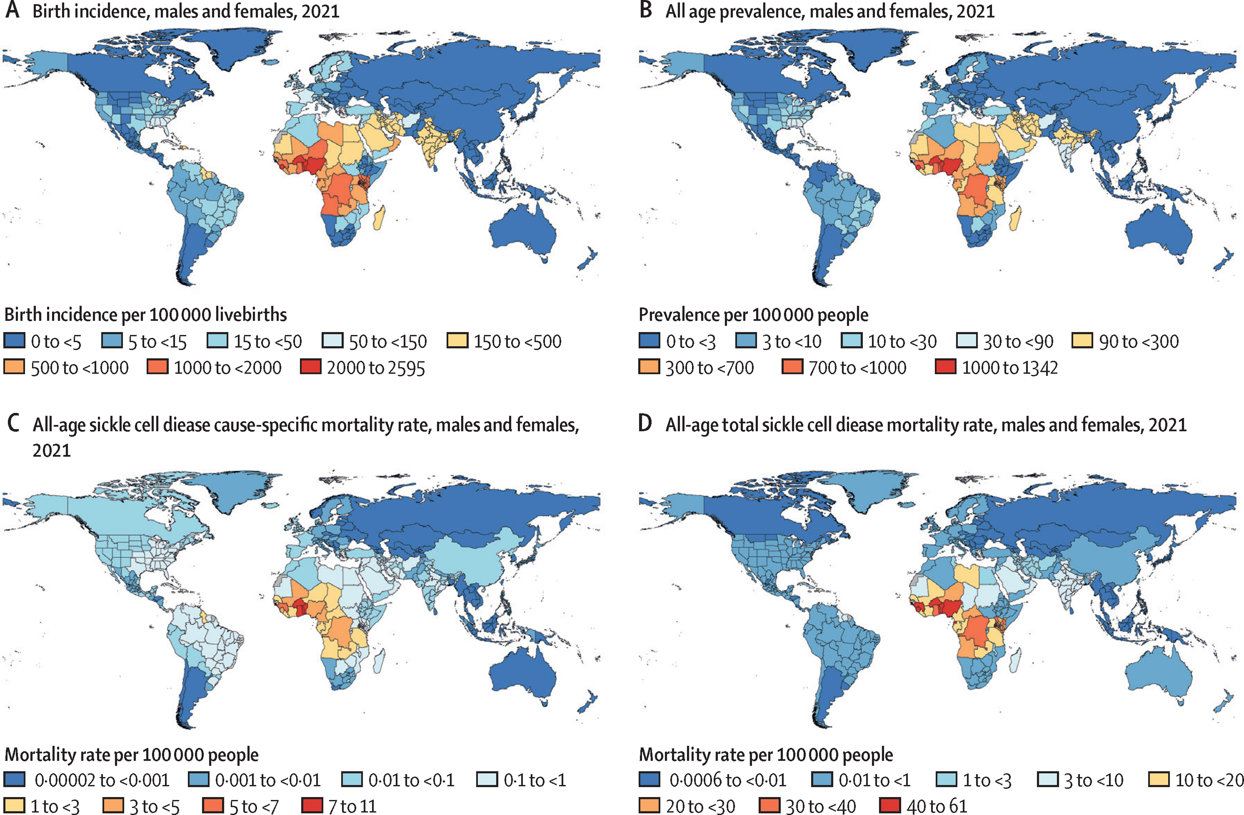
Incidence/Prevalence(SCD)
Background
Disease Burden
Global, regional, and national prevalence and mortality burden of sickle cell disease, 2000–2021: a systematic analysis from the Global Burden of Disease Study 2021.Thomson, Azalea M et al.The Lancet Haematology, Volume 10, Issue 8, e585 - e599

Slide 5
Sickle Cell Disease
(SCD)

Slide 6
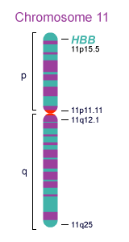
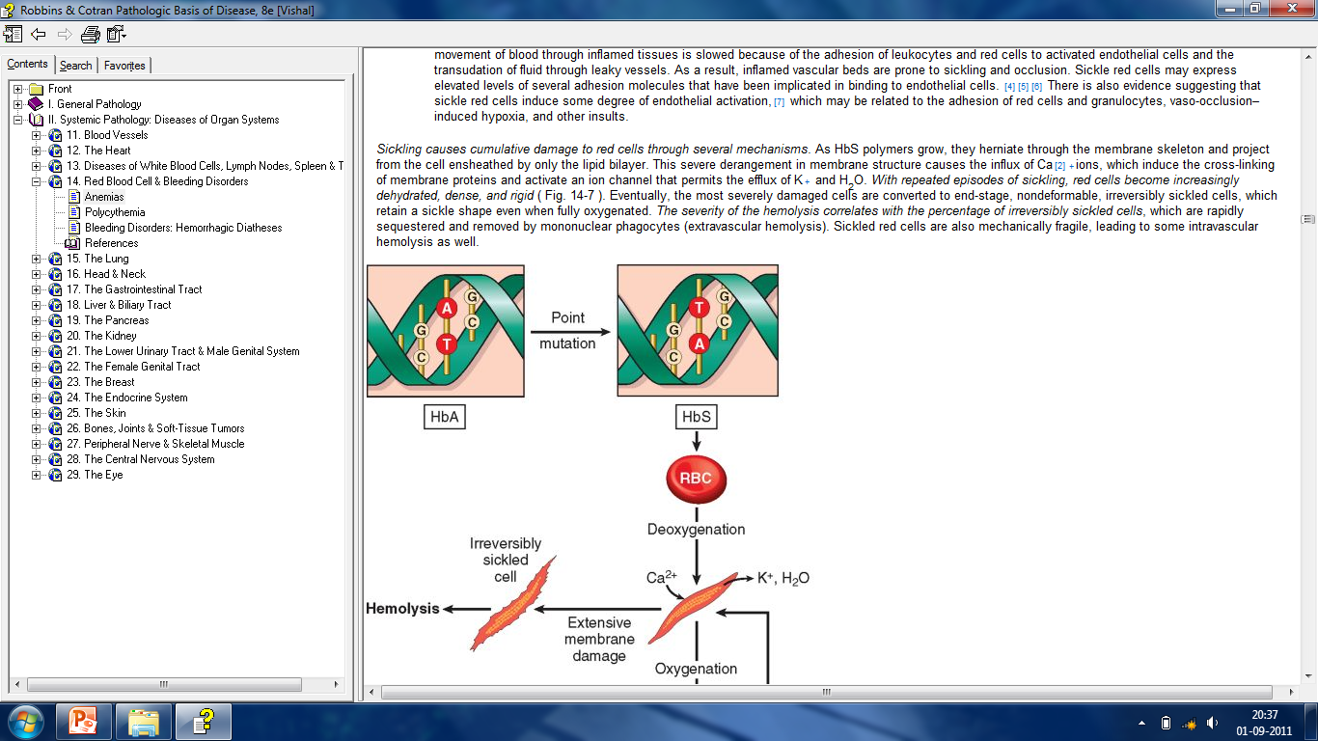
Sickle Cell Disease (SCD)
Description
The gene related to sickle cell anemia is the β hemoglobin gene (Hb β)
The Hb β gene is found on chromosome 11
The β Hb protein is 146 amino acids long

Slide 7
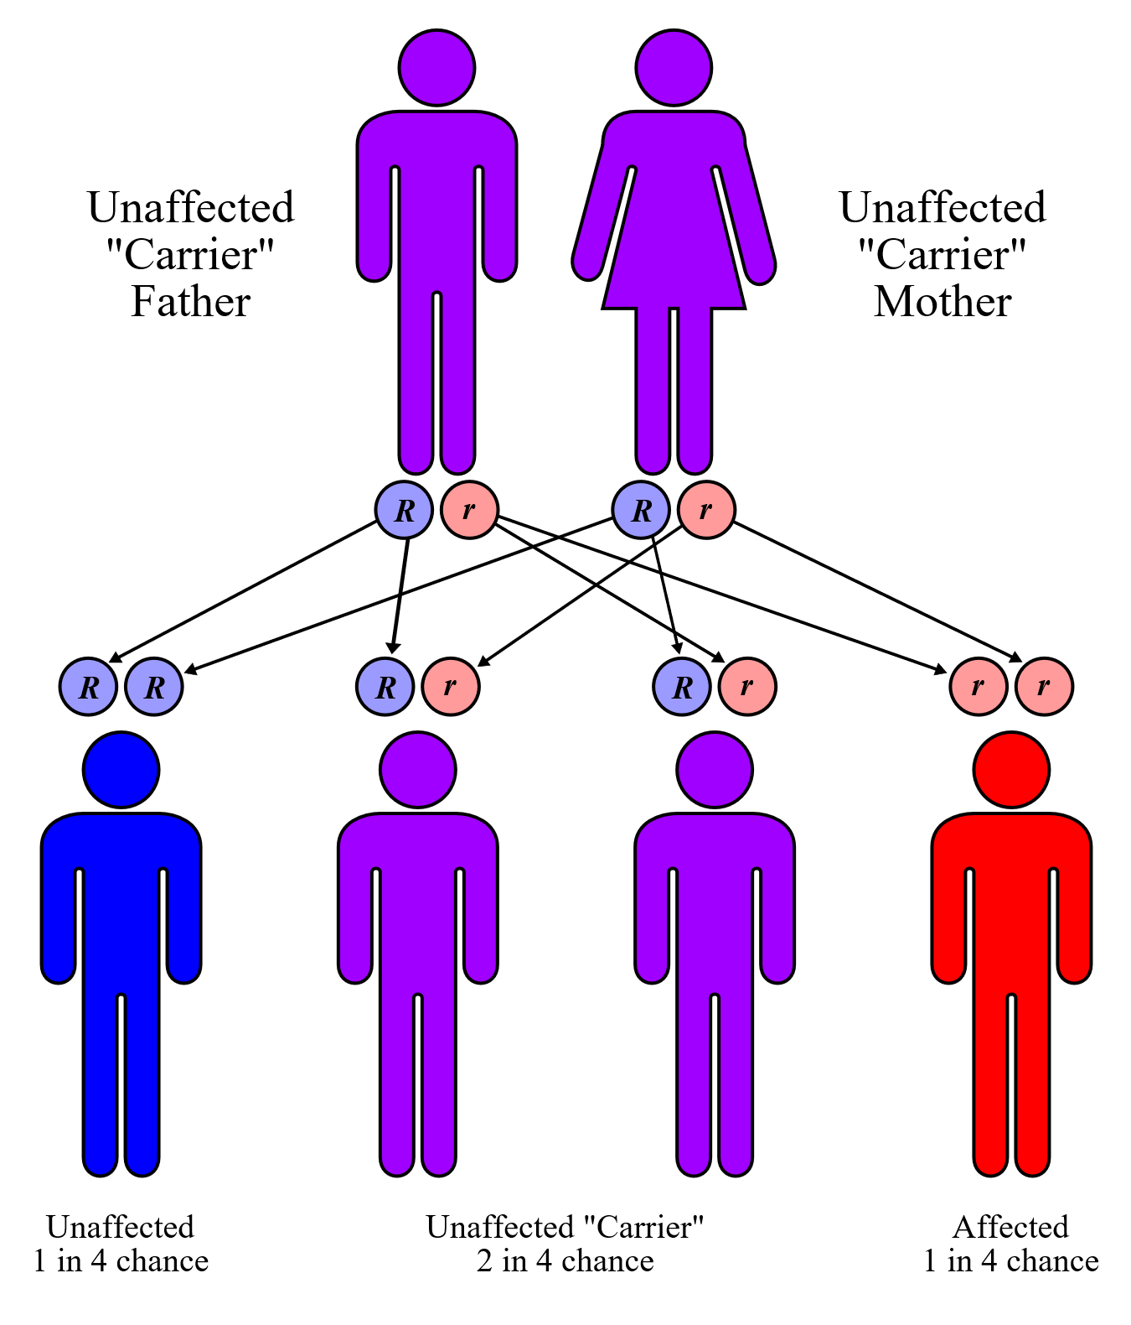
SCD (Inherited RBC disorder)
Inheritance
Hemoglobin
Alpha
Alpha
Beta
Beta S
Hemoglobin
Alpha
Alpha
Beta S
Beta S
Sickle Cell trait
Sickle Cell Disease

Slide 8
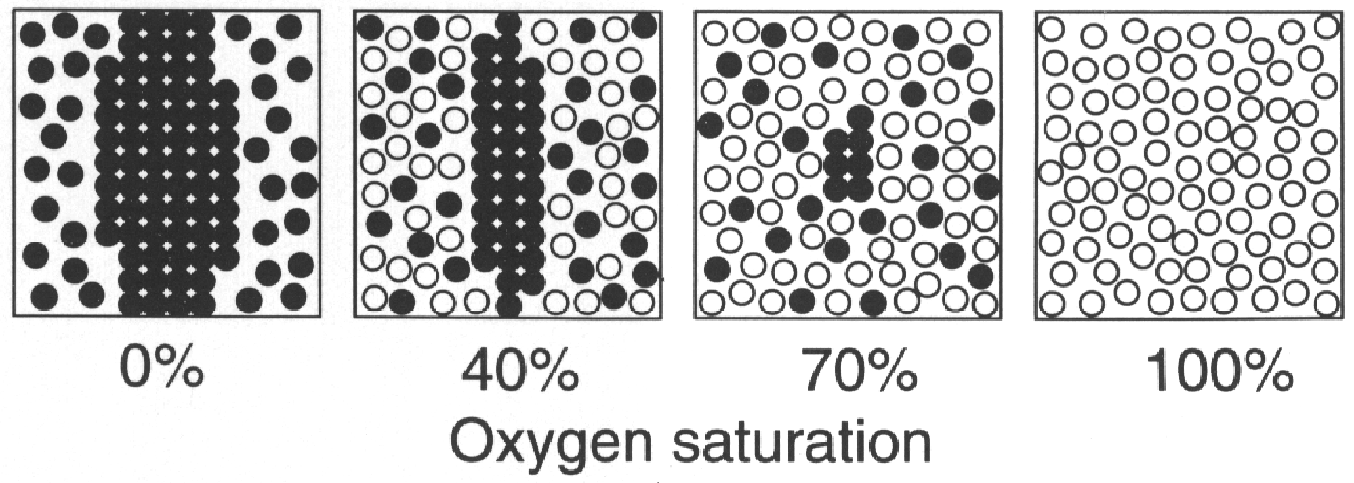
Pathophysiology
Pathophysiology
When oxygenated…
When deoxygenated
- O₂
+ O2
Normal Hb molecules allows red cell to be round, and deformable
Hb S molecules aggregate and polymerize into long fibers resulting in formation of sickle cell

Slide 9
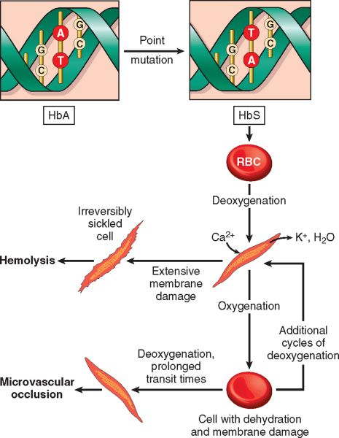
Pathophysiology
Pathophysiology
Chronic hemolytic anemia (Sickle cells lifespan 10 to 20 days)
Chronic Hypoxia
Capillary stasis & thrombosis
Ischemia and Infarction

Slide 10
Clinical Presentations of Sickle Cell Disease
Clinical features
Delayed growth and puberty in children
Anemia/ Infections
Acute Chest Syndrome/ Stroke
Organ damage/ Splenic crises
Renal complications
Slow growth/ Priapism
Gallstone
Ulcers on the legs/Joint problems
Pulmonary Arterial Hypertension
Multiple Organ Failure
Hand-Foot Syndrome / Eye problem
Pain episodes/Vaso-occlusion

Slide 11
Management
Management
Treatment is symptomatic/control and management of disease complications (Fluids, supplemental oxygen, antibiotics, analgesics {including opioids})
Physiotherapy
Vaccination (hepatitis B vaccination)
Blood Transfusion (Simple {top up} Transfusion/Exchange Transfusion
Allogenic HPC transplantation
Gene therapy

Slide 12
Transfusion in Sickle Cell Disease
(Tx in SCD)

Slide 13
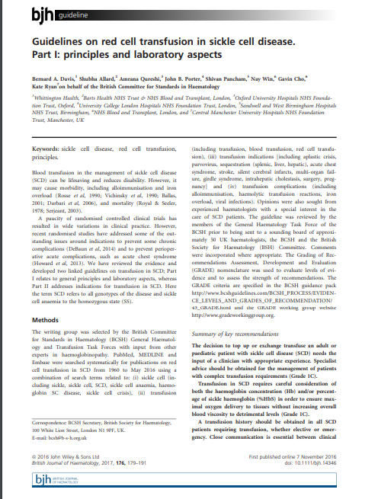
Transfusion Guidelines
Transfusion

Slide 14
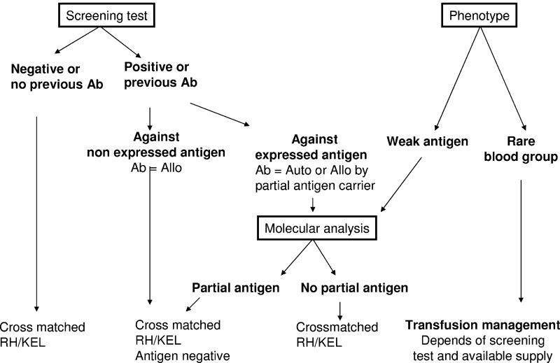
Transfusion Guidelines
Transfusion

Slide 15
Exchange Transfusion
(RBC Exchange)

Slide 16
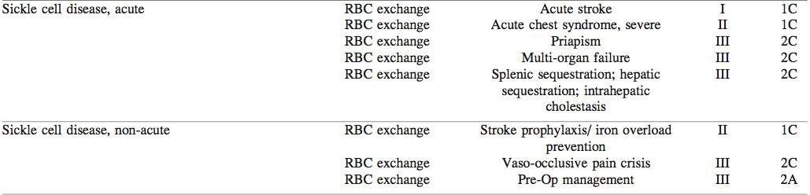
Indications for RBC Exchange Transfusion
Exchange Transfusion
ASFA Guidelines

Slide 17
RBC Exchange - removing sickled red cells and replacing them with healthy donor cells
Exchange Transfusion
Process Overview (Blood Tx in Mx of SCD can be lifesaving and reduces disability. However, it may cause morbidity, including alloimmunization, hyperviscosity and iron overload )
  improving oxygen-carrying capacity by correcting anemia
  Preventing/reversing complications of SCD related to vaso-occlusion and hemolysis (by decreasing the proportion of HbS in relation to HbA)
Types: Manual vs Automated exchange
Procedure Steps

Slide 18
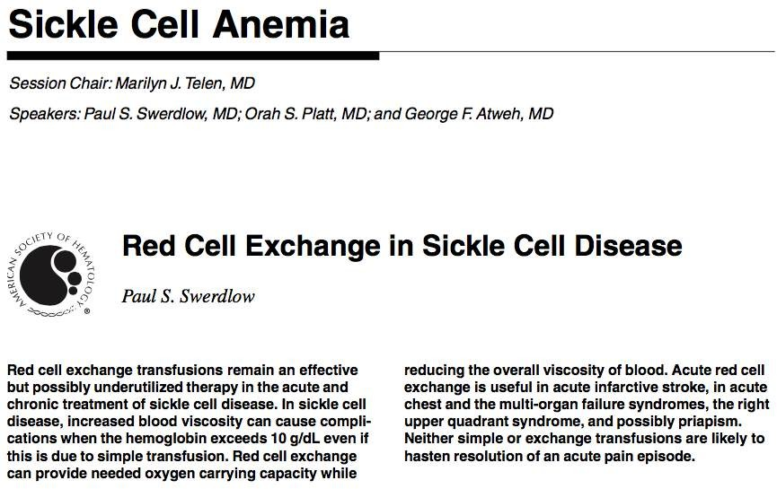

Slide 19
Exchange Transfusion
(Illustration)

Slide 20
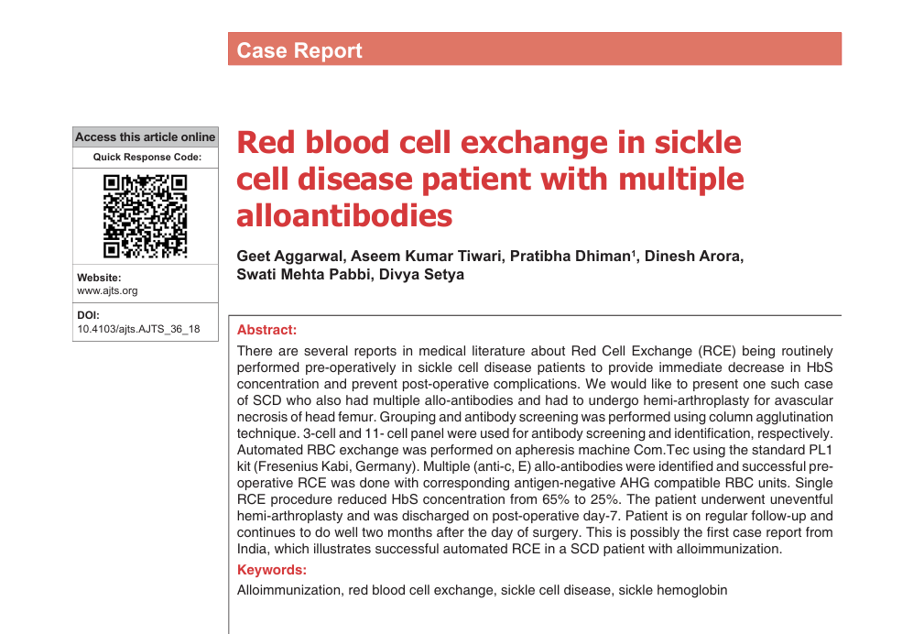
Illustration
Case report
Multiple case reports have been published on use of RBC exchange in SCD. However, none of these reports have included SCD patient with previous allo- immunization
Report of a successful RBC exchange in an allo-immunized SCD patient undergoing hemi- arthroplasty

Slide 21
Case Description
Background
A known homozygous SCD (HbSS) patient, 18-year old male, presented with pain in right hip and difficulty in walking (limping)
as the principal complaint. Patient was diagnosed with avascular necrosis of head femur and advised right hemi- arthroplasty
Hematological consultation included blood group and antibody screen. Blood grouping and antibody screen was performed on an automated platform Vision {Quidel Ortho, USA} using CAT technique. 3-cell panel {Surgiscreen} and 11- cell panel {Resolve Panel A} with additional select cells were used to identify the specificity of the antibody
Blood Group | Antibody Screen | Antibody identified
A Pos | Positive | anti-c and anti-E

Slide 22
Management (Planned RBC exchange)
Management
Very high HbS concentration warranted an RBC exchange before the patient could be taken up for hemi-arthroplasty of the hip joint
Ten c and E antigen negative, anti-human globulin (AHG) crossmatch compatible RBC units (A Pos/Neg or O Pos/Neg) were identified from the inventory for planned RBC exchange
Hemodialysis type double lumen 16F catheter was inserted in left femoral vein for unhindered blood flow during the apheresis procedure
RBC exchange was performed on apheresis machine (Com.Tec, Fresenius Kabi, Germany) using the PL1 kit (Fresenius Kabi, Germany)

Slide 23
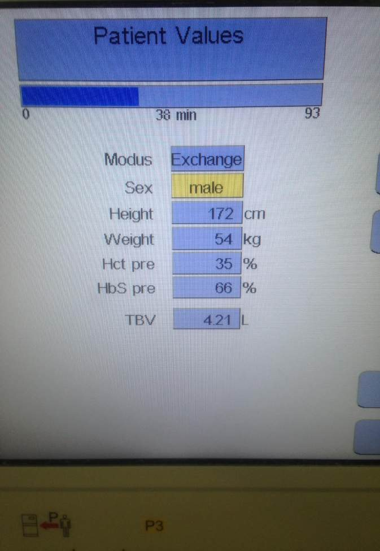
RBC Exchange
RBC Exchange (demographic/test values)
The machine has inbuilt software program for performing RBC exchange. As part of pre-procedure requirements, demographic details of patient including gender, weight and height along with hematologic parameters including hematocrit (HCT) and HbS (66 %) were entered in the software

Slide 24
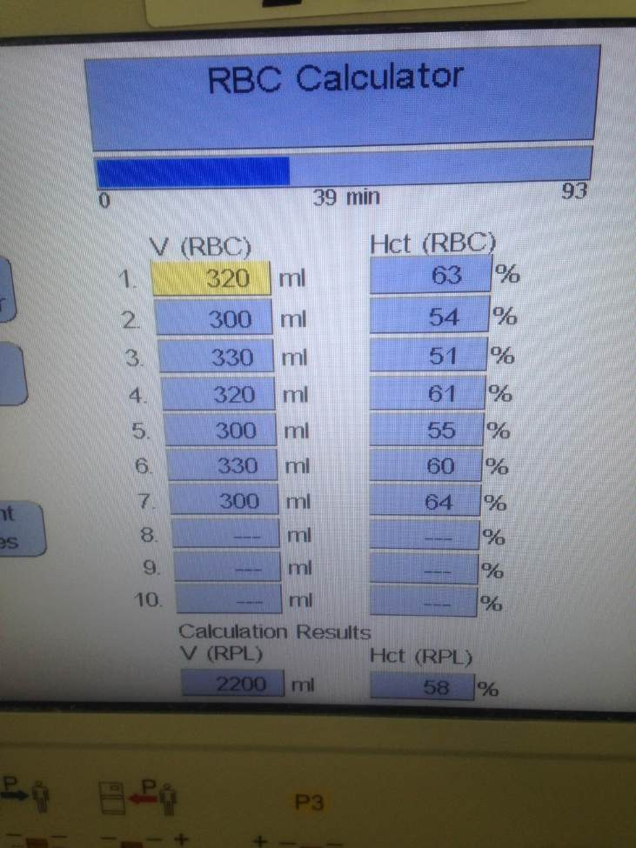
RBC Exchange
RBC Exchange (seven donor units)
Details of seven donor RBC units (HCT) were entered in the RBC calculator
The software predicted post-procedure HCT at 34.5% and HbS at 28% when the volume of RBC exchange was set at 2200ml (Actual 35% HCT and 25.6 HbS)

Slide 25
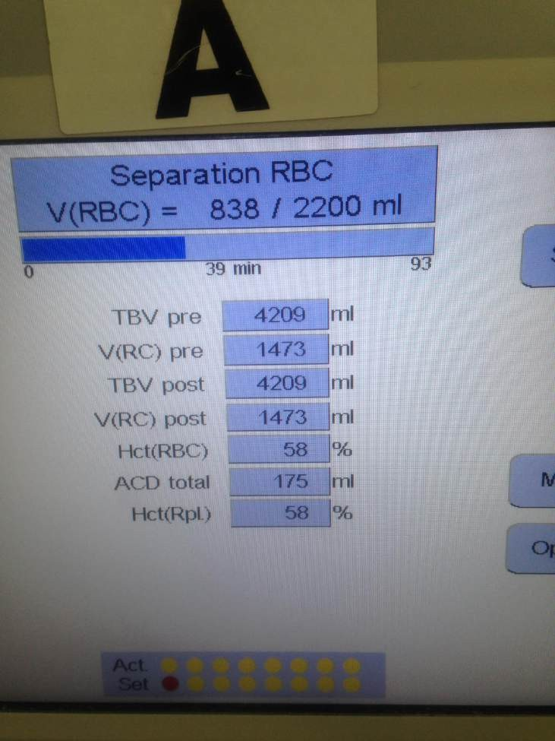
RBC Exchange
RBC Exchange (procedure lasted 95 minutes)
Total Blood Volume pre – 4209 ml/RBC pre – 1473/HCT - 58
Total Blood Volume Post – 4209/RBC pre – 1473/HCT – 58
Vitals monitored throughout procedure
Prophylactic IV Ca

Slide 26
Hemi-arthroplasty surgery
RBC Exchange
Patient underwent hemi-arthroplasty of the right hip joint on the following day. Surgery was uneventful and patient was transfused one unit RBC during surgery and one unit later in post-operative period
Clinical course uneventful, over next one week; discharged on post-operative day 7; Advised bed rest for six weeks
Patient is able to walk with support, on follow-up at day-45. The patient has been advised allogeneic BMT to cure SCD and his brother is being investigated as potential stem cell donor
This was possibly the first case report of successful RBC exchange in an alloimmunised SCD patient

Slide 27
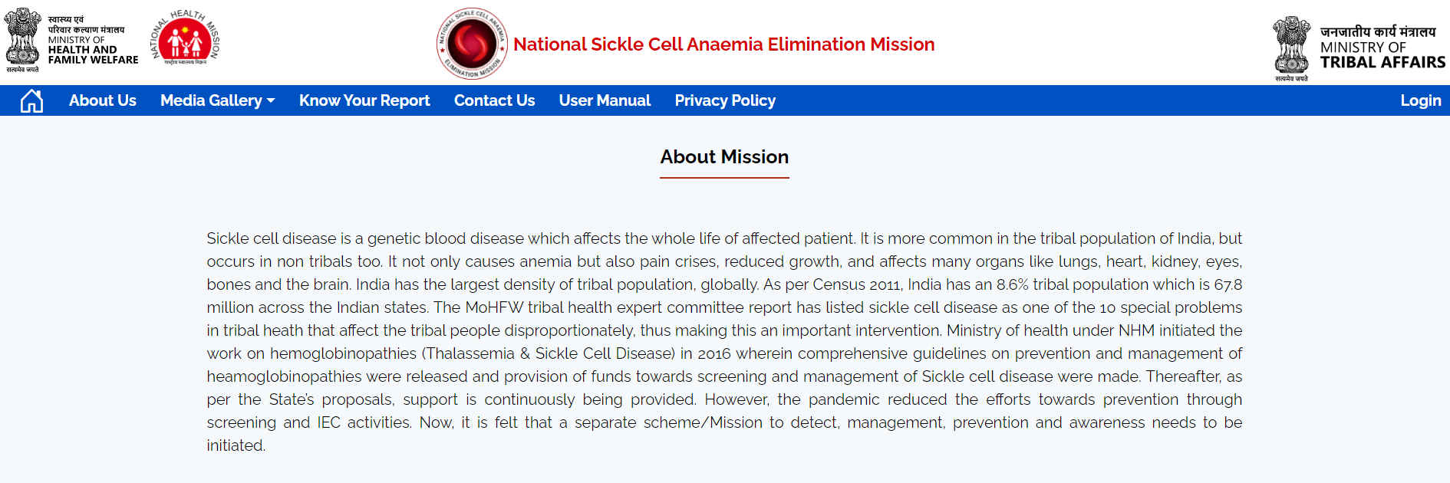
National Sickle Cell Anaemia Elimination Mission
Background
Strategy: THREE pillars: Health Promotion/Prevention: Universal screening and early detection/Holistic Management & Continuum of Care
3rd pillar: Important to have capabilities to detect and identify alloantibody(s) and perform therapeutic RBC exchange (tertiary-care level)

Slide 28
Summary
India has substantial burden of SCD, specially in tribal population (300-700/100,000). Point mutation in haemoglobin beta chain leads to either carrier (heterozygous) or disease (homozygous)
At lower oxygen saturation, RBC assume sickle shape, leading to chronic hypoxia, haemolytic anaemia, capillary stasis, and thrombosis. The clinical feature/complications include anaemia, growth retardation, organ damage, pain crisis, acute chest syndrome, stroke, etc
Management includes symptomatic treatment, vaccination, simple blood transfusion, RBC exchange transfusion, and HPC transplantation

Slide 29
Summary
Indications of RBC exchange Tx are acute stroke, severe acute chest syndrome, pre-op management
An illustration describes successful RBC exchange transfusion, followed by surgery and patient doing well at follow-up
Strategy of National Sickle Cell Anemia Elimination Mission has three pillars: Health promotion/prevention, universal screening and early detection/holistic management & continuum of care
Under holistic management & continuum of care, there has to have capacity building to detect and identify alloantibody(s) and perform therapeutic RBC exchange (tertiary-care level)

Slide 30
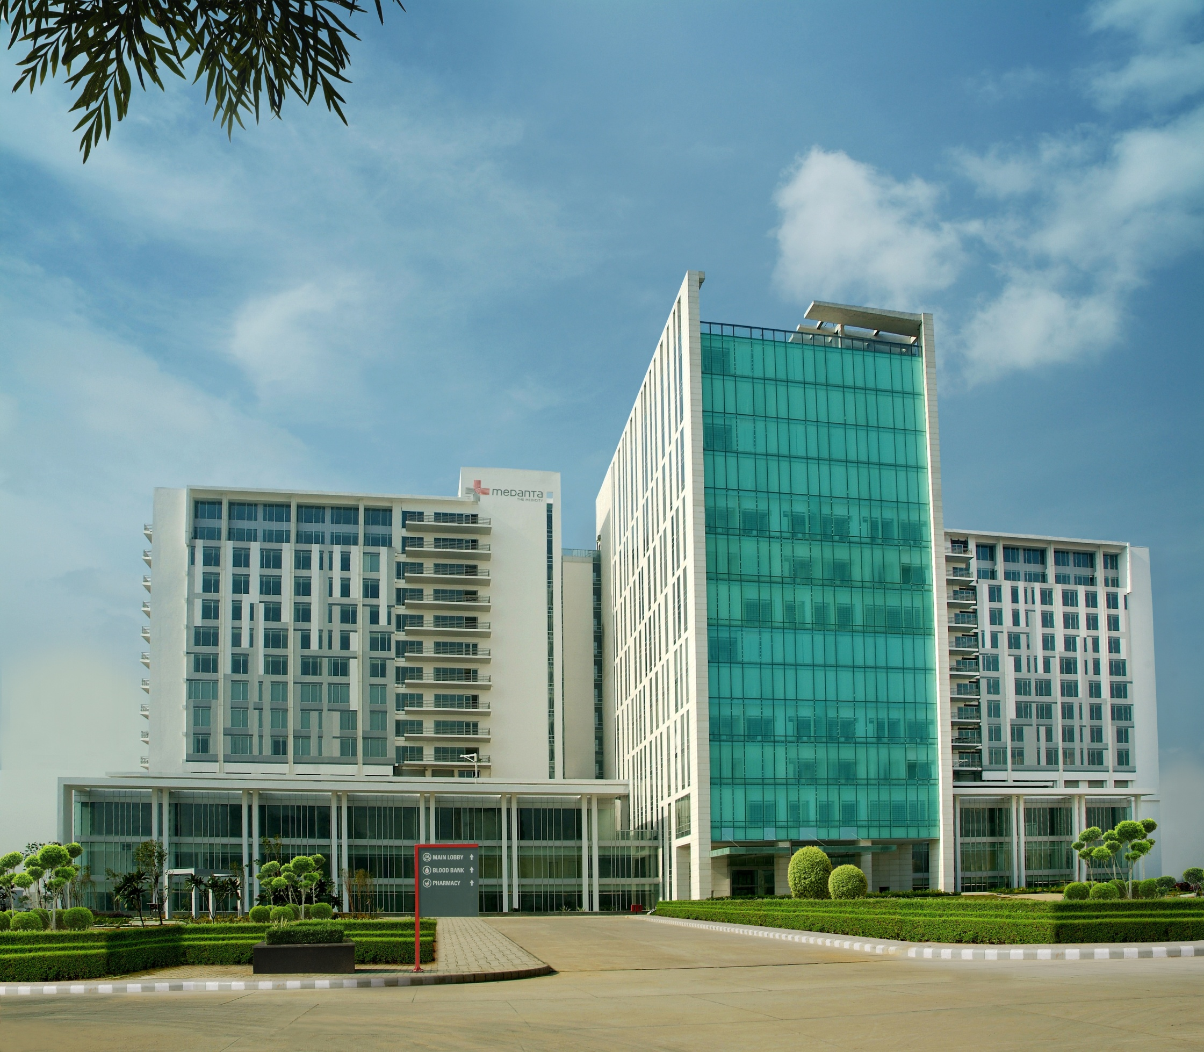
Perioperative blood transfusion and blood conservation in cardiac surgery: the Society of Thoracic Surgeons and The Society of Cardiovascular Anesthesiologists clinical practice guideline .Ann Thorac Surg 2007
Thank You
Based on available evidence, institution-specific protocols should screen for high-risk patients, as blood conservation interventions are likely to be most productive for this high-risk subset. Available evidence-based blood conservation techniques include (1) drugs that increase preoperative blood volume (eg, erythropoietin) or decrease postoperative bleeding (eg, antifibrinolytics), (2) devices that conserve blood (eg, intraoperative blood salvage and blood sparing interventions), (3) interventions that protect the patient's own blood from the stress of operation (eg, autologous predonation and normovolemic hemodilution), (4) consensus, institution-specific blood transfusion algorithms supplemented with point-of-care testing, and most importantly, (5) a multimodality approach to blood conservation combining all of the above

