Slide 1
स्वास्थ्य एवं परिवार कल्याण मंत्रालय
Ministry of Health and Family Welfare
National Sickle Cell Anaemia Elimination Mission
Presenter Details:
Tapas Kumar Patra(Deputy Director(IT)) Pallavi Agrawal(Assistant Director(IT))

Slide 2
स्वास्थ्य एवं परिवार कल्याण मंत्रालय
Ministry of Health and Family Welfare
National Sickle Cell Anaemia Elimination Mission
Treatment Module
Medicine
Drug Name
Lab Investigation
Test Name
Vaccination
Blood Transfusion
Date
Vaccine
Date
Quantity
Date
Centre
Centre
Dose
Date
Centre
Centre

Slide 3
स्वास्थ्य एवं परिवार कल्याण मंत्रालय
Ministry of Health and Family Welfare
Treatment Module Overview
1. Treatment Module will be available both in Web portal and Mobile Application.
2. A separate user needs to be created for access to treatment module in web portal who can access the portal without the need of gov/nic email id.
3. Sickle diseased patients treatment details can be entered by any states users irrespective of the state of the patients.
Some of the Important Modules of Treatment Modules in Web portal are:
1. Treatment details entry
2. Lost Follow up Module(Development In process)
3. MIS Reports (Development In process)
4. Treatment Dashboard (Development In process)

Slide 4
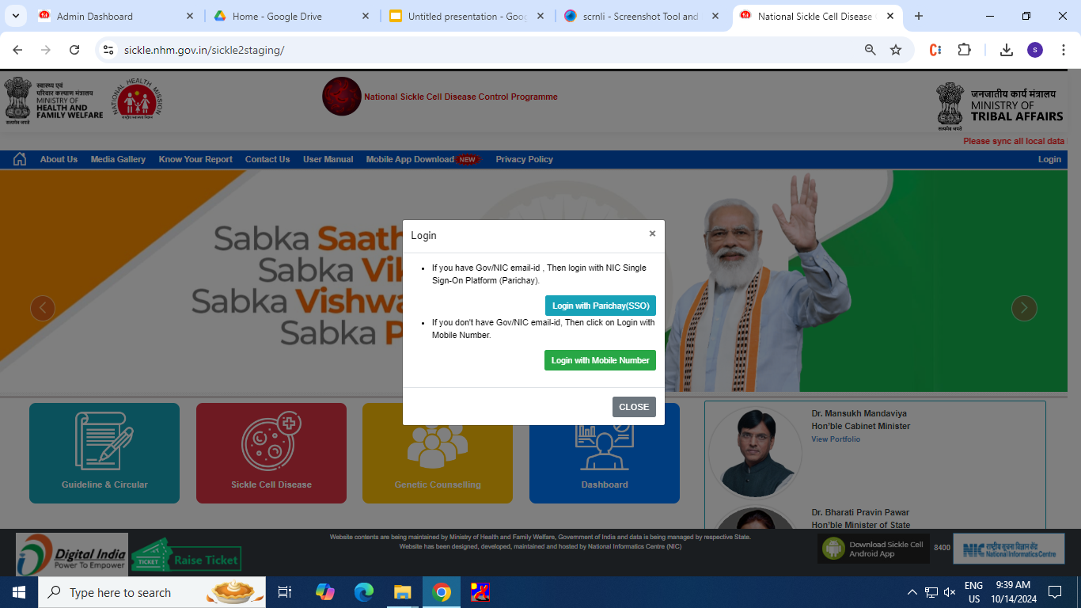
स्वास्थ्य एवं परिवार कल्याण मंत्रालय
Ministry of Health and Family Welfare
Treatment Module Login

Slide 5
स्वास्थ्य एवं परिवार कल्याण मंत्रालय
Ministry of Health and Family Welfare
Login using Registered Mobile No.

Slide 6
स्वास्थ्य एवं परिवार कल्याण मंत्रालय
Ministry of Health and Family Welfare
Authentication of User through OTP
An OTP will be sent registered mobile number of user to login to treatment module

Slide 7
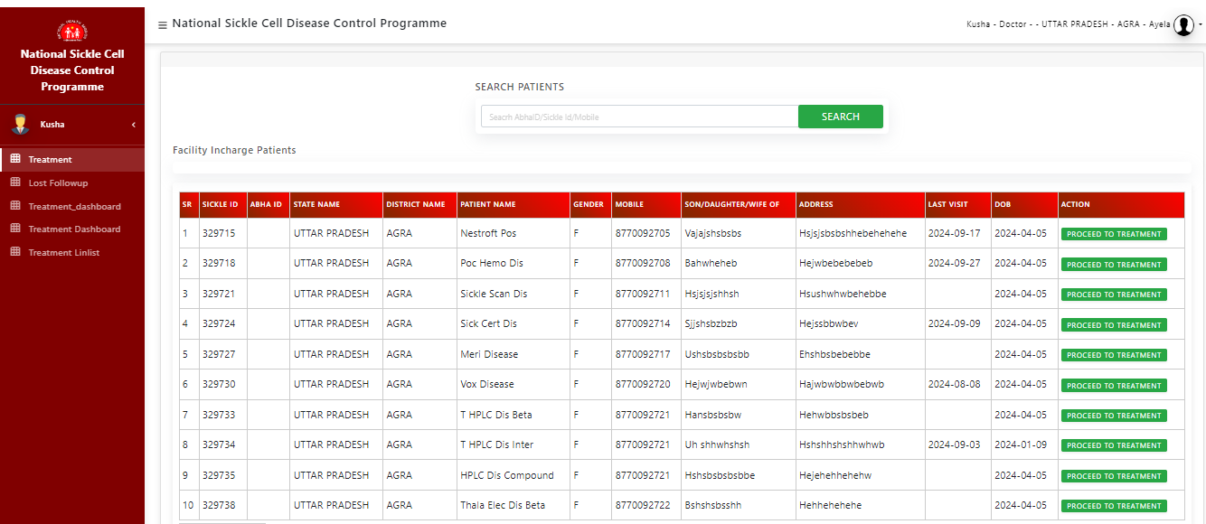
स्वास्थ्य एवं परिवार कल्याण मंत्रालय
Ministry of Health and Family Welfare
Treatment Home Page
User can search the patient with the help of sickle id, ABHA id or registered mobile number . After successfully found the result, Click on the Proceed to Treatment button to enter treatment details.

Slide 8
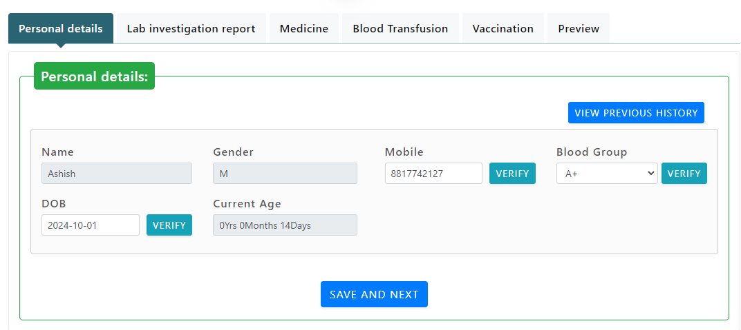
स्वास्थ्य एवं परिवार कल्याण मंत्रालय
Ministry of Health and Family Welfare
Patient Details Tab
1. Basic information of Patient will be auto filed. 2. User can update the patient DOB, Blood Group and Mobile number if changes are required. 3. After successfully enter the details and click on the SAVE AND NEXT button, other tabs will be activated.

Slide 9
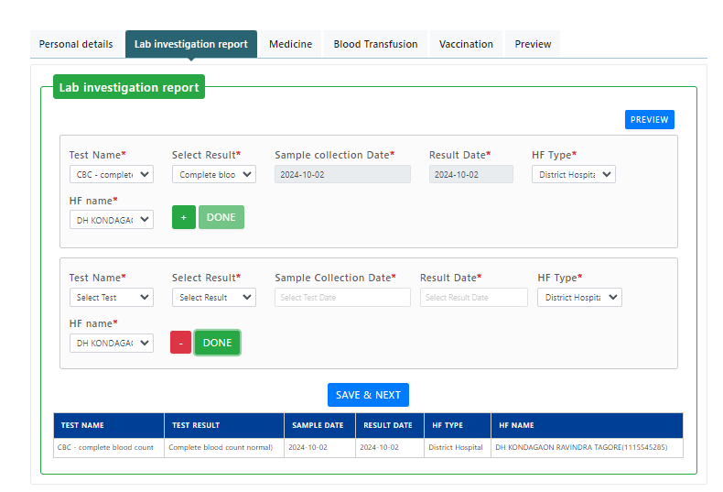
स्वास्थ्य एवं परिवार कल्याण मंत्रालय
Ministry of Health and Family Welfare
Lab Investigation

Slide 10
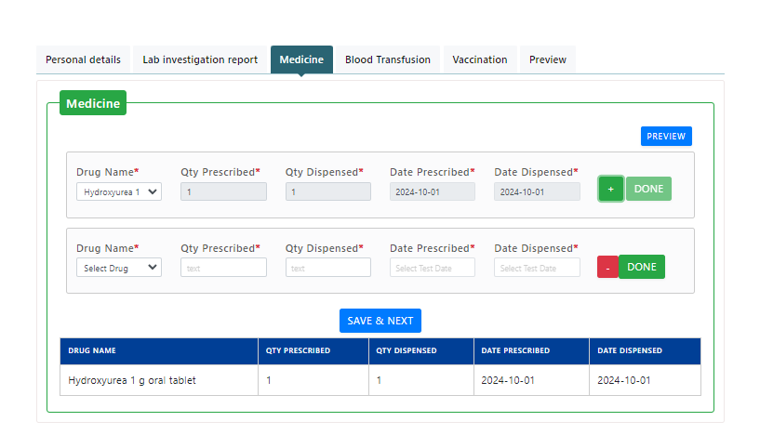
स्वास्थ्य एवं परिवार कल्याण मंत्रालय
Ministry of Health and Family Welfare
Medicine
.

Slide 11
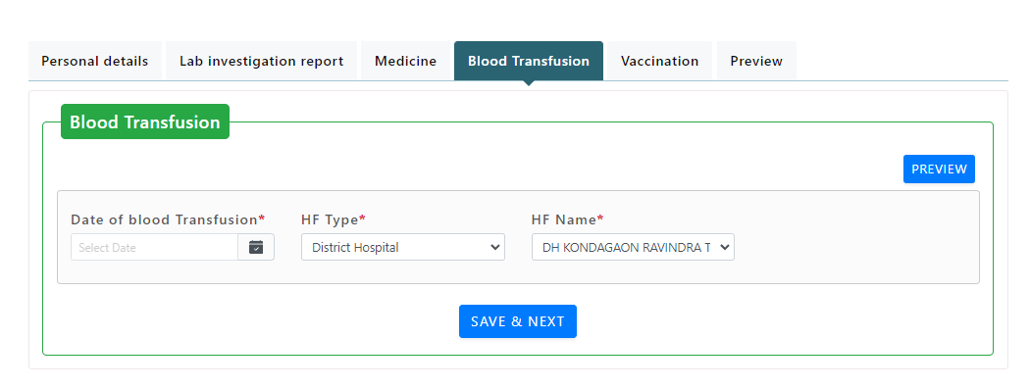
स्वास्थ्य एवं परिवार कल्याण मंत्रालय
Ministry of Health and Family Welfare
Blood Transfusion

Slide 12
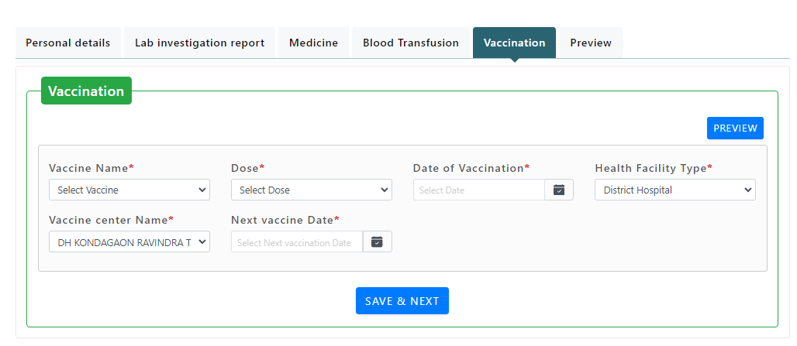
स्वास्थ्य एवं परिवार कल्याण मंत्रालय
Ministry of Health and Family Welfare
Vaccination

Slide 13
स्वास्थ्य एवं परिवार कल्याण मंत्रालय
Ministry of Health and Family Welfare
Preview the entered details

Slide 14
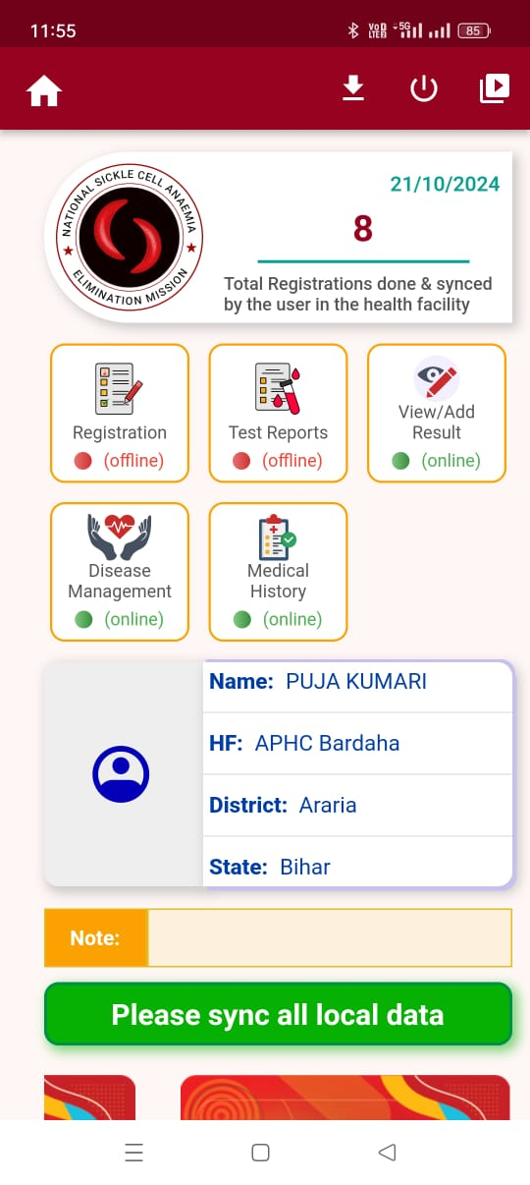
स्वास्थ्य एवं परिवार कल्याण मंत्रालय
Ministry of Health and Family Welfare
Overview(Mobile App)
Modules Added
Disease Management
Medical History

Slide 15
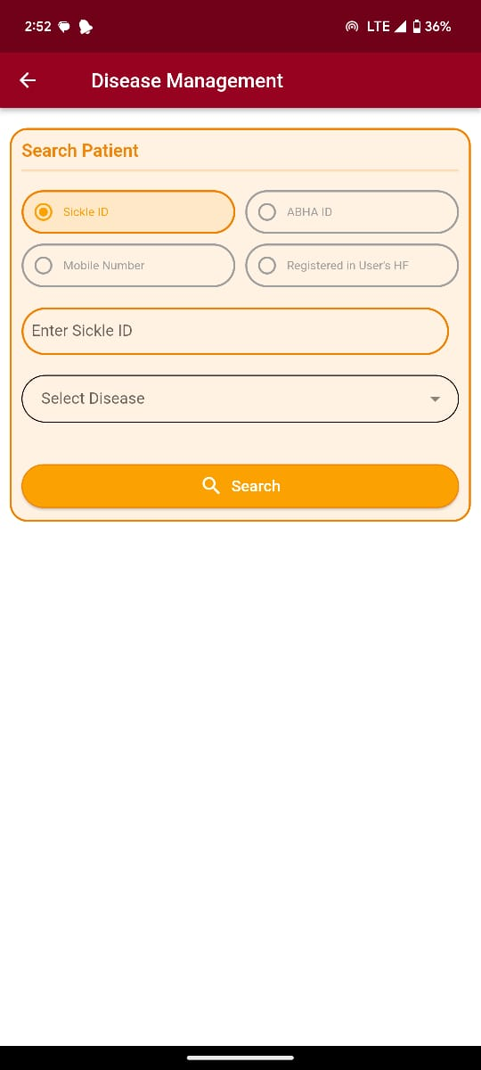
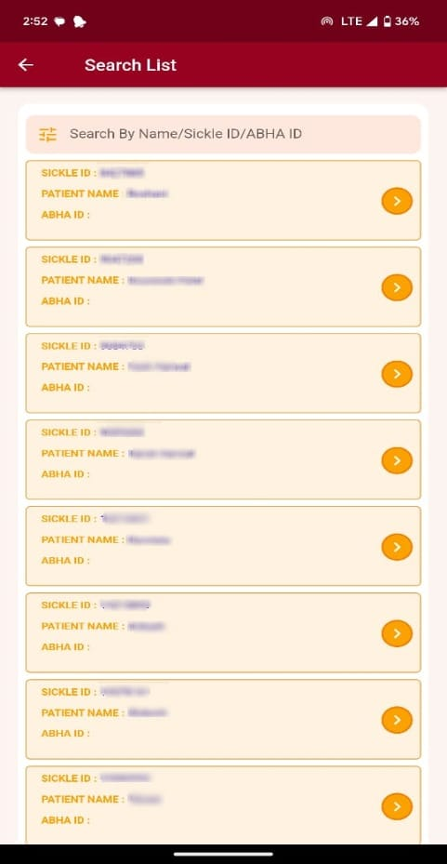
स्वास्थ्य एवं परिवार कल्याण मंत्रालय
Ministry of Health and Family Welfare
Disease Management
Search Patient

Slide 16
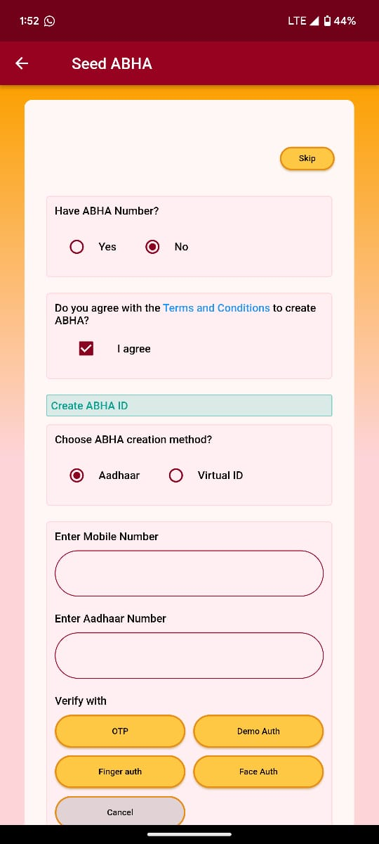
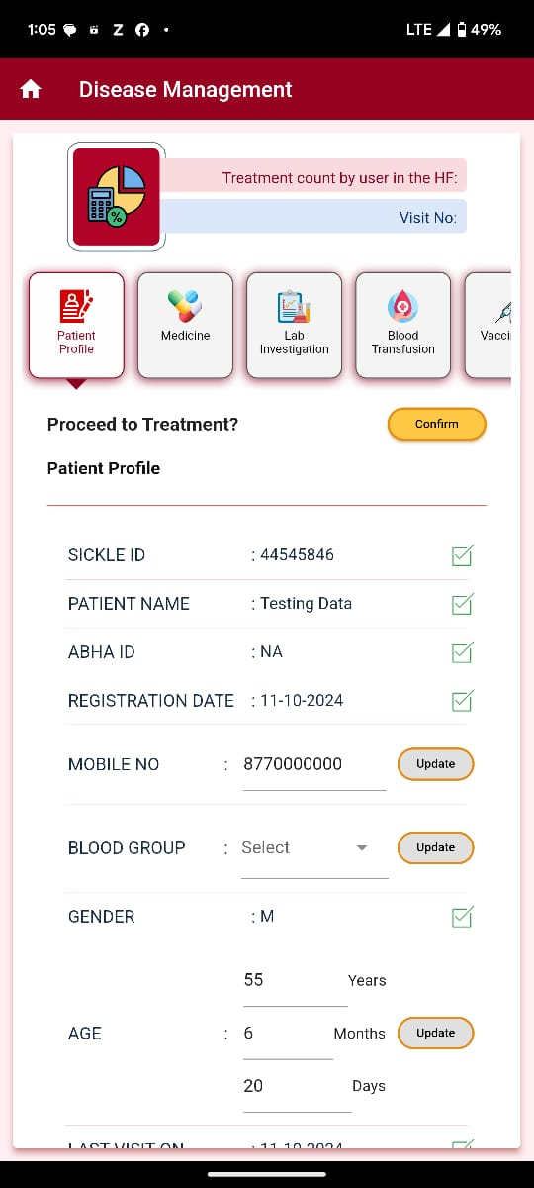
स्वास्थ्य एवं परिवार कल्याण मंत्रालय
Ministry of Health and Family Welfare
Disease Management
Treatment details

Slide 17
स्वास्थ्य एवं परिवार कल्याण मंत्रालय
Ministry of Health and Family Welfare
Disease Management
Patient Profile
Following details are displayed:
Mobile Number(One Time Editable)
Blood Group(One Time Editable )
Age(One Time Editable)

Slide 18
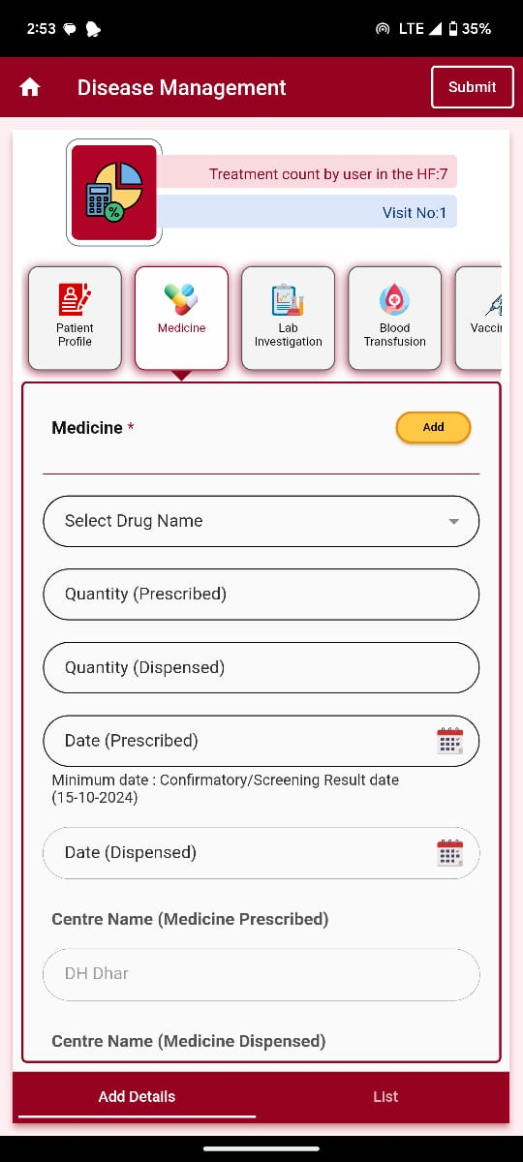
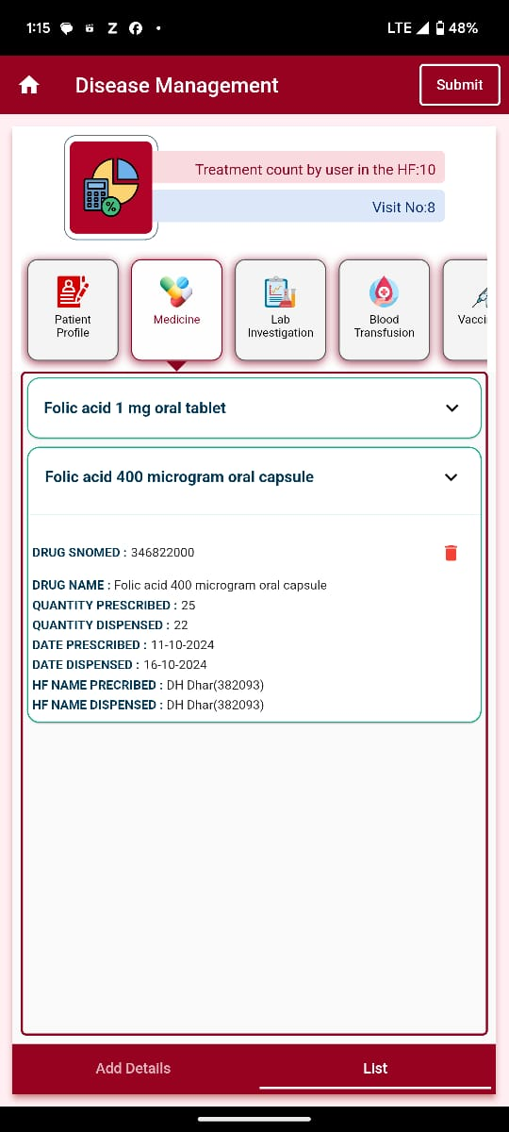
स्वास्थ्य एवं परिवार कल्याण मंत्रालय
Ministry of Health and Family Welfare
Disease Management
Medicine

Slide 19
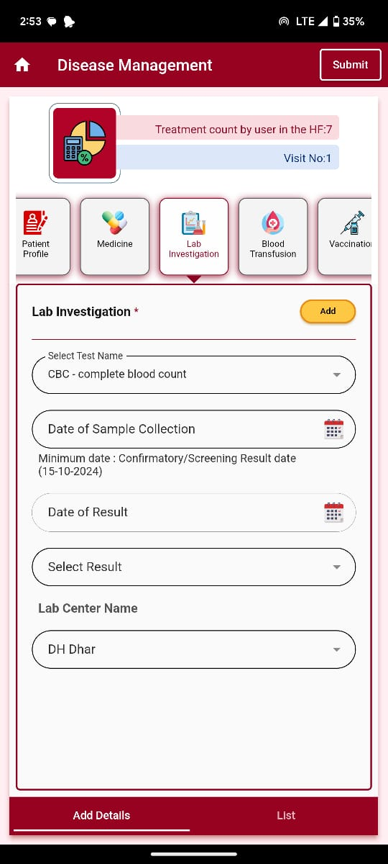
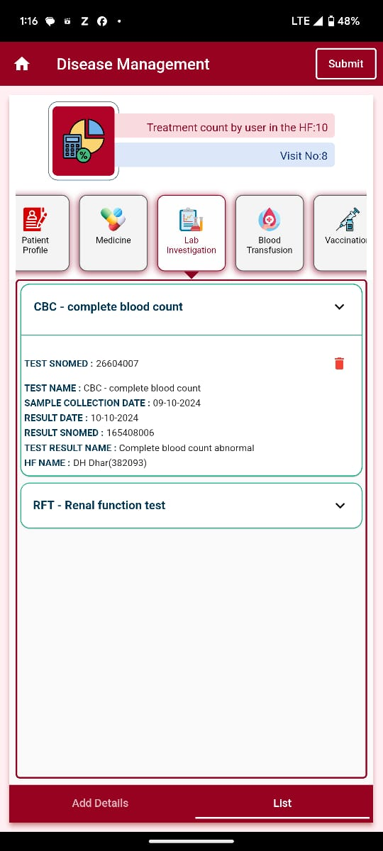
स्वास्थ्य एवं परिवार कल्याण मंत्रालय
Ministry of Health and Family Welfare
Disease Management
Lab Investigation

Slide 20
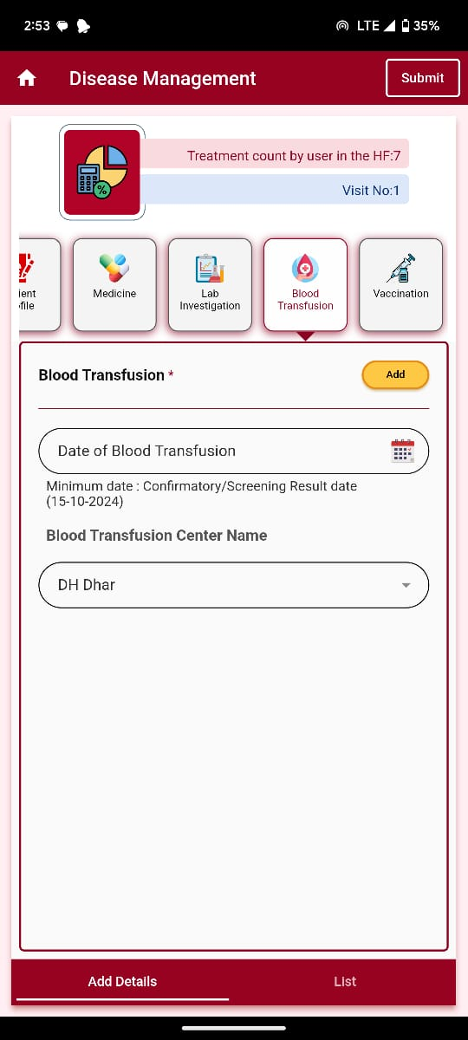
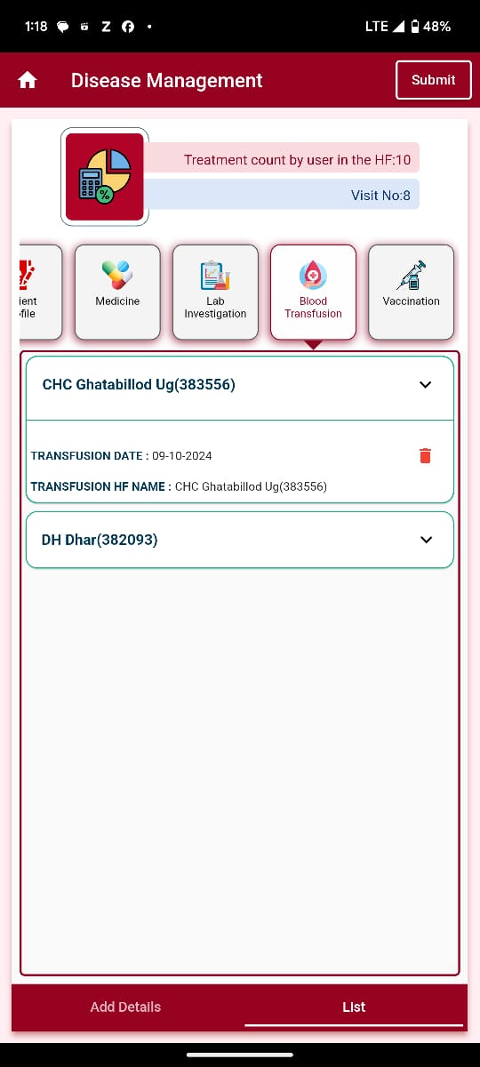
स्वास्थ्य एवं परिवार कल्याण मंत्रालय
Ministry of Health and Family Welfare
Disease Management
Blood Transfusion

Slide 21
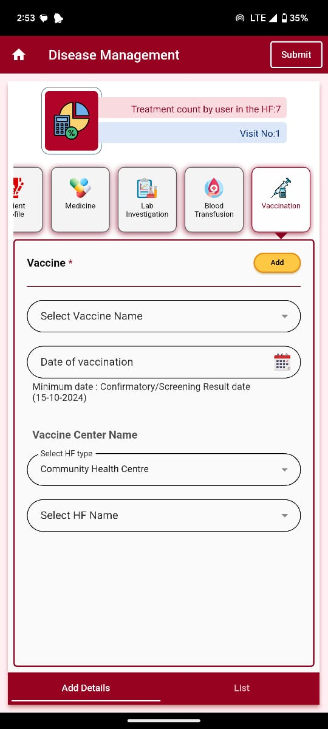
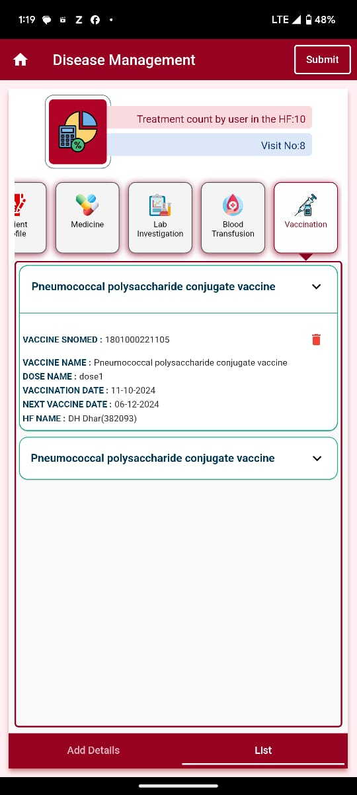
स्वास्थ्य एवं परिवार कल्याण मंत्रालय
Ministry of Health and Family Welfare
Disease Management
Vaccination

Slide 22
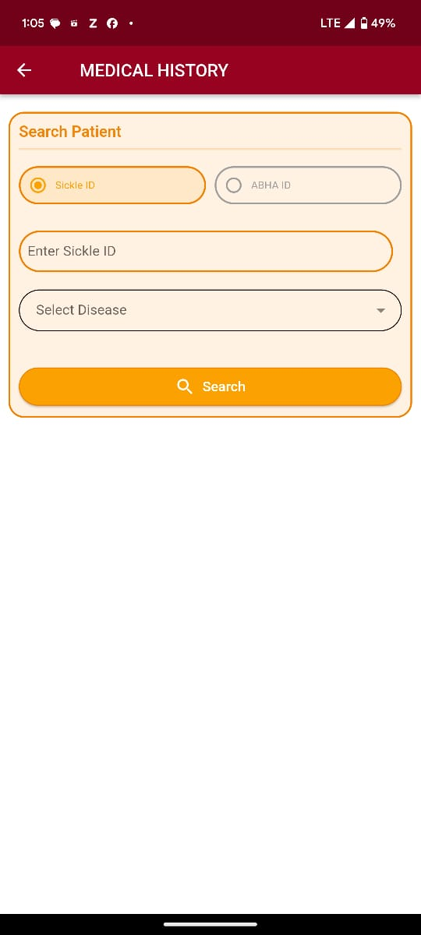
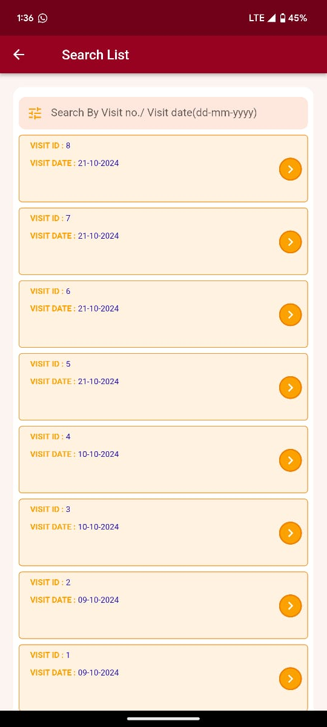
स्वास्थ्य एवं परिवार कल्याण मंत्रालय
Ministry of Health and Family Welfare
Medical History
Search Patient

Slide 23
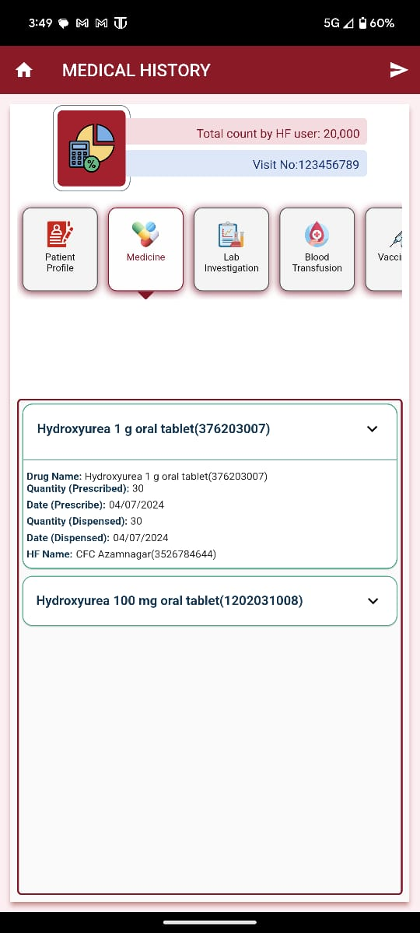
स्वास्थ्य एवं परिवार कल्याण मंत्रालय
Ministry of Health and Family Welfare
Medical History
Patient Details

Slide 24
स्वास्थ्य एवं परिवार कल्याण मंत्रालय
Ministry of Health and Family Welfare
Transparency in governance leads to greater responsibility towards people and a sense of accountability, which in turn bring changes in work culture and impact of (government) schemes."
Hon'ble Prime Minister of India, Shri Narendra Modi

