Slide 1
From Genes to Cure: The Journey of Sickle Cell Disease
Dr Rahul Bhargava
DM Clinical Hematology
Principal Director and Head
FMRI
Gurugram

Slide 2
Sickle Cell Disease is Caused by a Single Nucleotide Variant in the HBB Gene
Hgb A Hgb S Sickle (E6V)
Median Lifespan
United States: mid-40s (though taking medicine for pain >3 times/week) (neurocognitive damage starts occurring in first years of life)
Africa: 5-8 years old
Hertz Nazaire

Slide 3
Living with sickle cell disease can be incredibly challenging
Kato, G., Piel, F., Reid, C. et al. Sickle cell disease. Nat Rev Dis Primers 4, 18010 (2018).

Slide 4
Current Therapies For SCD
SUPPORTIVE BUT NOT CURATIVE

Slide 5
Current Therapies For SCD
CURATIVE OPTIONS

Slide 6
What are the barriers to bone marrow
transplant (BMT) in sickle cell disease?

Slide 7
Main Obstacles TO BMT
Lack of clear cut indications for SCT
Lack of awareness, information among physicians, parents and patient’s
Lack of funds (maximum disease burden in most resource poor or resource limited settings)
Lack of available donors

Slide 8
Does every patient with sickle cell disease
require a bone marrow transplant?

Slide 9
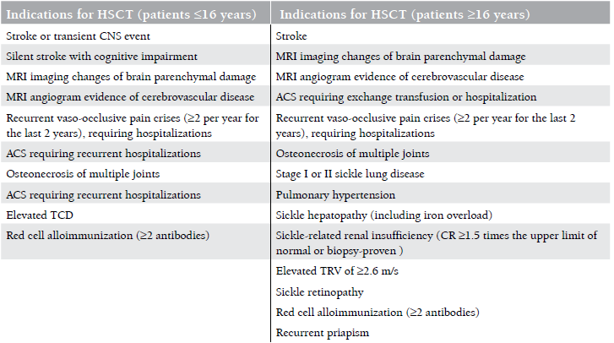
Lack of Clear Cut Indications

Slide 10
At what age should a transplant be offered?

Slide 11
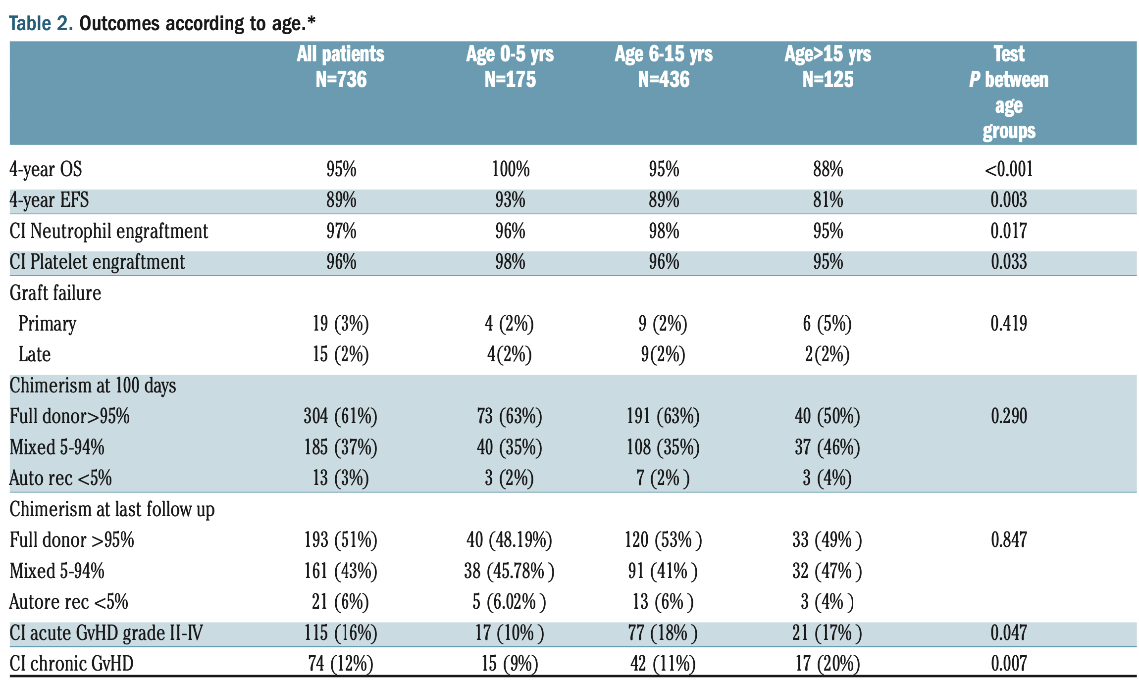
Decline in OS if late HSCT
Any delay in HSCT increase risk for
Alloimmunization and hyperhemolysis syndrome
Iron overload
Infectious complications
Irreversible organ damage like nephropathy , retinopathy , pulmonary ,cardiac ,low IQ
Increase TRM bcoz
VOD risk bcoz of liver fibrosis as age increase
Graft rejection due to heavy transfusion
PRES and other CNS issue due to vasculopathy
Earlier transplants lead to better outcomes

Slide 13
Multivariate analysis for EFS
 | HR | 95% CI | p-value
PBSC vs BM | 1.93 | 0.87 – 4.26 | 0.104
CB vs BM | 0.55 | 0.13 - 2.31 | 0.412
Patient age | 1.09 | 1.05 - 1.12 | <0.001
Year of Tx | 0.95 | 0.90 - 0.99 | 0.013
RIC vs MAC | 1.13 | 0.46-2.81 | 0.793
in vivo TCD | 1.34 | 0.63 – 2.82 | 0.445
Younger age at HSCT and year of transplant
≥ 2006
were independently associated both with a better EFS
Gluckman E, et al. Blood 2016

Slide 14
Haematologica. 2014
Expert international panel recommended that symptomatic children with SCD undergo early (pre school age) HSCT if they had MSDs, but no mention was made of the “asymptomatic” or “less severe patient” with SCD

Slide 15
Is pre-transplant evaluation in sickle cell
disease different from other conditions?

Slide 16
Patient evaluation in SCD (pre-HCT)
Neurological assessment (including neurocognition)
Brain MRI/MRA
May uncover unanticipated severe cerebral vasculopathy (“moyamoya”)
Potential increase in transplant-related mortality (TRM) and morbidity
Transcranial Doppler (TCD)
Effective in predicting the risk of stroke
To predict the severity of disease
Iron overload/secondary hemosiderosis from RBC transfusion
Alloimmunization from prior RBC transfusion
Increased risk of graft rejection
Pulmonary hypertension/hepatopathy

Slide 17
Full match sibling ……..but HbS carrier
Can an HbS carrier donate stem cells?

Slide 18
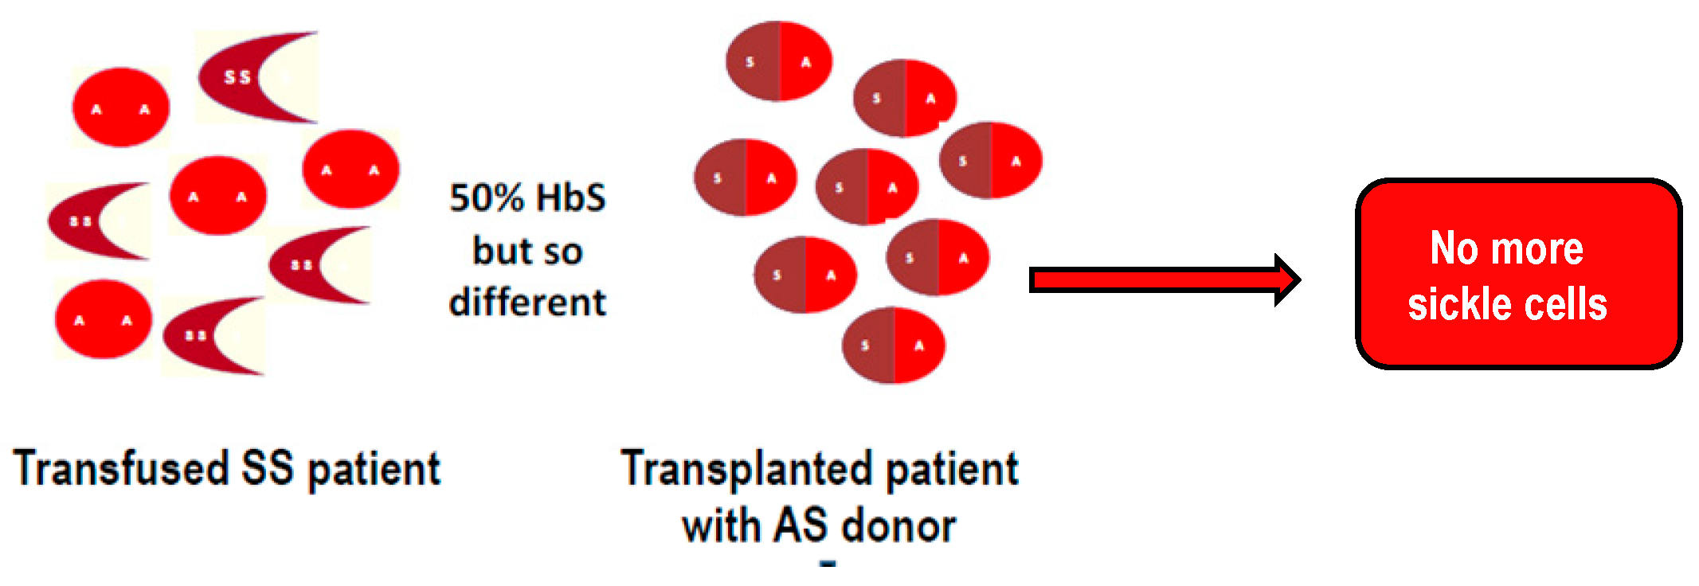
Can carrier be a donor
G-CSF mobilization in PB hematopoietic stem cells from sickle cell trait donors
Safe and can be done
Cryopreservation also has no negative impact

Slide 19
The First Successful Transplant for SCD
First successful HCT in SCD performed in 1984
A pediatric patient with coexisting acute myeloid leukemia (AML) from sickle cell trait sibling
Preparative regimen:
11.5 Gy TBI/ Cyclophosphamide 120 mg/kg
GVHD Prophylaxis: Methylprednisolone and Methotrexate
Engraftment occurred day +12
Developed aGVHD that evolved into chronic GVHD
16 months after transplant:
Remission from AML
Karyotype: XY, suggesting donor engraftment
Hemoglobin electrophoresis: A1, S, A2 (trait pattern)
No signs of sickle cell disease (a potential cure!)
Johnson FL, et al. NEJM 1984

Slide 20
Still we are using TBI or conditioning is different now

Slide 21
MAC HLA matched sibling BMT
 | Walters | Panepinto | Bernaudin | Locatelli | Maheshwari | Leucarelli | Dedekan
Year /Country | 2001 USA | 2007 CIBMTR | 2007 France | 2013 Eurocord, Oakland | 2014 USA | 2014 Nigeria Albania, Kuwait, Iraq, Lebanon | 2014 Belgium
Median FU year | 4.8(3.2-7.9) | 5.1(0.25-14.8) | 6(1.6-17.5) | 5.8(1-12.5) | 3(1.3-9) |  | 7.7(0.4-21.3)
N | 50 | 67 | 87 | 160 | `16 | 42 | 50
Conditioning | Bu ,CY,ATG or Campath | Bu ,CY other | Bu ,CY ATG >1992 | Bu ,other | Bu ,CY ATG | Bu ,CY other | Bu ,CY ATG >1991
Age | 3.3-15.9 | 2-27 | 2-22 |  | 1.2-19.3 | 2-16 | 0.9-31.8
Primary engraftment % |  |  | 98 |  | 100 | 97.6 | 94
Graft rejection % | 10 | 15 | 3 |  | 0 | 0 | 8
aGVHD % |  | 10 | GII 11.6 GIII-IV 8.1 |  | GII 13 GIII-IV 0 | GI-II 30 GIII-IV 17.5 | GI-II 12 GIII-IV 10
cGVHD% |  | 22 | 12.6 |  | 0 | 5 | 20
Death % | 6 | 3 | 5 >2000 | 3 | 0 | 9 | 6
DFS % | 84 | 85 | 95>2000 | 92 | 100 | 91.6 | 85.5
BU CY +/-ATG. = Good EFS (73%-96%) and OS (91%-100%)
Rejection ~10%
Late toxicity?
Flu Bu
- High risk of GvHD (add ATG?)

Slide 22
1000 HSCT
From 94 centers in 23 Countries
CIBMTR, 439
France, 237
Belgium, 99
Italy, 55
UK, 49
Spain, 17
Germany, 14
Austria, 9
Sweden, 9
The Netherlands, 7
Switzerland, 6
Turkey, 6
Denmark, 1
Greece, 1
Brazil, 18
Saudi arabia, 8
Iran, 7
South africa, 6
Israel, 5
Nigeria, 3
Canada, 2
Jordan, 2
Russia, 1
USA, N=439
6
9
1
8 6
7
1
6
3
2 2
14
9
18 ⁷ ⁵
49
55
17
1
EBMT
European countries N=513
439
99
237
EBMT
Non European countries N=48

Slide 23
Sickle cell disease: an international survey of results of HLA-identical sibling hematopoietic stem cell transplantation
Gluckman E, et al. Blood 2016
1000 SCD pts transplanted from HLA matched sib (94 centres in 23 countries )(EBMT+CIBMTR+Eurocord)
846 children median age at HSCT 9 year(03- 16)
154 adult median age at HSCT 20 year( 16-54)
OS | EFS % | Graft rejection % | aGVHD % | CGVHD %
92.9 | 91.4 | 2.3 | 14.8 | 14.3
 | BM=835 | PB= 73 | Cord= 75
5 year OS | 96% | 79%c | 100%

Slide 24
Is there any role of RIC in BMT for sickle cell

Slide 25
NEED FOR RIC
A major limitation of MAC is the risk of TRM or treatment-related toxicities
Organ toxicities are more likely to occur and be more severe in symptomatic patients with SCD who have impaired organ function or have been exposed to multiple red blood cell transfusions before MAC
Several reduced intensity conditioning regimens (FLU/ MEL + ALEM +/− TT or ALEM + TBI 300 cGy +/− PT-CY or FLU/CY or TBI 300 cGy +/− ATG) have been used in many small patient series
Initial trials failed to induce stable donor engraftment despite the HLA-identical context of the transplants.
This underlines the singularity of transplantation for SCD where the recipient is fully immunocompetent and has a proliferative bone marrow, and GVHD has no utility
Iannone R, et al toxic non-myeloablative transplantation in patients with sickle cell anemia and beta-thalassemia. Biol Blood Marrow Transplant. 2003

Slide 26
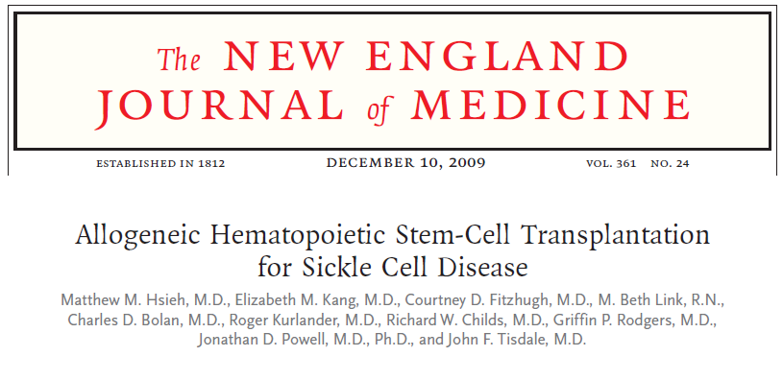
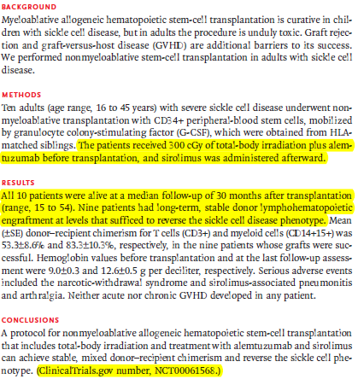
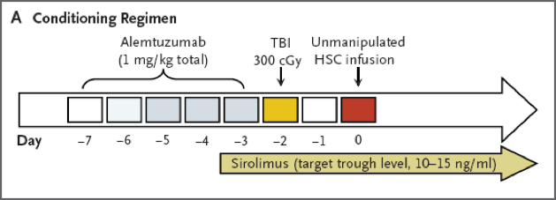
Nonmyeloablative conditioning regimen based on alemtuzumab (Campath), low-dose total body irradiation (TBI), and transplantation with peripheral blood stem cells (PBSCs) from an HLA- identical donor followed by sirolimus was successfully applied to 10 adults

Slide 27
Strocchio et al 2015
Treosulfan/thiotepa/fludarabine matched sib or unrelated donor-HSCT in 15 children with SCD, vs historical cohort (15 patients) given a busulfan-based regimen
Engraftment 28/30 ,GF 1 each group
7 year OS 100% DFS 93% fro whole cohort
93% DFS in both group
So conclusion treosulfan can use in place of busulfan

Slide 28
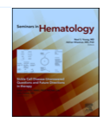
2018

Slide 29
Unrelated allogeneic donor sources for alloHSCT in patients with SCD

Slide 30
Shenoy et al. Blood 2016
Shenoy et al. Blood 2016
Reduced intensity trial of unrelated donor transplantation for severe SCD
Based on multi-center experience with SCD HSCT
Transplanted: 30 , 29 evaluable (year 2008 -2014)
Indication stroke =12 ,Elevated TCD =2 ,VOC = 12 ACS =4
Median CD34 dose: 2.9 x 10⁶/kg
Age: 3-19 yrs
Follow up: 26 months (12-62 months)
TRM: 5%
Graft Rejection: 8%
Gr 2-4 aGVHD: 22% Gr 3-4 aGVHD: 7%
cGVHD: 15%
Cord arm closed on the BMT CTN SCURT trial for increased rejection

Slide 31
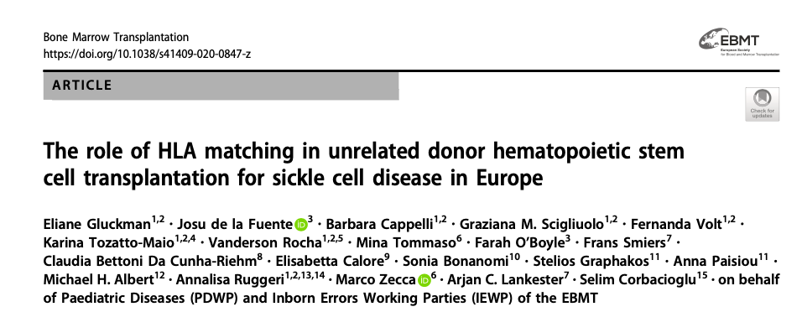
BMT2019
Unrelated allogeneic HSCT in 71 SCD 2005 and 2017
Median age was 9.3 years;
graft type was bone marrow in 79% and peripheral blood in 21%.
Recipient–donor HLA match at high resolution typing was 10/10 in 31, 9/10 in 20, and 8/10 in 4 patients
The most frequent conditioning regimens were fludarabine–thiotepa–treosulfan (64%) or busulfan–cyclophosphamide (12%).

Slide 32
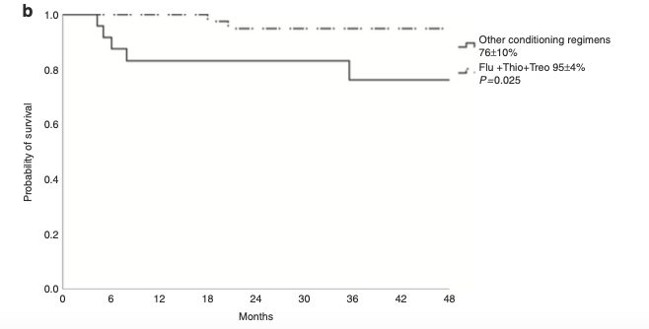
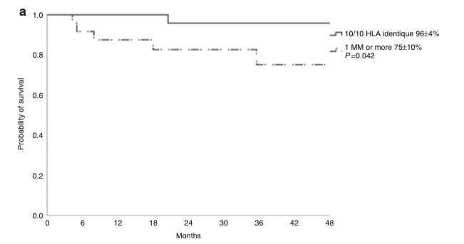
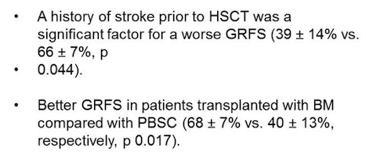
BMT2019

Slide 33
Haploidentical SCT for SCD
As Few Have a MSD/MUD & HCT Cures SCD…

Slide 34
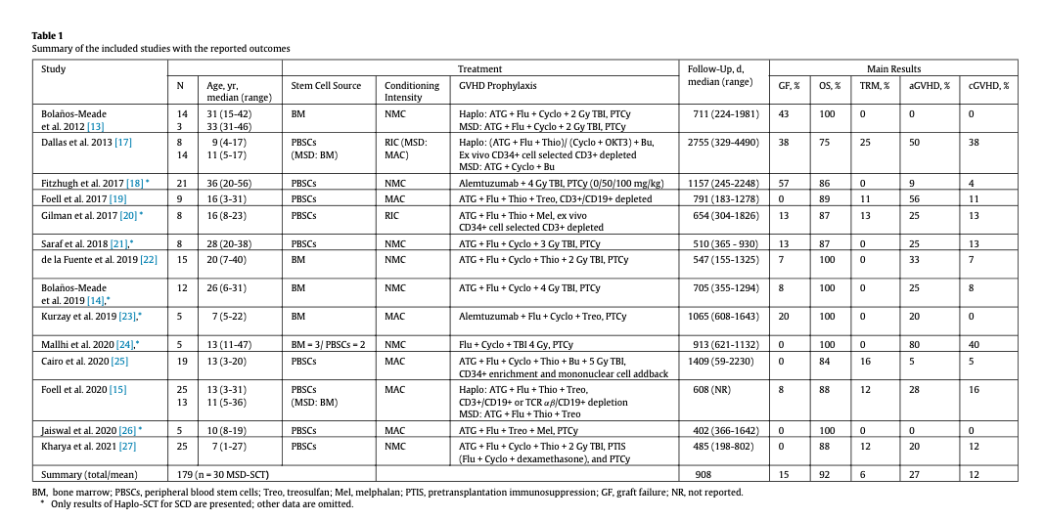
2021

Slide 35
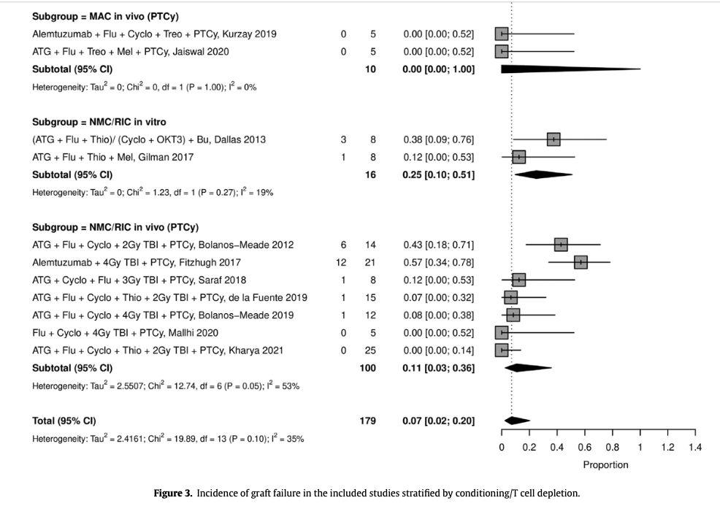
2021

Slide 36
Experience in Paediatric cases

Slide 38
HSCT for SCD in Adults
HSCT is currently indicated in persons with severe SCD with complications including stroke, acute chest syndrome, recurrent pain crisis, nephropathy, retinopathy, osteonecrosis of multiple joints, and priapism
Paradoxical relationship between eligibility and fitness for transplant
With age, in adulthood, the end organ damage tends to accumulate, especially in the Indian Sickle phenotype

Slide 39
HSCT for SCD in Adults
The decision to transplant in adult SCD remains a complex one.
Given these challenges, there is a void in the arena of adult sickle cell transplantation in our country, that we endeavor to fulfill.

Slide 40
HSCT for SCD in Adults at FMRI, Gurgaon
14 adults with SCD with severe phenotypes, ranging from 18 -29 years of age underwent HSCT from 2018 to 2024 at our institution.
5 haploidentical donors while 9 patients had matched sibling donors
Median follow-up of 31 months (range 6 to 80 months)

Slide 41
HSCT for SCD in Adults at FMRI, Gurgaon
2 patients developed acute gut GVHD and 1 developed chronic skin GVHD.
1 patient developed primary graft failure precipitated by early CMV reactivation (autologous rescue done).
Mortality
2 patients of MSD HSCT( intracranial bleed d+18, Infectious complication d+68)
1 patient of haplo HSCT ( delayed infectious complication at 1 year )

Slide 42
HSCT for SCD in Adults at FMRI, Gurgaon
Safe and effective transplantation in adults is feasible!
Important for referral for transplant at an appropriate time point is crucial, especially in adult patients

Slide 43
Gene therapy vs BMT

Slide 44
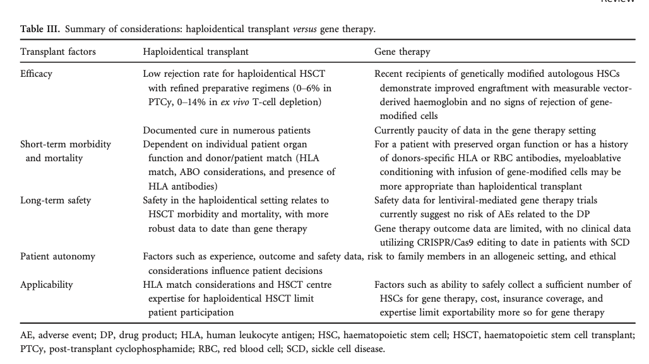
7 February 2020

Slide 45
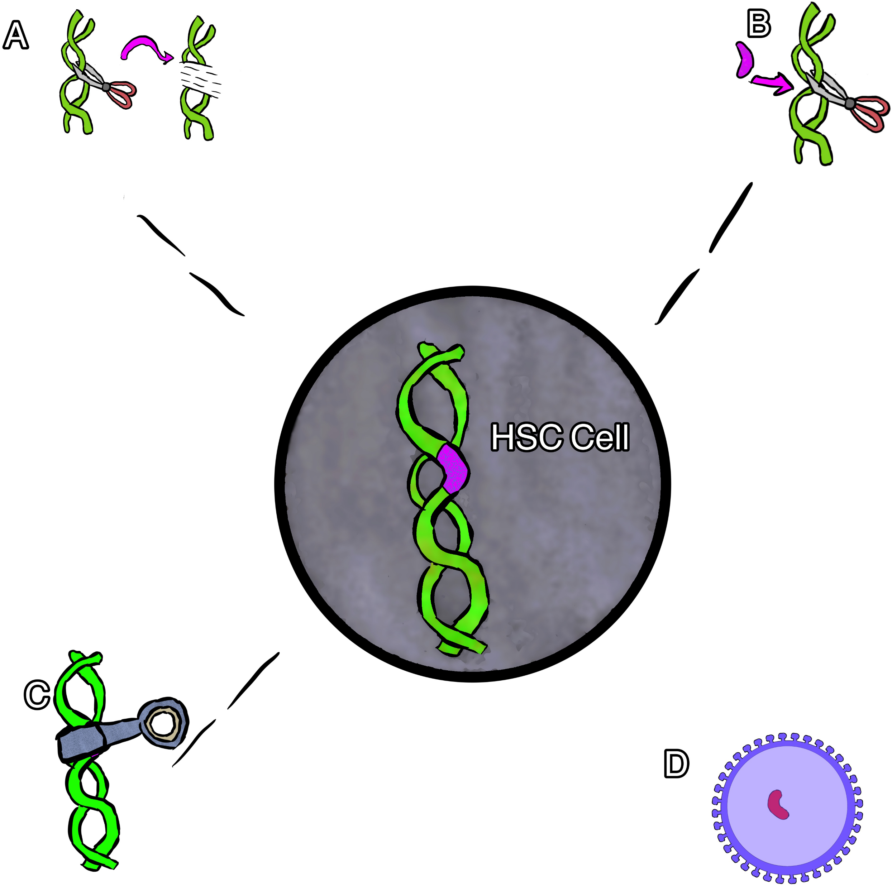
Gene therapy for sickle cell disease
Gene editing
gene correction
gene silencing
gene addition via viral vector.
Copyright © 2024 American Society of Hematology
Notes:
Figure Legend:

Slide 46
Gene addition therapy : addition of a new gene using a viral vector to deliver a nonsickling globin gene to the stem cells. Native HbS gene is not altered. lentiviral vector (LVV) to deliver a new gene.¹⁶
Gene editing : used to target suppressors of HbF to increase HbF and decrease HbS. The specific DNA cut allows one to change the sequence with high precision, usually resulting in an insertion and deletion. Increases HbF production while reciprocally suppressing HbS production.
Therapies target the BCL11A gene, a negative regulator of HbF.

Slide 47
Gene silencing: prevents expression of BC11A gene, resulting in an increase in HbF while reciprocally suppressing HbS production. viral vector is used to deliver an antisense to messenger RNA to suppress the gene product instead of cutting the gene.
Gene correction can be performed in several different ways. In most cases, however, a guide RNA is used to identify the target mutation for cutting, and then editing occurs with the simultaneous delivery of template DNA of the correct sequence, directing homology-directed repair

Slide 48
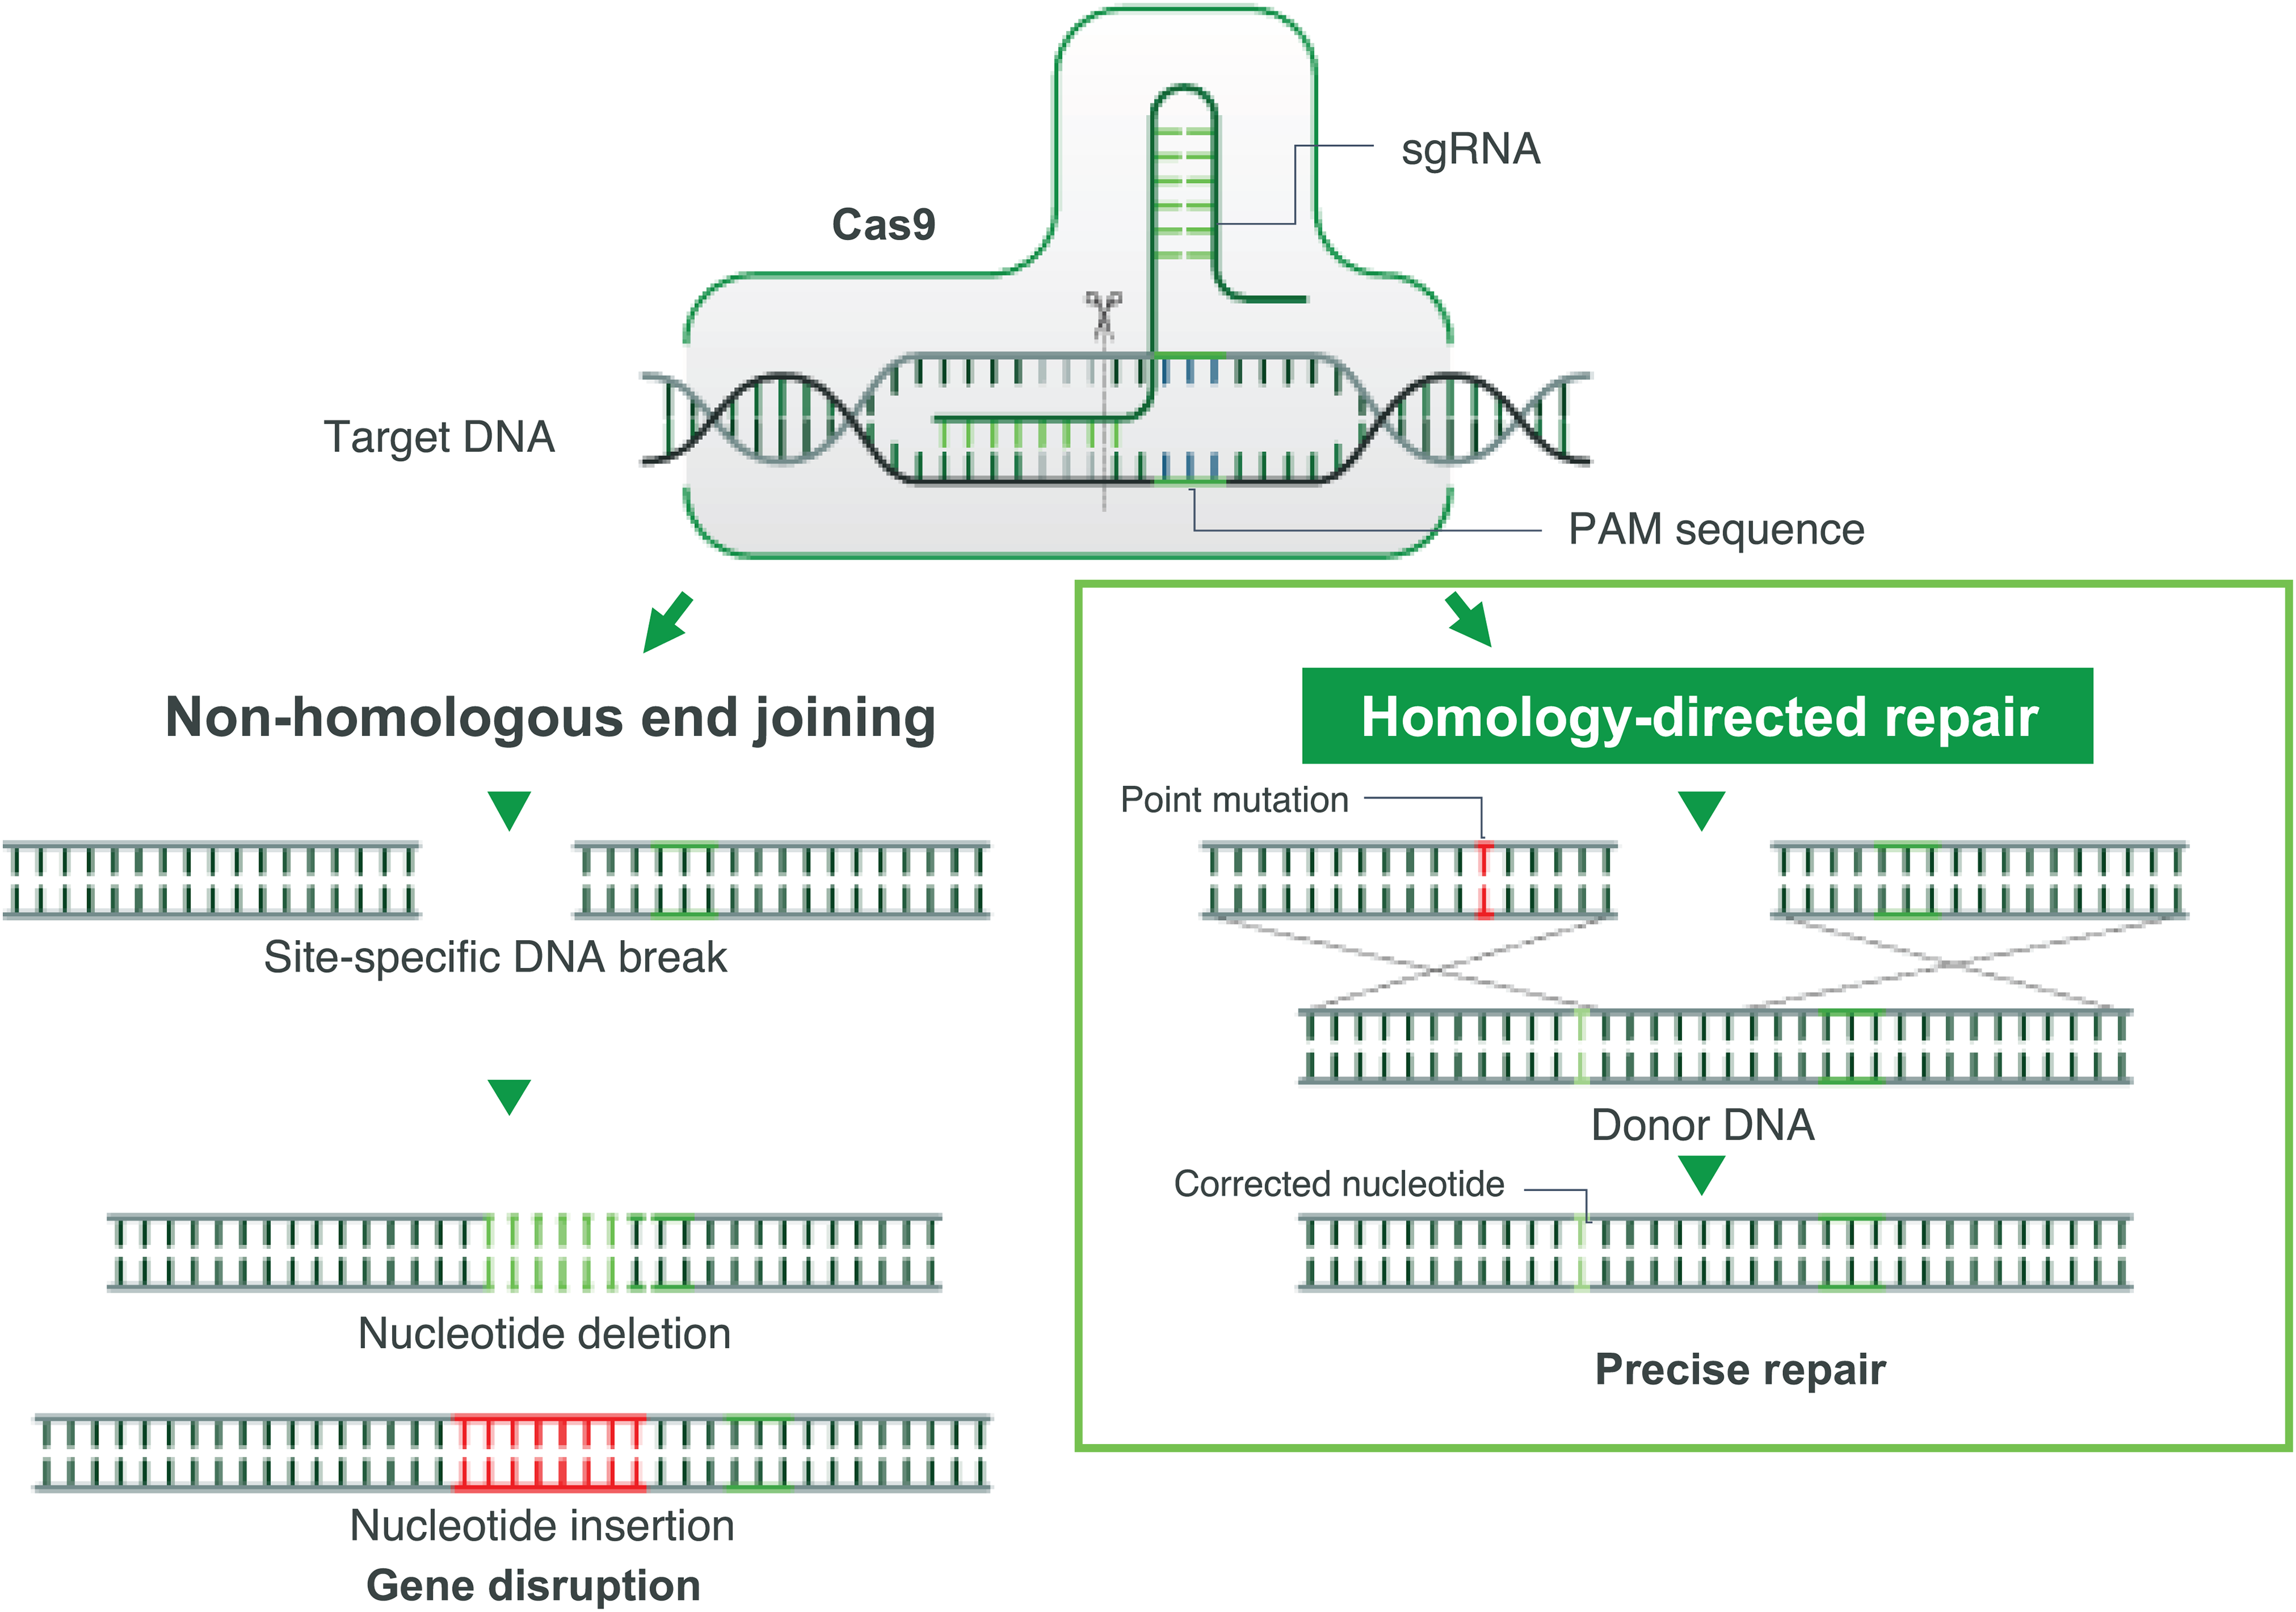
Gene Correction
Notes:
Figure Legend:
CRISPR-Cas-9-induced double-stranded break and its sequential repair pathways.Left: nonhomologous end joining. Right: HDR, which requires the insertion of a homologous DNA strand used as a template for a high-fidelity double-stranded DNA break. PAM, protospacer adjacent motif; sgRNA, single-guide RNA.

Slide 49
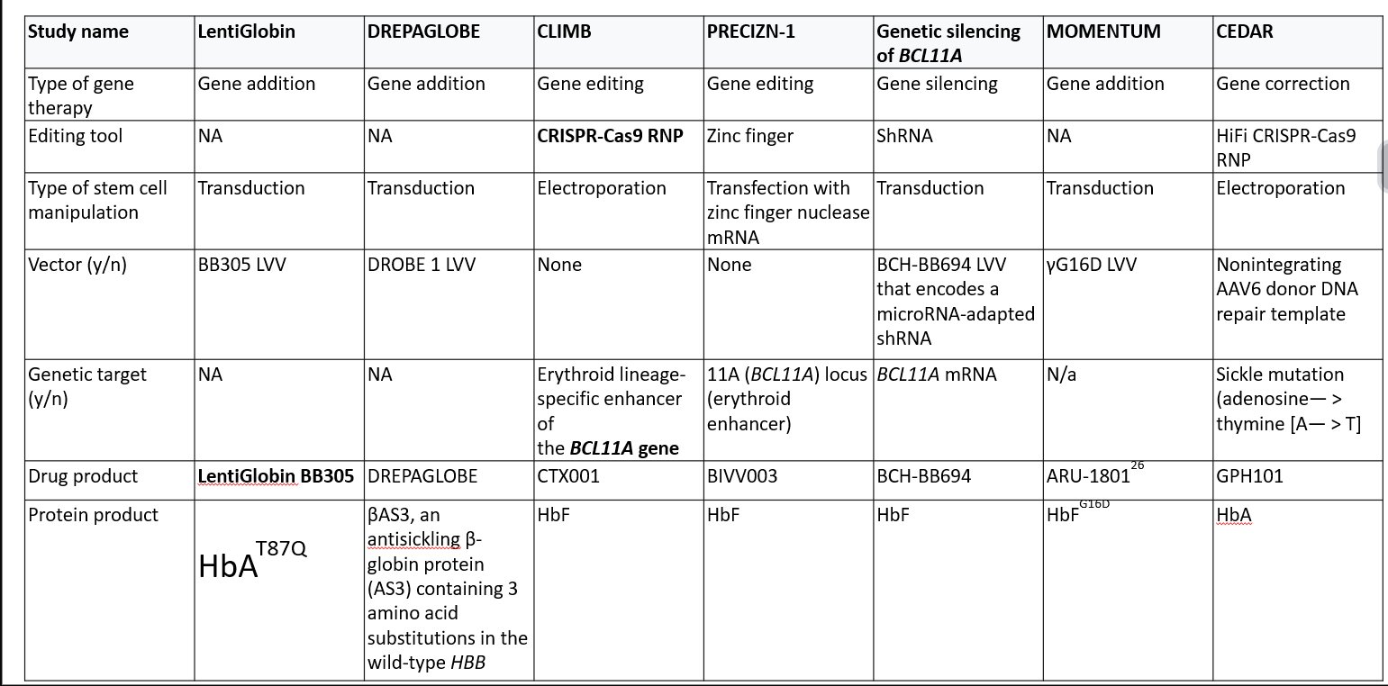

Slide 50
Procedure

Slide 51
Take home message
HCT for SCD, highly effective, but underused
Age: before end organ damage (as early as possible)
With organ damage : RIC/RTC preferred
PTIS has lower graft rejection
Serotherapy: Preferred to improve QOL
BM is preferred source
Achievement of mixed chimerism - minimum target
Longer follow-up is necessary to evaluate efficacy and to monitor for late effects

Slide 52
Future Directions
Geriatric Institute
Fortis Institute of Genomics
Launch of BMT centre for auto immune disorders
Coal India Supported BMT for Sickle cell and Thalassmia

Slide 53
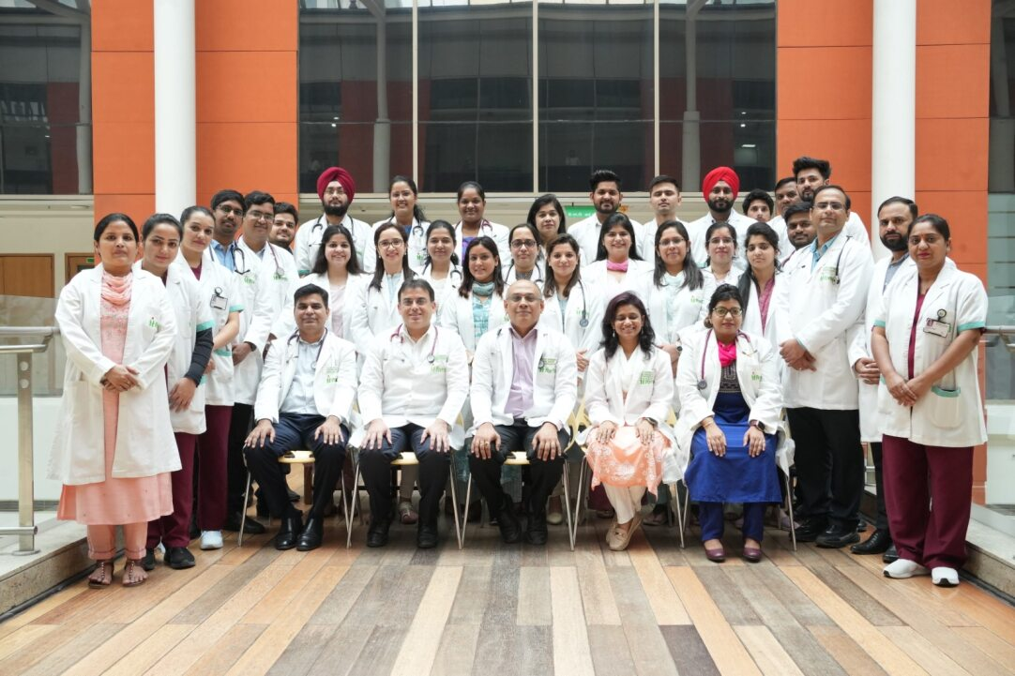

Slide 54
Thank you

