Slide 1
Therapeutic approaches in Sickle Cell Disease
Dr Dipty Jain

Slide 2
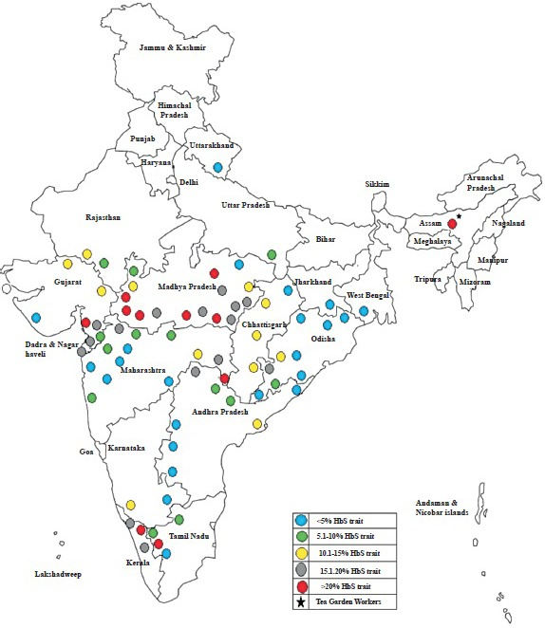
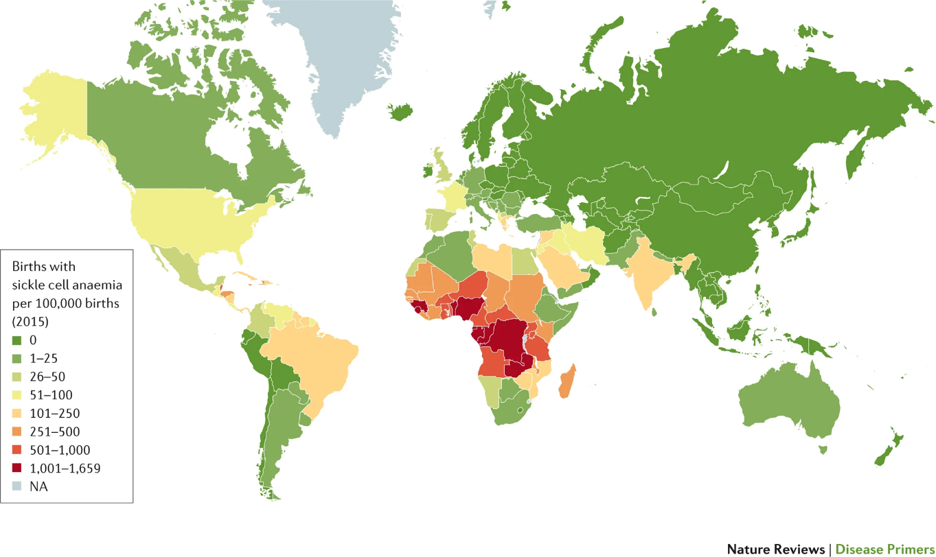
Epidemiology
Worldwide
300,000-400,000 newborns with SCD per year
Majority in Sub-Saharan Africa
Mortality rate among newborns to 5-year-olds is 75%
India is the second-largest hub of SCD after Africa
Overall prevalence of 4.3%
Kato, G., Piel, F., Reid, C. et al. Sickle cell disease. Nat Rev Dis Primers 4, 18010 (2018)
Bhalla N et al. Allogeneic hematopoietic stem cell transplantation to cure sickle cell disease: A review. Front Med (Lausanne), 2023

Slide 3
OBJECTIVES
How to care for patients with SCD in the Community Care Setting.
To know to treat acute and chronic complications of SCD.
To know the protocol for initiation of hydroxyurea therapy in patients with sickle cell disease.
To know recommendations for acute transfusion in patients with Sickle cell disease.

Slide 4
Clinical manifestations of sickle cell disease
The disease is present at birth, but symptoms appear at ~6 months of age with the shift from predominantly HbF to HbS^{1,2}
The severity and complications of the disease worsen with age and are related to organ damage¹
Causes of death are more variable in adults than in children¹
The most common symptoms are linked to:^{1,3}
Hemolytic anemia
Painful vaso-occlusive crisis
Complications resulting from organ damage due to microinfarctions
HbF, fetal hemoglobin; HbS, sickle hemoglobin. 1. Kanter J and Kruse-Jarres R. Blood Rev 2013;27:279-87; 2. Sankaran VG, Orkin SH. Cold Spring Harb Perspect Med 2013;3:a011643; 3. Kato GJ et al. Nat Rev Dis Primers 2018;4:18010.
Notes:
There is a great variability in the signs and symptoms of sickle cell disease, which are different for each person and can range from mild to severe.
Complications of SCD also differ across child and adulthood:
In both child and adulthood, complications of SCD include:
Stroke
Dental protrusion
Acute Chest Syndrome
Gallstone (jaundice)
Cholelithiasis
Priapism and delayed sexual development
Avascular necrosis
Chronic ulcers (lower extremities)
Vaso-occlusion
Chronic haemolytic anaemia
Immunosuppresion
During childhood, the most frequent problems are: pain, infection, acute splenic sequestration (blood pooling in spleen), acute chest syndrome (ACS) and stroke.
Poor splenic function results in a compromised immune system and increased susceptibility to infection (including sepsis), which is the primary cause of mortality in pediatric patients.
Penicillin prophylaxis and anti-pneumococcal vaccination have significantly decreased the incidence of life-threatening infections in children with SCD in regions where these treatments are utilized.
Other complications include:
Aplastic crisis, impaired immunity, delayed growth
Retinal artery occlusion
Asthma
Left ventricular hypertrophy, cardiomyopathy
Autoinfarction
Dactylitis
Hyposthenuria, renal impairment/failure, enuresis, proteinuria
During adulthood, additional disease manifestations include:
Progressive retinopathy
Pulmonary hypertension, chronic lung disease
Cardiomegaly, heart failure, premature coronary artery disease
Functional asplenia
Hepatic sequestration, liver failure (from transfusional iron overload)
Kidney failure, nephropathy, frequent urinary tract infections
Bone necrosis/early loss of bone density

Slide 5
Common types of Sickle Cell Disorders
Type of anaemia | Hemoglobin variation | comment
Sickle Cell Anemia | Sickle haemoglobin (HbS) + Sickle haemoglobin | Most Severe – No HbA
Hemoglobin S-Beta thalassemia | Sickle haemoglobin (HbS) + reduced HbA | Mild form of Sickle Cell Disorder
Hemoglobin S-C disease | Sickle haemoglobin (HbS) + (HbC) | Mild form of Sickle Cell Disorder
Sickle Cell Trait | Sickle haemoglobin (S) + Normal haemoglobin (A)

Slide 6
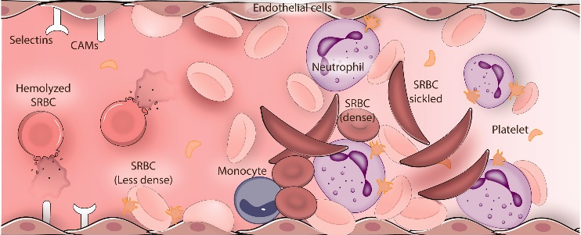
The vicious cycle
HbS polymerisation/
Sickling
Vaso-occlusive process
Intravascular hemolysis
Inflammation

Slide 7
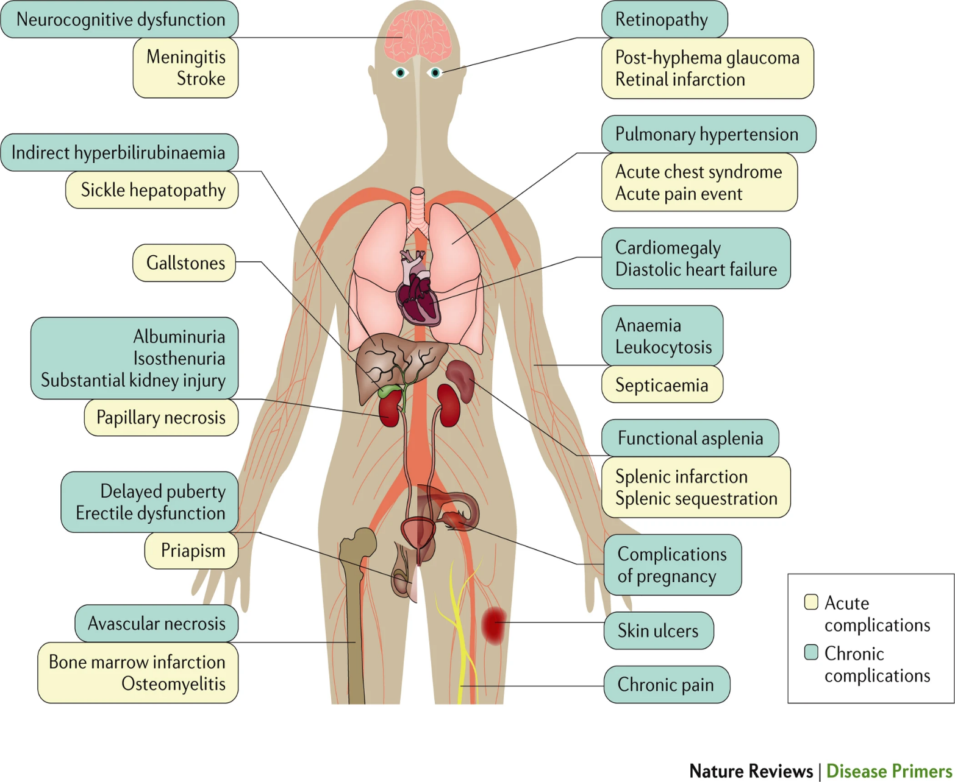
Manifestations of Sickle Cell Disease
Manifestations and complications
Acute | Hemolytic anemia
 | Painful vaso-occlusive episodes
 | Stroke
 | Acute chest syndrome
 | Infections
Chronic | Pulmonary hypertension
 | Hepatic complications
 | Kidney disease
 | Retinopathy
 | Avascular necrosis
Kato, G., Piel, F., Reid, C. et al. Sickle cell disease. Nat Rev Dis Primers 4, 18010 (2018)

Slide 8
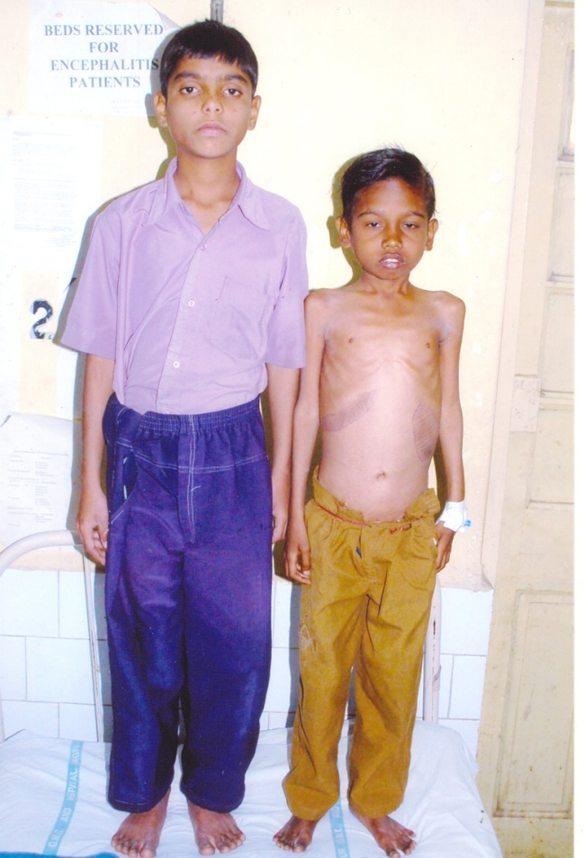
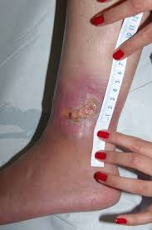
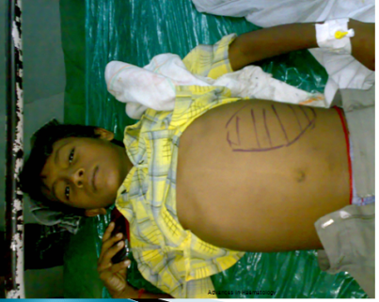
Extreme Heterogenousity in Clinical Manifestations
Notes:
This slide is very important. It should be able to give the audience an overview on heterogenous picture of the disease in India. How the disease manifestations, presentation and complications differ from state to state in India. On what parameters the patients differ from Vidarbha region, Chhattisgarh, Madhya Pradesh, Odisha and Gujarat. What could be the cause for a genetic disease to manifest in myriad patterns may be discussed and call for further investigations / analysis.

Slide 9
Management of Sickle Cell Disease - Overview
Acute Complications
Prevention
&
Treatment
Chronic Complications
Prevention
&
Treatment
Cure
Hematopoietic stem cell transplantation
Investigational Options
Health Maintenance
-Routine health visits
-Screening
-Education
-Ongoing support
-Lab monitoring
+
+
+
COMPREHENSIVE CARE

Slide 10
Evidence supported management strategies in sickle cell disease.
Penicillin prophylaxis prevents pneumococcal sepsis in children [evidence from Prophylactic Penicillin Studies I and II(PROPS I & II)].
Pneumococcal vaccine prevents pneumococcal infection in children.
Hydroxyurea decreases crises in patients with severe sickle cell disease [evidence from the Multicenter Study of Hydroxyurea in Sickle Cell Anemia (MSH) trial]
Folic acid 5 mg daily
Transfusions to reduce HbS levels to below 30% prevent strokes in children with high central nervous system blood flow [evidence from the Stroke Prevention Trial in Sickle Cell Anemia (STOP I)].

Slide 11
Timeline of drug development
1st drug approved for SCD
(Hydroxyurea)
SCD first reported
L-glutamine
New in pipeline
2017
88 years
20 years
1910
1998
2019
Crizanlizumab
Voxelotor
2023
Gene therapy

Slide 12
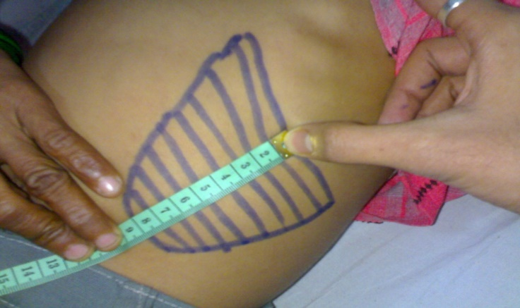
Comprehensive Health care for Newborn Screening Programme
Risk of infection
Penicillin prophylaxis
Vaccinations
Nutritional Supplements
Education and Counselling
DACTYLITIS
SEQUESTRATION CRISIS

Slide 13
Immunization schedule in addition to Routine Immunization for children
Vaccine | Age/ Frequency route IM
Pneumococcal Vaccine (conjugated) (PCV13/10) & Pneumococcal Vaccine (Polysaccharide) (PPSV23) | Starting at 6 weeks, 10 weeks, 14 weeks and booster 15 months (4 doses of PCV13/10) Then administer PPSV23 at 2 years
Pneumococcal Vaccine (conjugated) (PCV13/10) & Pneumococcal Vaccine (Polysaccharide) (PPSV23) | (Sickle cell disease) (In IAP this schedule for 1-2 years of normal children only) If child 1 year old till 5 years: give at least 2 doses of PCV13/PCV10 at intervals of 4 weeks, Followed by booster PPSV23 after at least 2 months gap (CDC recommendation)
 | (Sickle cell disease) (In IAP this schedule for all normal children >2 years old) 6 years till 18 years: Then only one dose PCV13/PCV10 is required, followed by booster with PPSV23 after 2months of the PCV13/10. After 5 years of last PPSV23 should receive booster of PPSV23 (CDC recommendation)
H-influenza vaccine | <1 year, 3 doses at an interval of 1 month; <2 years, 2 doses at an interval of 1 year >2 years, 1 dose
Typhoid Vaccine (Conjugate) (TCV) | First dose from 6 months of age till any age
Typhoid Polysaccharide vac- cine(PFS) | Given >2 years and booster dose every 3 every year
Influenza vaccine | Annually
Covid 19 vaccine | As per government guidelines

Slide 14
Management of Acute Complications
Fever
Acute Anemia
Vaso-Occlusive Pain
Medical emergency for infants
Prompt evaluation for older children and adults with antibiotic treatment
Non-pharmacologic management of pain
Pharmacologic pain plan
Hydration
CBC, reticulocyte count
Confirm cause
Red blood cell transfusion
Notes:
We need to include overt strokes management- DeBaun Blood Advances ASH guidelines

Slide 15
Management of Acute Complications
Hepatobiliary Complications
Acute Chest Syndrome
Referral to hematologist for consideration of surgery
Surgical consult
Transfusion prior to surgery to prevent acute chest syndrome
Antibiotics
O₂ if pO₂ <94%
Incentive spirometry
Simple transfusion for mild symptoms, RBC exchange for severe symptoms
Acute Sequestration crisis
Oxygen treatment
Arrange for blood transfusion
ICU admission
Notes:
We need to include overt strokes management- DeBaun Blood Advances ASH guidelines

Slide 16
Treat PAIN as a DISEASE

Slide 17
Vaso-Occlusive Crisis (VOC)
PAIN
Acute
Chronic
Neuropathic

Slide 18
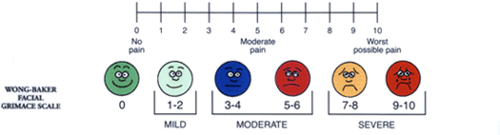
SCD : Pain Measurement Tools

Slide 19
SCD :
Pain Management
Pain management should begin as soon as there is aura of pain
DO NOT wait for the pain to being/worsen to commence treatment
Once analgesics started for pain, continue to ATLEAST 5 days irrespective of the pain
After 5 days of the analgesic course, begin tapering by reducing the dose – but keep dosing interval fixed (TDS)
DO NOT taper as TDS --- BD --- OD
If pain is refractory for 24 hours, add the 2nd analgesic
Blood Transfusion
IV Fluids

Slide 20
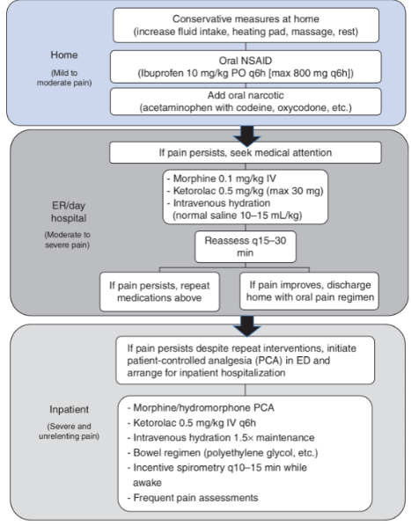
Management of Pain : SCD
PARACETAMOL
OTHER NSAID`S:
DICLOFENAC
KETOROLAC
OTHER OPIODS:
TRAMADOL
CHRONIC NEUROPATHIC PAIN :
GABAPENTINE
PREGABALINE
AMITRYPTILLINE

Slide 21
Ideal health maintenance for children with sickle cell disease
Physical examination | Age | Frequency
All systemic examination | 0-24 months | Every month till 3 months if possible
 | >24 months | Every three months
Laboratory tests
CBC /Platelet/ reticulocyte | 3-24 months | Every 3 months
 | >24 months | Every 3 months (Monthly if on Hydroxyurea)
Renal function tests | 12months | Annually (every 3 months if on Hydroxyurea OR if micro- albuminuria present)
Liver function Tests | 12 months | Annually (every 3 months if on Hydroxyurea)
Urine Analysis for micro-albuminuria | >6 years | Annually If abnormal repeat every 3 months
Serum ferritin | Iron deficiency and iron overload are both seen, if iron overload regular monitoring needed. | Every 6 months for those on regular blood transfusions.
Screening test
Physical examination | Age | Frequency
Transcranial Doppler | 2-18 years | Annually, if borderline repeat every 4 months, if abnormal repeat after 2-4 weeks. Do MRI if abnormal.
Pulmonary function tests | >6 years | Annually based on clinical course
Echocardiogram USG | >8 years | Annually or depending on symptoms.

Slide 22
Management of Chronic Complications
Mental Health
Overt Strokes and Silent Strokes
Elevated Tricuspid Jet Velocity or
NT-BNP
Renal
Chronic Pain
Asthma or Recurrent Wheezing
Prevention is critical
Brandow AB, et al. Blood Adv. 2020;4(12):2656-2701. Zhao D, et al. J Orthopaedic Transl. 2020;21:100-110.
National Heart Lung and Blood Institute. Published 2014. https://www.nhlbi.nih.gov/sites/default/files/media/docs/sickle-cell-disease-report%20020816_0.pdf
Accessed February 9, 2021. Liem RI, et al. Blood Adv. 2020;3(23):3867-3897.
Notes:
Hello,
We need to put silent stroke and overt stroke into the management of chronic complications.
For pulmonary hypertension we need to put NT-BNP and six minute walk

Slide 23
Management of Chronic Complications (cont)
Chronic Pain
-R/O other causes (AVN, other fractures)
-Individualized plan
-Formal evaluation for depression and anxiety
-Primary care provider referral
Brandow AB, et al. Blood Adv. 2020;4(12):2656-2701. Zhao D, et al. J Orthopaedic Transl. 2020;21:100-110.
National Heart Lung and Blood Institute. Published 2014. https://www.nhlbi.nih.gov/sites/default/files/media/docs/sickle-cell-disease-report%20020816_0.pdf
Accessed February 9, 2021. Liem RI, et al. Blood Adv. 2020;3(23):3867-3897.
Notes:
Hello,
We need to put silent stroke and overt stroke into the management of chronic complications.
For pulmonary hypertension we need to put NT-BNP and six minute walk

Slide 24
Management of Chronic Complications (cont)
Mental Health
-Ongoing assessment of depression and anxiety
-Primary care management
-Referral to mental health therapist
Brandow AB, et al. Blood Adv. 2020;4(12):2656-2701. Zhao D, et al. J Orthopaedic Transl. 2020;21:100-110.
National Heart Lung and Blood Institute. Published 2014. https://www.nhlbi.nih.gov/sites/default/files/media/docs/sickle-cell-disease-report%20020816_0.pdf
Accessed February 9, 2021. Liem RI, et al. Blood Adv. 2020;3(23):3867-3897.
Notes:
Hello,
We need to put silent stroke and overt stroke into the management of chronic complications.
For pulmonary hypertension we need to put NT-BNP and six minute walk

Slide 25
Management of Chronic Complications (cont)
Overt Strokes and Silent Strokes
-Standard care
-Blood transfusion therapy
-Iron chelation
-Bone marrow transplant
Brandow AB, et al. Blood Adv. 2020;4(12):2656-2701. Zhao D, et al. J Orthopaedic Transl. 2020;21:100-110.
National Heart Lung and Blood Institute. Published 2014. https://www.nhlbi.nih.gov/sites/default/files/media/docs/sickle-cell-disease-report%20020816_0.pdf
Accessed February 9, 2021. Liem RI, et al. Blood Adv. 2020;3(23):3867-3897.
Notes:
Hello,
We need to put silent stroke and overt stroke into the management of chronic complications.
For pulmonary hypertension we need to put NT-BNP and six minute walk

Slide 26
Management of Chronic Complications (cont)
Elevated Tricuspid Jet Velocity or NT-BNP
-Standard care
-Echocardiogram if symptomatic
-Referral if TRV ≥2.5 m/sec
Brandow AB, et al. Blood Adv. 2020;4(12):2656-2701. Zhao D, et al. J Orthopaedic Transl. 2020;21:100-110.
National Heart Lung and Blood Institute. Published 2014. https://www.nhlbi.nih.gov/sites/default/files/media/docs/sickle-cell-disease-report%20020816_0.pdf
Accessed February 9, 2021. Liem RI, et al. Blood Adv. 2020;3(23):3867-3897.
Notes:
Hello,
We need to put silent stroke and overt stroke into the management of chronic complications.
For pulmonary hypertension we need to put NT-BNP and six minute walk

Slide 27
Management of Chronic Complications (cont)
Renal
-Screen for proteinuria beginning at age 5-6 years
-ACE-I or ARB if albuminuria
ACE-I, angiotensin converting enzyme inhibitor; ARB, angiotensin receptor blocker
Brandow AB, et al. Blood Adv. 2020;4(12):2656-2701. Zhao D, et al. J Orthopaedic Transl. 2020;21:100-110.
National Heart Lung and Blood Institute. Published 2014. https://www.nhlbi.nih.gov/sites/default/files/media/docs/sickle-cell-disease-report%20020816_0.pdf
Accessed February 9, 2021. Liem RI, et al. Blood Adv. 2020;3(23):3867-3897.
Notes:
Hello,
We need to put silent stroke and overt stroke into the management of chronic complications.
For pulmonary hypertension we need to put NT-BNP and six minute walk

Slide 28
Indian Scenario
Baseline HbF in Indian children is 15-18
Robust Indian Data supporting the use of 10-15 mg HU
Primary outcome : Clinical >>>Hematological
Affordability
Monitoring
Follow up
Compliance

Slide 29
Start HU 10 mg/kg
Cumulative Assess after 4 months
Has there been a clinical improvement of >25%?
YES
NO
Continue and stabilize the HU dose on 10 mg/kg
No Dose Escalation required
Increase HU dose by
5 mg/kg
Cumulative Assess after 4 months
If >25% clinical improvement – Stabilize the dose
Escalate by 5 mg/kg every 4 months till the dose of 25 mg/kg is reached
OR
> 25% clinical improvement – whichever earlier

Slide 30
HU in SCD : Summary
Low fixed dose of HU is efficacious in improving clinical parameters
Acceptable to the patient
Transient neutropenia, thrombocytopenia
Pregnancy, Infertility ??
Personalized dosing based on pharmacokinetic modelling
Better monitoring, Physician training and quality control of HU therapy in SCD in India
Standardization and Protocols are the mainstay of treatment and follow up

Slide 31
Hydroxyurea
CASE SCENARIO 1
CASE SCENARIO 2
Mr Sunil, a 25 year old male patient, known case of sickle cell disease “SS” pattern came with H/O yellowish discolouration of body and swelling all over the body.
He was started on Hydroxyurea at the age of 10 years and has been taking it on weekends only.
He has never been on follow up since then for any blood investigations.
Ms Lata, a 18 year old adolescent female came with c/o severe pallor of body.
Was started on Hydroxyurea 5 years back and stopped it 15 months ago, in view of ? Reason not known – as told by a near by physician.
Checking her documents, A persistently low Platelet count was found before stopping Hydroxyurea.
However she had not gone for follow up since then.
Daily dosing is the only recommendation.
Weight appropriate dose as age increases.
Regular follow up with appropriate investigations when on therapy.

Slide 32
Recommendations Against Transfusion
COMPLICATIONS
Anemia, asymptomatic
Kidney injury, unless multisystem organ failure
Pain crisis, uncomplicated
Priapism
CHRONIC Splenic sequestration, Recurrent

Slide 33
Lesson 1 : Anemia
A 6 years old Meenal SS patient admitted, 5-6 times/year for blood transfusion to maintain Hb 8gm% since the age of 3 years.
Died in 2008
Fulminant Hepatitis
Retrovirus Positive
Blood can cause more harm than good to SS Patients
PALLOR
Cases of low haemoglobin Level
Bone marrow (n = 54)
Infection Iron deficiency Folate Deficiency
Combined. Aplastic crisis. Sequestration crisis Hypersplenism

Slide 34
Lesson 2: Anaemia
Vishal, 9 year old admitted from Betul with Hb 5gm%.
No CCF, no Encephalopathy, compensated anaemia.
Reticulocyte count | Mcv reduced | Mcv unchanged | Mcv increased
0% |  | Aplastic crisis
2-5% | Iron deficiency | Combines deficiency Renal failure Infection | Folate deficiency
8-12% | Blood loss | Blood loss
>20% | Iron deficiency on treatment | Acute splenic sequestration Hypersplenism Hepatic sequestration | Folate deficiency on treatment
LOOK FOR CAUSES OF ANAEMIA AND TREAT

Slide 35
Lesson 3 : Malaria
4 years old Raghav (AS) admitted with gross pallor, splenomegaly and fever
PS for Malarial Parasite positive (vivax and Falciparum)
Malaria seen as much in normal patients
Think Malaria – May need prophylaxis

Slide 36
Lesson 4 : Prophylaxis for Infection
Bacteremia in Sickle Cell Disease in India raises the question of epidemiology of bacterial Infection
(Cohort Study)
Pneumococcal Prophylaxis
? Others site specific
Pneumococcal Infections and Sickle Cell disease in Africa : does absence of evidence imply evidence of absence Arch Dis Child 2009 94: 713-716
Bacteraemia in homozygous sickle cell disease in Africa : is pneumococcal prophylaxis justified? Arch Dis Child 2007; 92 : 21-23

Slide 37
Lesson 5 : Protocol
Comprehensive health care guidelines available from World Literature is collected on patients with different background
Where there is no malaria, no malnutrition and no severe bacterial and viral infections
Guidelines for resource restrain countries
Multidisciplinary Team (Commitment)

Slide 38
Living Well With Sickle Cell Disease
SPIROMETER
MASK
TABLETS
PULSE OXIMETER
WATER BOTTLE
MARKER
THERMOMETER
SICKLE DIARY

Slide 39
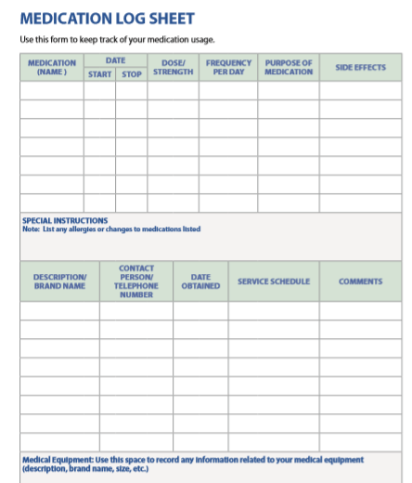
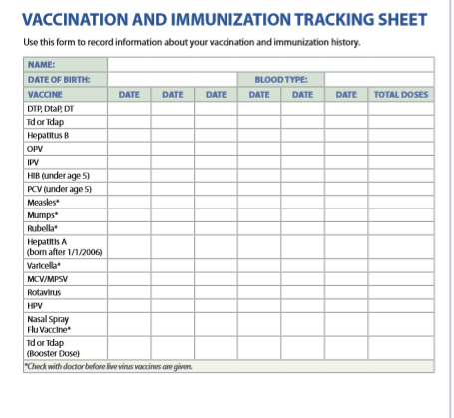
Record keeping diary

