Slide 1
Sickle cell disease: manifestations and complications
Dr Tulika Seth
AIIMS, New Delhi

Slide 2
Single gene mutation- HbS (α2β2^{6 glu-val})
One point mutation in the gene coding globin causes a substitution of thymidine for adenine at position 6 of glutamic acid DNA codon-
results in valine instead of glutamic acid.
The resulting hemoglobin tetramer (alpha2/betaS2) is poorly soluble when deoxygenated
The sickle shaped cells are more rigid and sticky. They can block small blood vessels.
These RBC are not very deformable and break leading to a shorter life span, this hemolysis causes anemia.
Notes:
valine for glutamic acid as the seventh amino acid of the beta globin chain. The resulting hemoglobin tetramer (alpha2/betaS2) is poorly soluble when deoxygenated

Slide 3
Why Sickle cell disease?
Polymerization of Hemoglobin S in the red blood cells (RBCs) occurs under various stressors- dehydration, hypoxemia etc.
Initially reversible
Then permanent
These rigid RBCs adopt the characteristic - sickle shape
Anemia not always present- Sickle cell disease
Why icterus?- due to hemolysis
Anemia depends on rate of red blood cell production and destruction, and other variables – other inherited mutations, nutrition etc.

Slide 4
HbSS homozygous : green depicts mutation for sickle cell disease
C N
Healthy, but carrier of
a mutated gene
C N
Healthy, but carrier of
a mutated gene
C C
Both genes mutated, suffers from severe form of disease
C N
Healthy,
but carrier of a mutated gene
C N
Healthy,
but carrier of a mutated gene
N N
Normal,
no mutated gene

Slide 5
Inheritance of compound heterozygote state - e.g. HbSβ (sickle beta thalassemia)
C N
Healthy, but carrier of a HbS mutated gene
C N
Healthy, but carrier of a mutated gene Hbβ
C C
Both genes mutated, suffers from severe form of disease HbSβ
C N
Healthy, but carrier of a mutated gene (HbS trait)
C N
Healthy, but carrier of a mutated gene
Hbβ trait
N N
Normal,
no mutated gene

Slide 6
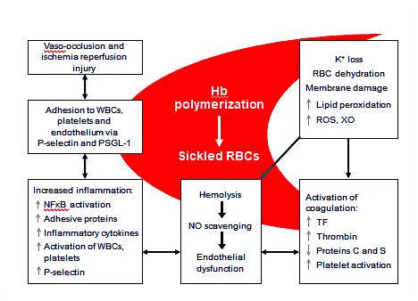
Definition and mechanism of VOC
DEFINITION:
VOC is defined as pain resulting from tissue ischaemia caused by Vaso occlusion most commonly in bone(s) and bone marrow.

Slide 7
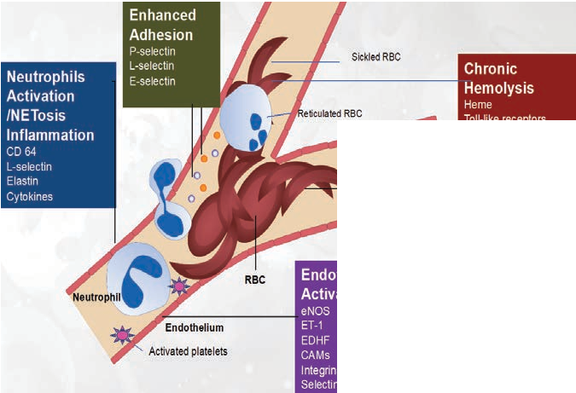
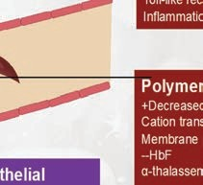
Blockage = infarction / ischemia & results in pain / vaso-occlusive (VOC) crises

Slide 8
VOC has four distinct phases days¹
4 stages of VOC
3. Established phase¹
Patients maintain peak pain severity
Signs of joint effusion and inflammation
2. Initial phase¹
Patients reach peak pain severity
Increased anxiety
Prodromal phase
Initial phase
Established phase
Resolving phase
1. Prodromal phase¹
Symptoms
include numbness,
paresthesia,
and vague aches
May be asymptomatic
4. Resolving phase¹
Pain severity decreases
Categorical pain scale
Common timing for onset of complications eg ACS, MOF, relapse, death
Day
1. Ballas SK et al. Blood 2012;120:3647–56
Notes:
Average 9-11 days

Slide 9
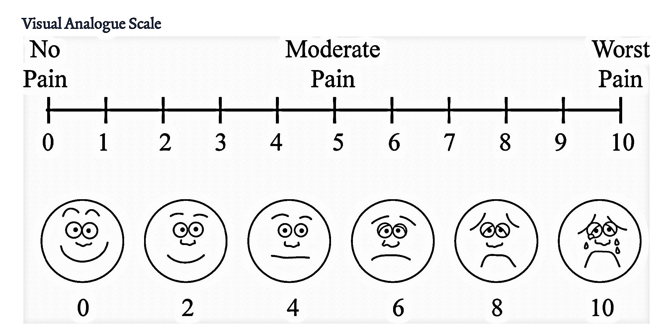
VOC is not just pain
Pain can affect any body part.
abdomen, bones, joints, and soft tissue, may present as dactylitis (bilateral painful and swollen hands and/or feet in children), acute joint necrosis or avascular necrosis, or acute abdomen.
End organ damage-
With repeated episodes in the spleen, infarctions and auto-splenectomy predisposing to life-threatening infection are usual. The liver also may infarct and progress to failure with time.
Papillary necrosis is a common renal manifestation of vaso-occlusion, leading to iso-thenuria
Chronic pain-
Many individuals with SCD experience chronic low-level pain, mainly in bones and joints. Intermittent vaso-occlusive crises may be superimposed, or chronic low-level pain may be the only expression of the disease

Slide 10
Triggers of VOC
Often, no precipitating cause can be identified.
However, as deoxygenated hemoglobin S (HbS) polymerizes, likely physiologic trigger of vaso-occlusive crises is hypoxemia.
Dehydration can precipitate pain, since acidosis results in a shift of the oxygen dissociation curve (Bohr effect), causing hemoglobin to desaturate more readily.
Hemo-concentration also is a common mechanism.
Another common trigger is changes in body temperature
increase due to fever or a decrease due to environmental temperature change.
Lowered body temperature likely leads to crises as the result of peripheral vasoconstriction. Patients should wear proper clothing and avoid exposure to ensure normal core temperature
Stress , infections, physical exertion, change in atmospheric pressure etc.

Slide 11
Sickle cell disease
Manifestation - Presentation- history, clinical features and investigations
Complications - discuss briefly
Age wise variations,
variability homozygous sickle cell,
Sickle beta thalassemia
Other mutation combinations seen etc.

Slide 12
Fetal to adult globin switch
Sickle cell disease (SCD) usually manifests early in childhood.
But for the first 6 months of life, infants are protected largely by elevated levels of HbF
After 6 months HbF starts to decrease and HbA should increase,
But in patients the HbS now rises
and the condition becomes evident.
Cold Spring Harb Perspect Med 2013;3:a011643
Notes:
BCL11A binding site

Slide 13
VOC variability
Variable presentation Spectrum –
The most common clinical manifestation of SCD is vaso-occlusive crisis.
Approximately half of individuals with homozygous HbSS disease
experience vaso-occlusive crisis (VOC).
The frequency of crisis is extremely variable-
Some have as many as 6 or more episodes annually,
whereas others may have episodes only at great intervals or none at all.
Each individual typically has a consistent pattern for crisis frequency.
A vaso-occlusive crisis occurs when the micro-circulation is obstructed by sickled RBCs, causing ischemic injury to the organ supplied and resultant pain.
Pain crises constitute the most distinguishing clinical feature of sickle cell disease and are the leading cause of emergency department visits and hospitalizations for affected patients
History – visits crying, pain

Slide 14
Some known genetic Modifiers of sickle cell disease-
Neurohemorrhagic stroke
VCAM1, TNFα, 1L4R,
LDLR, TGFβ, ANAX2, ADRB2 , SELP
VOC ?
Stroke? retinopathy?
Pulmonary artery hypertension
TGFβ,
BMP
Variability of phenotype
Genotype- type of mutation- Arab –Indian, Bantu etc.
HbF levels
Genetic Modifiers- other genes
Other factors- diet, environment etc.
Monitor and tailor therapy
Cholelithiasis
UGT1A
Renal failure
BMPR1B
Priapism
TGFβ, BMP, KL
Osteonecrosis
BMP6, ANXA2, KL
Bacteremia
TGFβ, BMP
Leg ulcers
TGFβ, BMP

Slide 15
Age related variable presentation & complications
Infancy increased susceptibility to infections-fever, pneumonia, dactylitis, crises- crying ( immunizations, parental guidance)
Older children - medical treatment for
anemia,
splenic sequestration,
stroke
Recurrent infections
Pain- acute VOC, acute chest syndrome and chronic pain
Renal problems
Adult patients-
AVN head of femur, cardiac, eye, CNS, difficulty getting pregnant or obstetric problems.,
Pulmonary artery hypertension,
end organ damage, shortened life expectancy

Slide 16
Dactylitis
Bone pain is often due to bone marrow infarction.
Certain patterns are predictable, since pain tends to involve bones with the most bone marrow activity and because marrow activity changes with age.
Infants with SCD may develop hand-foot syndrome/ dactylitis
Present with severe pain and soft tissue swelling of the dorsum of the hands and feet.
The syndrome develops suddenly and lasts 1-2 weeks the metatarsals and metacarpals can be involved, presenting as dactylitis or hand-foot syndrome.
Hand-foot syndrome occurs between age 6 months and 3 years;
it is not seen after age 5 years because hematopoiesis in the small bones of the hands and feet ceases at this age.
Cortical thinning and destruction of the metacarpal and metatarsal bones appear on radiographs 3-5 weeks after the swelling begins.
Leukocytosis or erythema does not accompany the swelling.
DACTYLITIS
Notes:
d/d osteomyelitis

Slide 17
Others skeletal problems at different ages
As the child grows older
Pain often involves the long bones of the extremities, sites that retain marrow activity during childhood.
Proximity to the joints and occasional sympathetic effusions lead to the belief that the pain involves the joints.
Adolescent and older
As marrow activity recedes further during adolescence, pain involves the vertebral bodies, especially in the lumbar region. Vertebral infarcts – acute or chronic back pain
Although the above patterns describe commonly encountered presentations, any area with blood supply and sensory nerves can be affected
Bone infarcts – any bone affected ribs
Avascular necrosis of femur and shoulder
Osteomyelitis

Slide 18
Musculo-skeletal complications
System | Complication
Skeletal | Dactylits, Bone Infarcts Avascular Necrosis, Osteomyelitis, Septic Arthritis, Growth Defects Pathological Fractures
skin | Leg Ulcers
Muscle | Myonecrosis, pyomyositis

Slide 19
Splenic sequestration
Occurs with highest frequency during the first 5 years of life in children with HbSS / SCD.
Splenic sequestration can occur at any age in individuals with other sickle syndromes.
Characterized by rapid enlargement of the spleen and sudden life-threatening anemia with high reticulocyte count
Splenic sequestration is a medical emergency that demands prompt and appropriate treatment.
Parents should be familiar with the signs and symptoms of splenic sequestration crises.
Children should be seen as rapidly as possible in the emergency room.
Because these episodes tend to recur, many advocate long-term transfusion in young children and splenectomy in older children

Slide 20
Growth
Stunting has been confirmed and this reduction in body habitus is reportedly more pronounced in males than females. Data from many countries including India exists indicating lower than normal anthropometric measurements in adults and adolescents who are HbSS patients
Rhodes et al found that children with SCD progressed more slowly through puberty than healthy control children.
Affected pubertal males were shorter and had significantly slower height growth than their unaffected counterparts, with a decline in height over time;
Why?
The resting metabolic rates (RMR) in SCD children is higher than normal children.
Protein metabolism consumes approximately 30% of energy at rest, and recent data indicate that the high resting energy expenditure (REE) in HbSS is determined primarily by energy needs for cardiac compensation and increased protein metabolism
Hyacinth HI, Gee BE, Hibbert JM. The Role of Nutrition in Sickle Cell Disease. Nutr Metab Insights. 2010 Jan 1;3:57-67
Rhodes M, Akohoue SA, Shankar SM, Fleming I, Qi An A, Yu C, Acra S, Buchowski MS. Growth patterns in children with sickle cell anemia during puberty. Pediatr Blood Cancer. 2009 Oct;53(4):635-41
Badaloo A, Jackson AA, Jahoor F. Whole body protein turnover and resting metabolic rate in homozygous sickle cell disease. Clin Sci. 1989;77(1): 93–7.
Hibbert JM, Creary MS, Gee BE, et al. Erythropoiesis and myocardial energy requirements contribute to the hypermetabolism of childhood sickle cell anemia. J Pediatr Gastroenterol and Nutr. 2006;43(5):680–7.

Slide 21
Pathogen | Predisposing factor to infection in PwSCD – (but not only factor)
Encapsulated bacteria (e.g., Streptococcus pneumoniae, Haemophilus influenzae, Neisseria meningitidis, Salmonella spp) | Impaired splenic function
Salmonellae | Impaired opsonization Recurrent vaso-occlusion with intestinal infarct, necrosis and increased gut permeability Decreased neutrophil killing
Malaria | Decreased deoxyhemoglobin solubility
Parvovirus Hepatitis B, C Yersinia enterocolitica Edwardsiella tarda Mycoplasma Chlamydophila | Increased red cell turnover Multiple blood transfusion Iron overload Increased intestinal permeability and biliary sludging Unknown Unknown

Slide 22
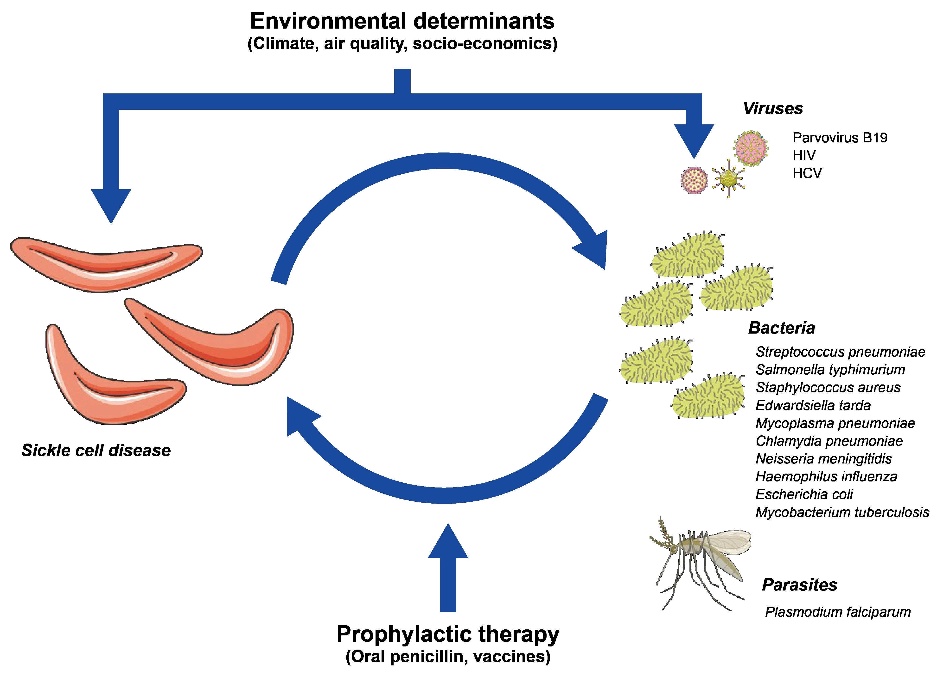
Relationship Between SCD and Infections
Association between SCD and infections under the potential influence of environmental determinants
SCD increases susceptibility to infections, while infections lead to SCD-specific pathophysiological changes.
Infections increase the risk of sickling by nonspecific effects through fever, anorexia, nausea, vomiting, and diarrhea, all of which contribute to dehydration.
Prophylactic therapy could lead to substantial improvement in both low- and high-income countries
Cannas G, et al. Mediterr J Hematol Infect Dis. 2019;11(1):e2019042.
HCV: Hepatitis C virus; HIV: Human immunodeficiency virus; SCD: Sickle cell disease.

Slide 23
Deciding about sending child with SCD to hospital for admission or outpatient or home treatment
GREEN MANAGE AT HOME | YELLOW CALL DOCTOR/ VISIT CLINIC | RED NEEDS ADMISSION
Mild pain No breathing problems No fever Child eating and drinking Up to date on immunizations on oral penicillin Parental treatment at home with bed rest, oral analgesia, and hydration is possible | Fever 99-100^{O}c Mildly reduced food and liquid Up to date on immunizations on oral penicillin Pain not resolved at home- visit hospital – should receive pain medicines within 30 minutes | Child less than 18 months of age Sick looking High Fever (101 ⁰C or more) or fever for at least 2 days Breathing faster Pulse oximetry less 94% Looks yellow/pale Less active Reduced drinking or eating Pain (VAS >7/10) or pain lasting more than 3 days Or any- Pain with aplastic crises/ swelling of body part/ breathing fast/ Spleen enlargement Priapism Child with fever & previous admission for sepsis Any altered consciousness, confusion, loss of consciousness, neurologic weakness. Has been recently discharged within last 10 days from hospital
HIGH RESPIRATORY RATE IN CHILDREN CAN MEAN PNEUMONIA/ SEPSIS/ ACS
Age | Normal respiratory rate (breaths per minute) | Tachypnea threshold (breaths per minute)
2 to 12 months | 25 to 40 | 50
1 to 5 years | 20 to 30 | 40
TOT Manual- MOTA & MOHFW

Slide 24
Anemia
Anemia is not universally present.
But is frequently seen- normochromic, normocytic anemia
Children exhibit few manifestations of anemia because they readily adjust by increasing heart rate and stroke volume; however, they have decreased stamina, which may be noted on the playground or when participating in physical education class
When present it can be chronic and hemolytic in nature and may be well tolerated.
While patients with an Hb level of 6-7 g/dL who are able to participate in the activities of daily life in a normal fashion are not uncommon, their tolerance for exercise and exertion tends to be very limited.
Acute anemia - Sequestration, aplastic crises, periodic bouts of hyperhemolysis may occur or due to infections related myelo-suppression etc.
Other causes of anemia-
Acute anemia may be complicated with megaloblastic changes secondary to folate deficiency. These result from increased RBC turnover and folate utilization.
Iron deficiency anemia can occur- in those not requiring blood transfusions

Slide 25
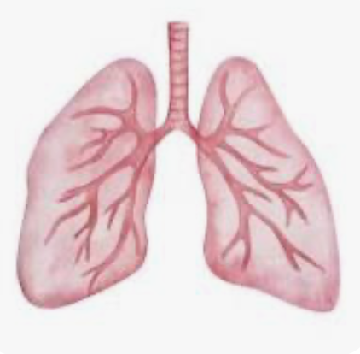
System | Complication | Pathology and imaging findings | Proposed mechanisms
Pulmonary system | Acute chest syndrome | Wedge pulmonary infarction In situ pulmonary thrombosis Rib infarction Pleural effusions Multi-lobar consolidations Foamy alveolar macrophages Arteriolar thrombosis | Necrotic marrow and fat embolization Atelectasis and central hypoventilation Heme-mediated stimulation of TLR4 and inflammasome pathways Hyperadhesion of platelets and neutrophils Infection
 | Restrictive lung disease | Decreased DLCO and TLC Lung fibrosis at the bases | Increased circulating and activated fibrocytes?
 | Pulmonary hypertension | Plexiform lesions Intimal hyperplasia Intraluminal thrombosis | Hemostatic activation (CTEPH) Cell-free hemoglobin quenching of NO
Annu. Rev. Pathol. Mech. Dis. 2019. 14:263–92
Notes:
Chronic thromboembolic pulmonary hypertension CTEPH)

Slide 26
Lung in acute chest syndrome (ACS)
ACS - clinical presentation is dramatic and the diagnosis straightforward
More common in children & has a high mortality
Pathology -ACS is a complication of VOC, usually occurs 2–3 days after the onset of vaso-occlusive pain crises
The link to VOC ?
hydroxyurea reduces the incidence of ACS
Hyperinflammatory event –
classic acute lung injury presents with alveolar-capillary leak and neutrophilic inflammation,
may be radiographically and clinically indistinguishable from multi-lobar pneumonia
May have a microbial trigger, but pathology is infarction
Hyperinflammatory response with release of cytokines, recruitment of neutrophils, and sterile inflammation –
that leads to breakdown of the endothelial-epithelial barrier (gap formation),
alveolar capillary leak, and
oxygen exchange difficulty.
Can progress to ARDS.
Free heme , cell free hb and eDAMPs
Bacteria
Activated platelets
Sickled red blood cells,
fat and marrow embolism
Neutrophils- activated, hyper adhesion with P selectins
Thickened hyaline membrane
Pulmonary edema with inflammatory cells
Interstitial edema

Slide 27
Acute Chest Syndrome (ACS) in child vs adults Because the appearance of radiographic changes may be delayed, the diagnosis may not be recognized immediately
Children
Acute chest syndrome consists of chest pain, fever, cough, tachypnea, leukocytosis, and pulmonary infiltrates in the upper lobes.
Acute chest syndrome begins with infarction of ribs, leading to chest splinting and atelectasis.
acute chest syndrome is usually due to infection.
Adults
Adults with ACS are usually afebrile and dyspneic with severe chest pain and multi-lobar and lower lobe disease.
Other etiologies include pulmonary infarction and fat embolism resulting from bone marrow infarction.
Infection can be a trigger
Notes:
Recognition of the specific cause is less critical than the ability to assess the management and pace of the lung injury.

Slide 28
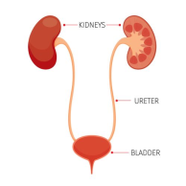
System | Complication | Pathology and imaging findings | Proposed mechanisms
Genito-urinary system | Priapism | Impaired venous outflow from the penis | NO depletion leading to low PDE-5 levels Sludging of erythrocytes in the penile vasculature Elevated adenosine levels
 | Chronic kidney disease | Focal segmental glomerulosclerosis Mesangial abnormalities Glomerual hypertrophy and hyperfiltration | Trafficking of macromolecules escaped from the glomerulus into the mesangial space and tubular epithelium Hemodynamic-mediated glomerular injury
 | Papillary necrosis of the kidney | Clubbed calyces (RPG) Parenchymal enhancement of the kidney (RPG) Triangular hypo-attenuated areas (CT) | Medullary ischemia Increased blood viscosity in vasa recta
Annu. Rev. Pathol. Mech. Dis. 2019. 14:263–92
Notes:
Phospho- diesterase 5

Slide 29
System | Complication | Pathology | Proposed mechanisms
Cardiac system complications | Elevated pulmonary artery systolic pressure Pulmonary hypertension | Plexiform lesions Intimal hyperplasia Intraluminal thrombosis Chronic anemia and thrombosis WHO group 5 – SCD can have group 1, 2, and 4 forms of PH | Hemostatic activation (CTEPH) Cell-free hemoglobin quenching of NO Hyper-adhesion of platelets and neutrophils Infection thrombosis
 | Left ventricular diastolic heart disease Coronary artery dilation | Chronic anemia and micro-infarcts Hypertension Hypoxia | Chronic hypoxemia Heme-mediated stimulation of TLR4 and inflammasome pathways
 | Dysrhythmia, sudden death | Diffuse myocardial fibrosis – Hemolysis and blood transfusion lead to hemosiderin deposition in the myocardium | Increased circulating and activated fibrocytes?
Annu. Rev. Pathol. Mech. Dis. 2019. 14:263–92
Notes:
The heart is involved due to chronic anemia and microinfarcts. Hemolysis and blood transfusion lead to hemosiderin deposition in the myocardium.
Both ventricles and the left atrium are all dilated.
A study by Nicholson et al also indicated that coronary artery dilation is common in children with SCD. The prevalence of coronary artery ectasia in patients with SCD was 17.7%, compared with 2.3% for the general population.[33]
Furthermore, a systolic murmur is usually present, with wide radiation over the precordium

Slide 30
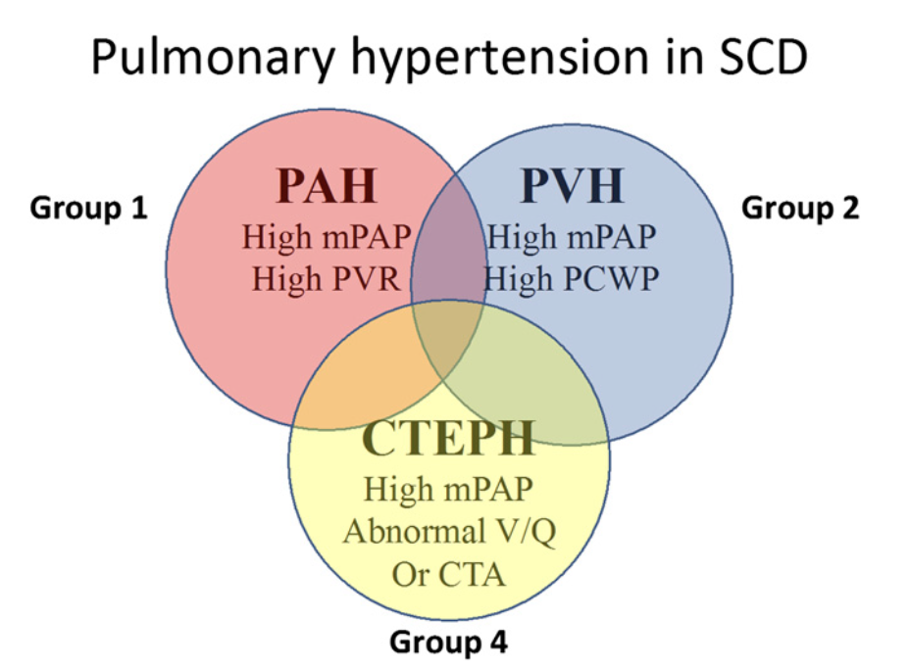
Chronic intravascular hemolysis leads to precapillary pulmonary arterial hypertension (PAH)
and pulmonary arteriole vaso-constriction and smooth muscle hypertrophy, and chronic anemia leads to diastolic left heart disease (now also called HFpEF).
Clinical types of PH observed in patients with SCD.
CTA, computed tomography angiography; CTEPH, chronic thromboembolic PH; mPAP, mean pulmonary artery pressure; PCWP, pulmonary capillary wedge pressure; V/Q, ventilation/perfusion.
Gladwin MT. Cardiovascular complications in patients with sickle cell disease. Hematology Am Soc Hematol Educ Program. 2017 Dec 8;2017(1):423-430. doi: 10.1182/asheducation-2017.1.423.
Notes:
Group 4 Chronic thromboembolic pulmonary hypertension
There are controversies surrounding TRV as a measure of PH. TRV can be used to estimate pulmonary artery systolic pressure and clearly identifies adult patients at high risk of death, but it should not be con- sidered a gold standard for the diagnosis of PH
Utility of TRV combined with a 6min walk test and high NT-proBNP level to diagnose patients with PH

Slide 31
System | Complication | Pathology and imaging findings | Proposed mechanisms
Hepatic system | Hepatic sequestration | Acute hepatomegaly Dilated sinusoids | Massive sequestration of erythrocytes in the liver Compression of biliary ducts by massively enlarged sinusoids Kupffer cell erythrophagocytosis
 | Cholelithiasis & Cholecystitis | Hemolysis | Pigment calculi
 | Hepatic crisis and intrahepatic cholestasis | Sinusoidal obstruction by sickle cells Dilated biliary canalicules with bile plugs Kupffer cell hyperplasia Centrilobular necrosis | Ischemia and infarction caused by sinusoidal occlusion Massive necrosis in intrahepatic cholestasis
Annu. Rev. Pathol. Mech. Dis. 2019. 14:263–92

Slide 32
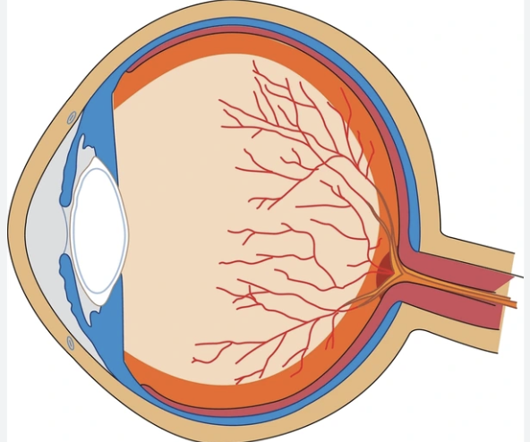
System | Eye part affected | Pathologic | Proposed mechanisms
Ophthalmic complications | Posterior segment | Optic disc changes Posterior retinal and macular vascular occlusion Chronic macular changes sickling maculopathy Choroidal vaso- occlusion Non- proliferative retinal changes Proliferative retinal changes | Vaso-oclusive crises (VOC) caused by sickled erythrocytes and increased adhesion of these cells to the vascular endothelium. Also due to secondary tissue changes in all vascular structures of the eye
 | Anterior segment | Corkscrew conjunctival vessels Iris infarct and atrophy Cataracts Phthisis bulbi Hyphema Lacrimal gland enlargement | Vaso-oclusive crises (VOC) caused by sickled erythrocytes and increased adhesion of these cells to the vascular endothelium. Also due to secondary tissue changes in all vascular structures of the eye
Al-Jafar, H. , Abul, N. , Al-Herz, Y. and Kumar, N. (2020) Ocular Complications in Sickle Cell Disease: A Neglected Issue. Open Journal of Ophthalmology, 10, 200-210. doi: 10.4236/ojoph.2020.103022.

Slide 33
System | Complication | Pathology and imaging findings | Proposed mechanisms
Central nervous system complications | Stroke | Large and medium artery intimal hyperplasia of the MCA and/or ICA Large-vessel thrombosis Saccular aneurysms Moya moya syndrome | Decreased functional reserve (CBF maximized at baseline) Decreased vascular autoregulation Hemostatic activation ?
 | Cognitive impairment | Silent cerebral infarct Small-vessel rarefaction ? | Small-vessel dysfunction ?
Annu. Rev. Pathol. Mech. Dis. 2019. 14:263–92
Notes:
It is usually ischemic in children and hemorrhagic in adults-Hemorrhagic stroke is associated with a mortality rate of more than 29%
These silent brain infarcts occur in 17% of patients and may be associated with deterioration in cognitive function, with effects on learning and behavior; these infarcts may increase the potential risk for clinical and subclinical damage to the CNS
Convulsions are frequently associated with stroke. Convulsions occur as an isolated event but also appear in the setting of evolving acute chest syndrome, pain crisis, aplastic crisis, and priapism.
Rapid and excessive blood transfusion to a hemoglobin level of greater than 12 g/dL increases blood viscosity and can lead to stroke.

Slide 34
Physical exam -
Scleral icterus is present, and, upon ophthalmoscopic examination of the conjunctiva with the +40 lens, abnormal or corkscrew-shaped blood vessels may be seen.
The mucous membranes are pale.
A systolic murmur may be heard over the entire precordium.
With the severe anemia that accompanies aplastic crisis, patients may exhibit signs of high-output heart failure.
Fever suggests infection in children; however, it is less significant in adults unless it is a high-grade fever.
Examine the head and neck for meningeal signs or possible source of infection (eg, otitis, sinusitis).
Orthostasis suggests hypovolemia.
Tachypnea suggests pneumonia, acute anemia, heart failure, or acute chest syndrome.
Dyspnea suggests acute chest syndrome, pulmonary hypertension, and/or heart failure.
Hypotension and tachycardia may be signs of septic shock or splenic sequestration crisis. Auscultate the heart to search for signs of congestive heart failure. Auscultate the lungs for signs of pneumonia, heart failure, or acute chest syndrome (similar to pulmonary embolism).
Palpate for tenderness (abdomen, extremities, back, chest, femoral head) and hepatosplenomegaly.
In childhood, splenomegaly may be present, although this is not present in adults due to autosplenectomy. Spleen size should be measured, and parents should be made aware of it. A tongue blade may be used as a "spleen stick" in a small child, with the upper end of the blade corresponding to the nipple in the midclavicular line and a marking made on the stick corresponding to the edge of the spleen
Growth parameters show patients falling below the growth isobars. This usually occurs around the prepubertal age because of delayed puberty.
Perform a neurological examination to search for focal neurological deficits.
In adults, leg ulcers may be found over the malleoli.
Notes:
nonspecific

Slide 35
Acute problems & end organ damage: examination and investigations
Physical findings of acute infarction include local effects from swelling of the affected bone,
Pain, swelling, and warmth of the involved extremity, such on the dorsum of the hands and feet in patients with dactylitis.
Or proptosis or ophthalmoplegia from orbital bone infarction etc.
Sequelae of chronic infarction include structural and functional orthopedic abnormalities.
Examples include an immobile or non-functional shoulder joint, abnormal hip growth and deformity, secondary osteoarthritis, shortened fingers and toes, and kyphoscoliosis.
Surgical scars
Pulmonary or other end organ damage
Basic Investigations to document – urgent CBC, DLC, reticulocyte count, RFT, LFT, CXR, other X-ray Pulse oximetry, urine analysis
Depending on problems further investigation

Slide 36
Monitoring for condition & co-morbidities in Persons with SCD
Condition/comorbidity |  |  | Screening test(s) used | Age at which screening is started |  |  | Action(s) to take if screening is abnormal
General pediatric issues that may require special attention in patients with SCD (assess at all routine visits)
Crises/ infections |  | Check immunization status & compliance with HU, folic acid, Penicillin |  | Infancy |  | Dose adjustments if needed, reinforcement for compliance, , vaccines, therapy change if increased VOC
Growth failure and delayed puberty |  | Measurement of height, weight, and assessment of pubertal stage | Measurement of height, weight, and assessment of pubertal stage | Infancy |  | Referral to endocrinologist | Referral to endocrinologist
Asthma |  | Symptom screening by ROS History of recurrent wheezing and/or recurrent ACS | Symptom screening by ROS History of recurrent wheezing and/or recurrent ACS | Infancy |  | Referral to an asthma specialist for spirometry and to optimize asthma management | Referral to an asthma specialist for spirometry and to optimize asthma management
Hypertension |  | Manual or automated blood pressure measurement | Manual or automated blood pressure measurement | Infancy |  | Referral to nephrologist | Referral to nephrologist
OSA |  | Screening questions regarding frequency of OSA symptoms | Screening questions regarding frequency of OSA symptoms | Age 2 years |  | Refer to pulmonary/sleep medicine specialist for PSG If PSG confirms OSA, refer to otolaryngologist for possible adenotonsillectomy | Refer to pulmonary/sleep medicine specialist for PSG If PSG confirms OSA, refer to otolaryngologist for possible adenotonsillectomy
Depression and other mental health issues |  | Screening questions or questionnaires | Screening questions or questionnaires | Once old enough to answer screening questions, typically by school age |  | Referral to mental health provider | Referral to mental health provider
SCD-specific issues (assess at least annually)
Stroke | TCD (patients with Hb SS or Hb S-beta⁰thalassemia only) Assess for neurocognitive or other neurologic deficits (eg, developmental delay, marked decline in school performance, frequent headaches) | TCD (patients with Hb SS or Hb S-beta⁰thalassemia only) Assess for neurocognitive or other neurologic deficits (eg, developmental delay, marked decline in school performance, frequent headaches) | TCD (patients with Hb SS or Hb S-beta⁰thalassemia only) Assess for neurocognitive or other neurologic deficits (eg, developmental delay, marked decline in school performance, frequent headaches) | 2 years^{Δ} | Obtain MRI/MRA if TCD is abnormal or if there are clinical concerns Referral to neurology for patients with confirmed stroke Follow-up abnormal TCD results with repeat testing^{Δ} For persistently abnormal flow velocity on TCD, primary prophylaxis with chronic transfusion is generally indicated^{Δ} | Obtain MRI/MRA if TCD is abnormal or if there are clinical concerns Referral to neurology for patients with confirmed stroke Follow-up abnormal TCD results with repeat testing^{Δ} For persistently abnormal flow velocity on TCD, primary prophylaxis with chronic transfusion is generally indicated^{Δ} | Obtain MRI/MRA if TCD is abnormal or if there are clinical concerns Referral to neurology for patients with confirmed stroke Follow-up abnormal TCD results with repeat testing^{Δ} For persistently abnormal flow velocity on TCD, primary prophylaxis with chronic transfusion is generally indicated^{Δ}
Nephropathy | Measurement of urinary protein (eg, urinalysis or urine protein-to-creatinine ratio) Serum creatinine | Measurement of urinary protein (eg, urinalysis or urine protein-to-creatinine ratio) Serum creatinine | Measurement of urinary protein (eg, urinalysis or urine protein-to-creatinine ratio) Serum creatinine | By age 10 years* | Referral to nephrology | Referral to nephrology | Referral to nephrology
Retinopathy | Dilated eye examination | Dilated eye examination | Dilated eye examination | 10 years | Referral to ophthalmology | Referral to ophthalmology | Referral to ophthalmology
Pulmonary hypertension | Echocardiogram | Echocardiogram | Echocardiogram | Once between age 8 to 18 years¶ | Referral to cardiology | Referral to cardiology | Referral to cardiology

Slide 37
Summary
Sickle cell disease can be suspected by knowing the presentations at different ages
There are variations, however the spectrum is identified
Under diagnosis and no or inadequate treatment may contribute to complications
Diagnosis confirmation and prompt regular therapy will prevent many of the complications
Public awareness will encourage persons to come forward for testing and allow them to come to the ambit of medical care

